Slide 1
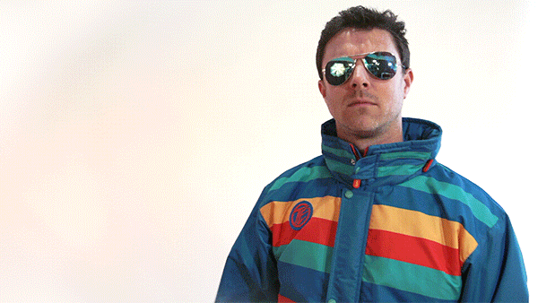
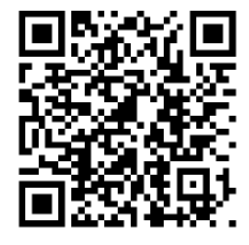
Scan with your Suitable App!
Notes:
lauren/mike

Slide 2
Notes:
lauren/mike

Slide 3
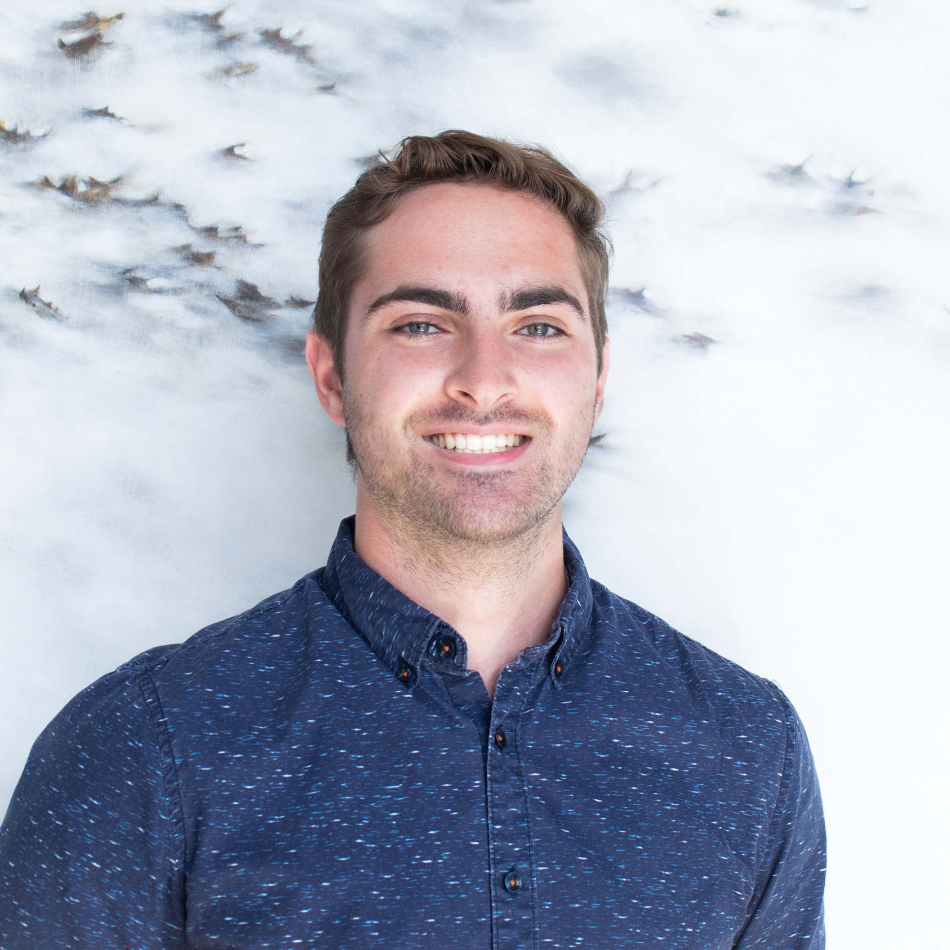
President & Vice President
Michael Breen
Senior
Marketing Major & Economics Minor
Lauren McGrath
Senior
Marketing Major & Sociology Minor
Notes:
Lauren and Mike introductions. Then introduce Elena and Juliette who will go through presentation.

Slide 4
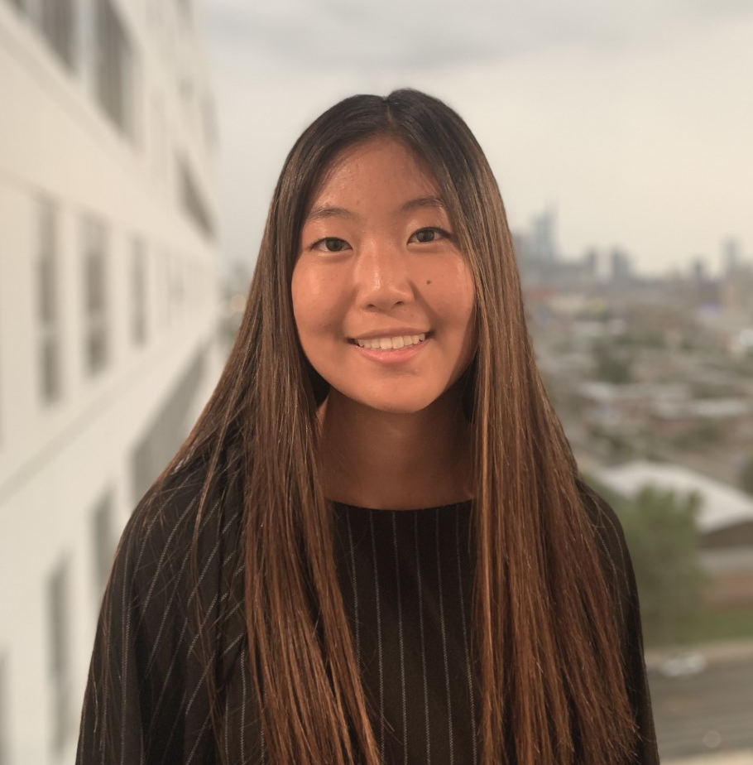
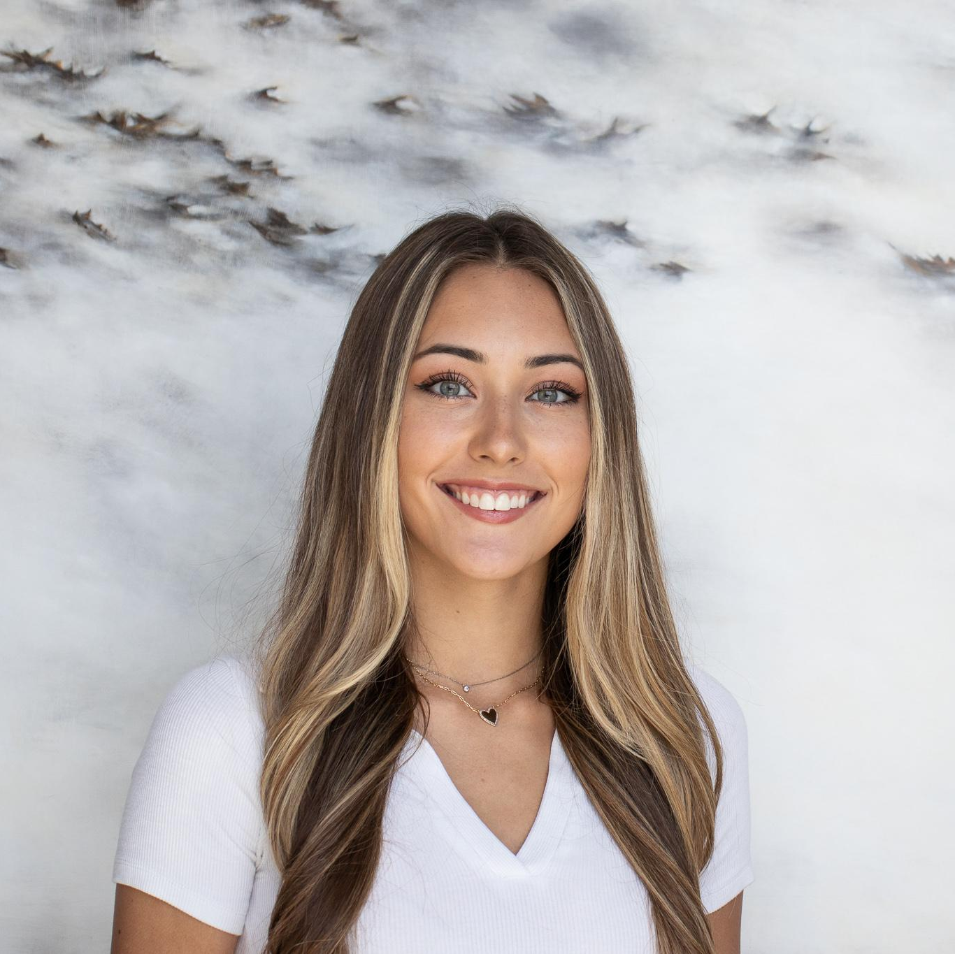
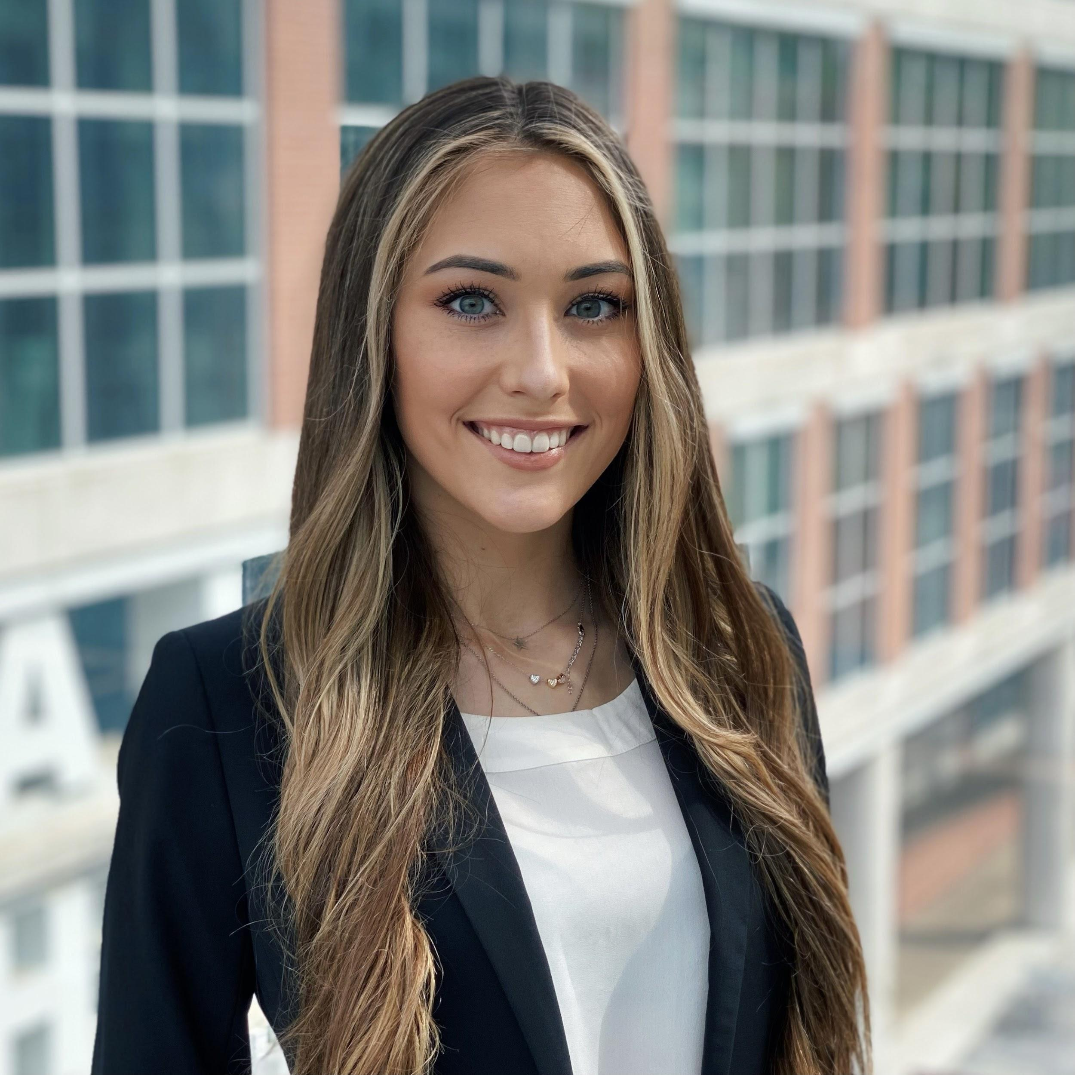
Membership
Insert headshot
Elena Rossetti
Junior
Marketing Major
Juliette Plummer
Senior
Marketing Major & MIS Minor
Notes:
Membership

Slide 5
Our Mission & Goal
TU-AMA aims to transform students’ lives.
We offer our members opportunities to become experienced marketers and proven leaders by advancing their business knowledge, enhancing their skill sets, and expanding their personal networks.
Notes:
Juliette
First we will start by going over our mission and goals: TU-AMA aims to transform students’ lives. We offer our members opportunities to become experienced marketers and proven leaders by advancing their business knowledge, enhancing their skill sets, and expanding their personal networks.

Slide 6
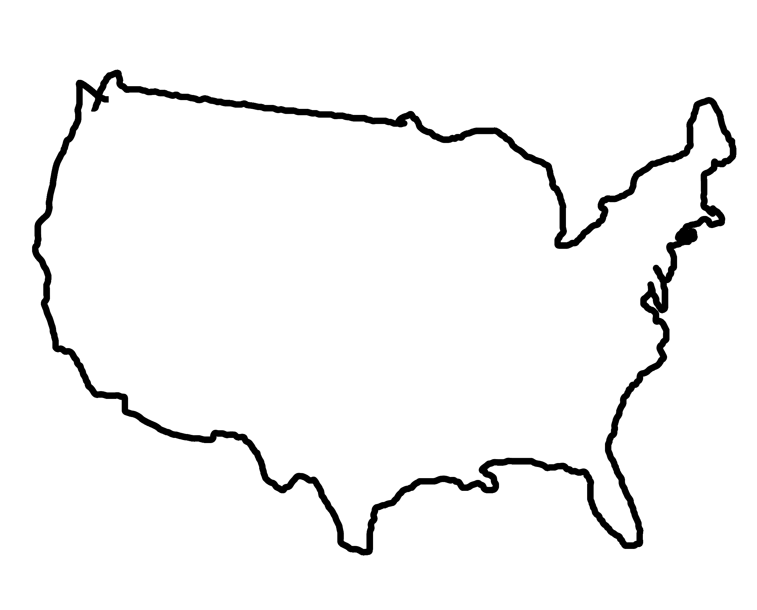
1 of 340+
collegiate chapters
Notes:
Juliette
As AMA is a national organization, Temple’s chapter is just one out of over 340 chapters internationally. Each year, we attend AMA’s International Conference where we are ranked and compete against the other chapters.

Slide 7
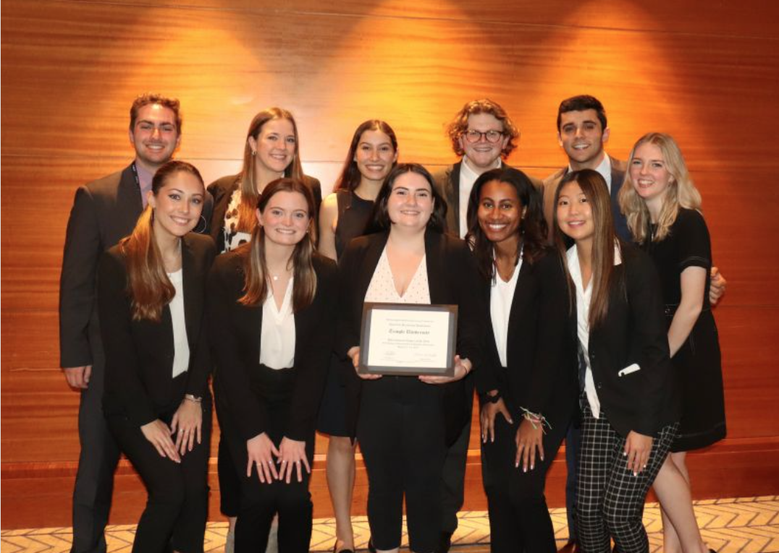
AMA National
Awards
International Chapter of the Year - 2022 AMAICC
1st Place - Amazon Prime Student International Collegiate
Case Competition
1st Place - Collegiate Chapter Website
1st Place - Chapter T-Shirt Design Competition
Notes:
Elena
Every year the American Marketing Association hold an Intercollegiate Conference where all the chapters come together to compete in various competitions, hear industry professionals, and network with members with other schools. This past year the conference was held in Chicago where our chapter took home Top International Chapter of the Year, 1st place in the Case Competition which was sponsored by Amazon Prime, and we have also won 1st place for our Chapter Website design and the t-shirt competition that also takes place at ICC

Slide 8
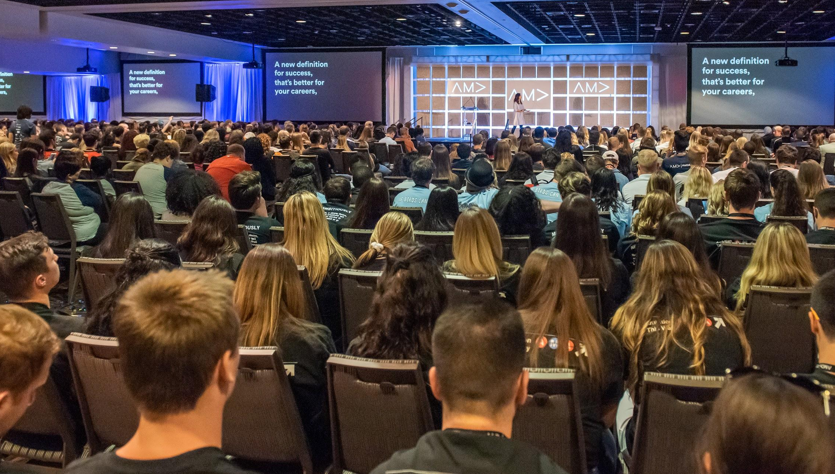
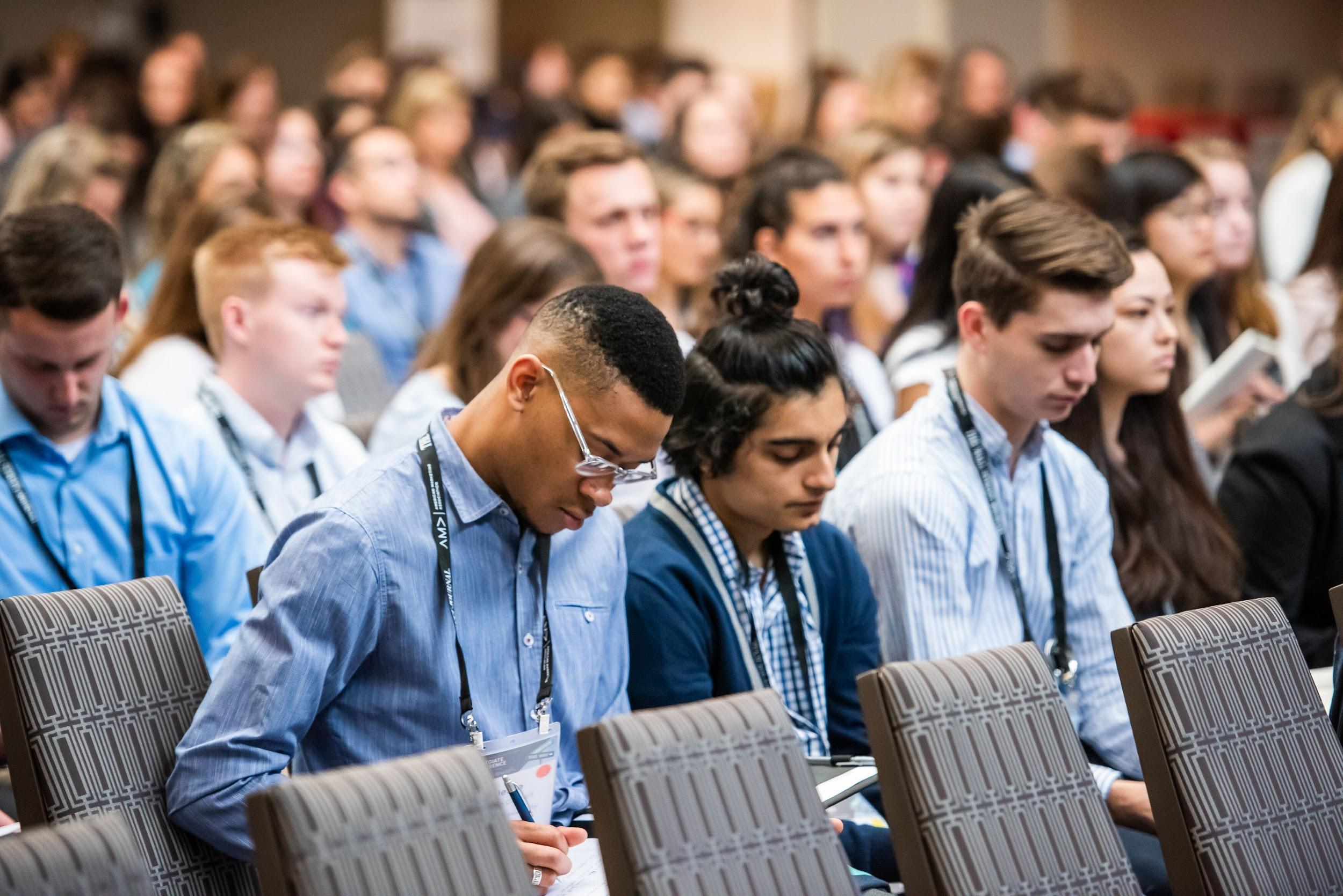
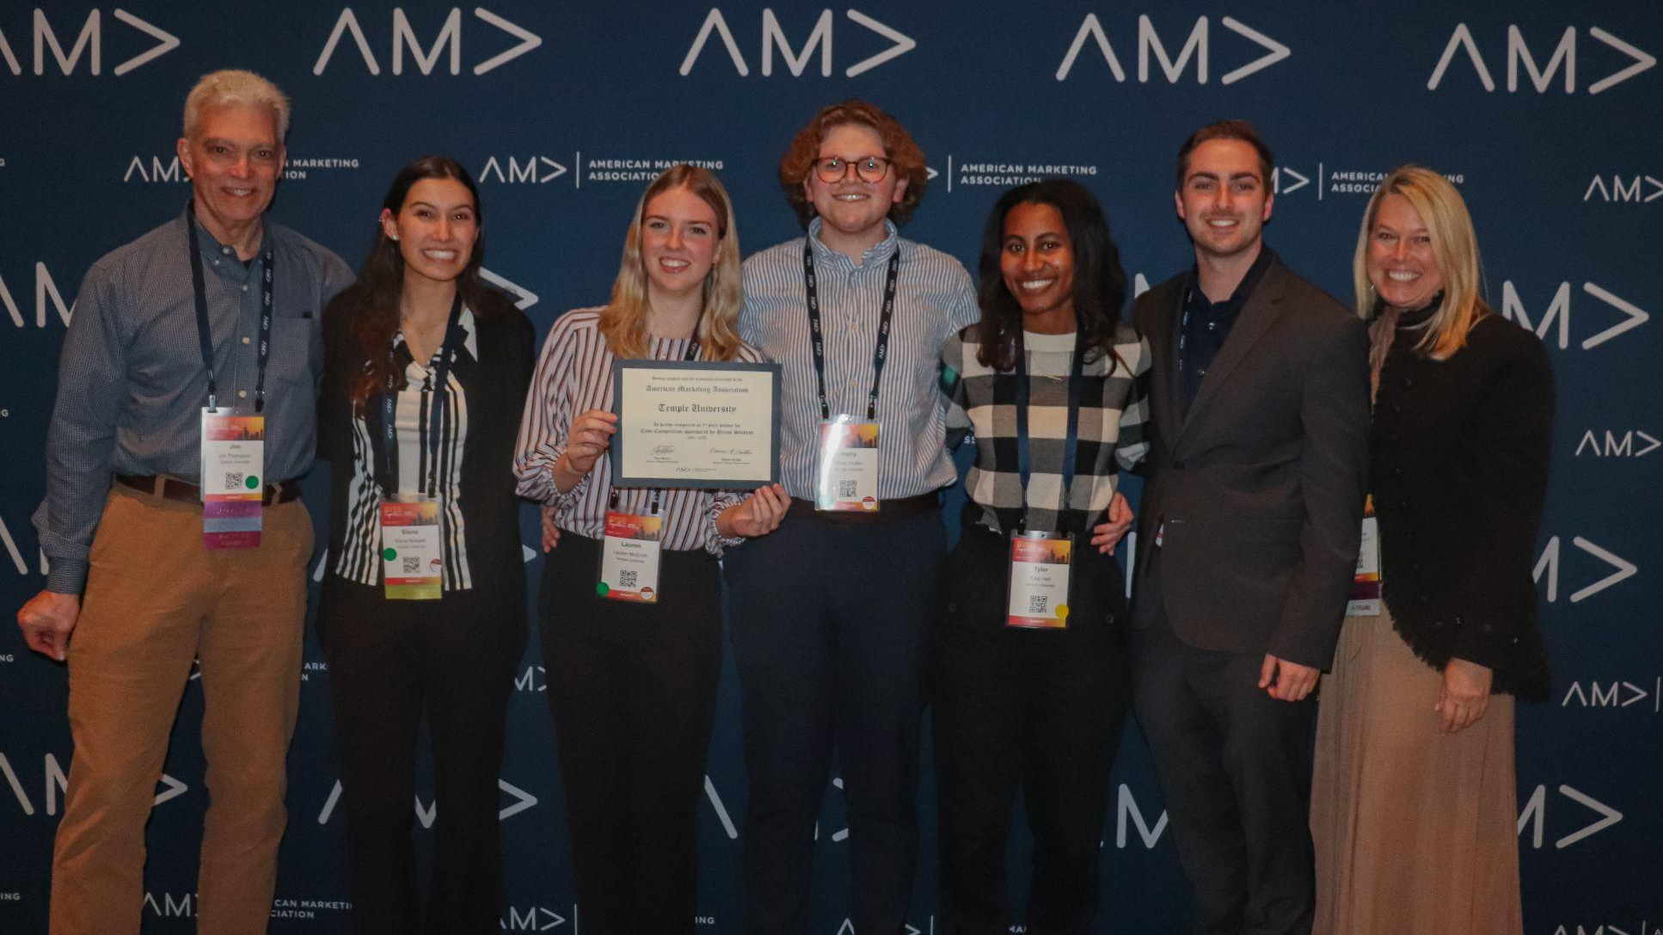
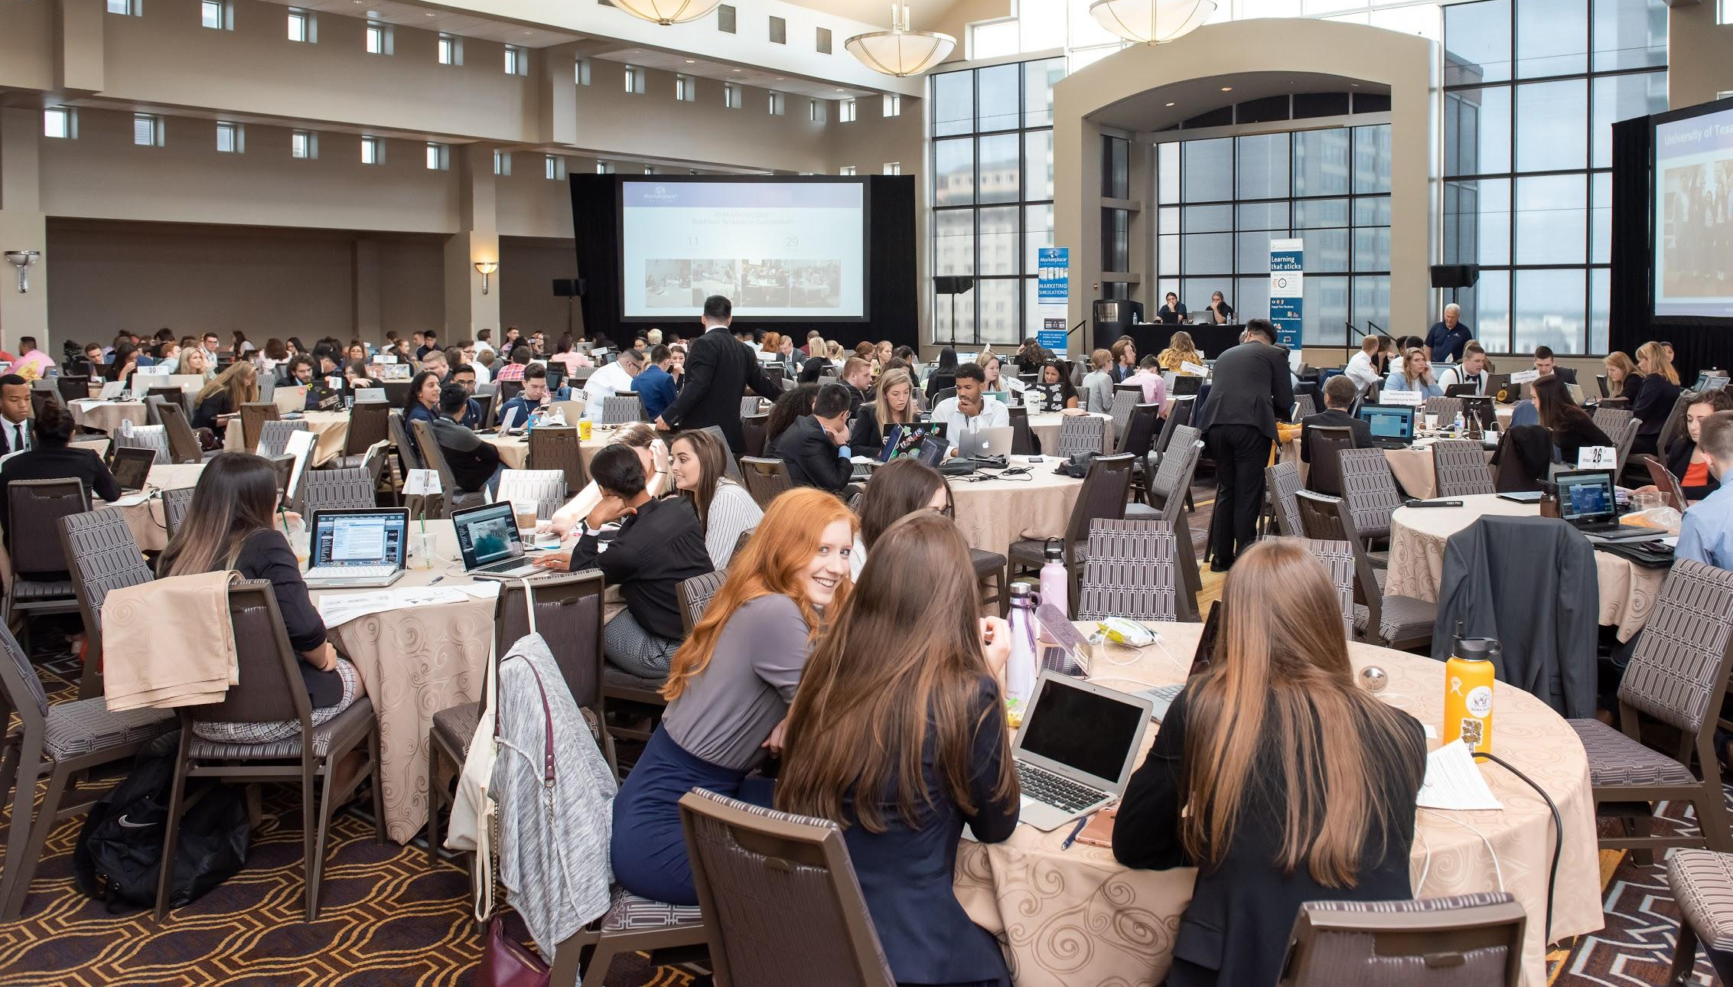
Notes:
elena
This year, the AMA International Collegiate Conference Competitions (ICC) will be in New Orleans, and since we were one of the Top International Chapters last year that means we actually get to host this year. Our chapter will be playing a big role in leading the conference and also representing Temple as a top chapter. (Photos of what to expect). It’s a lot of fun you get to travel with your other members and get great resume skills- I’ll touch more upon bringing general body members in the Citizenship points but attendance does play a role on your ability to attend.

Slide 9
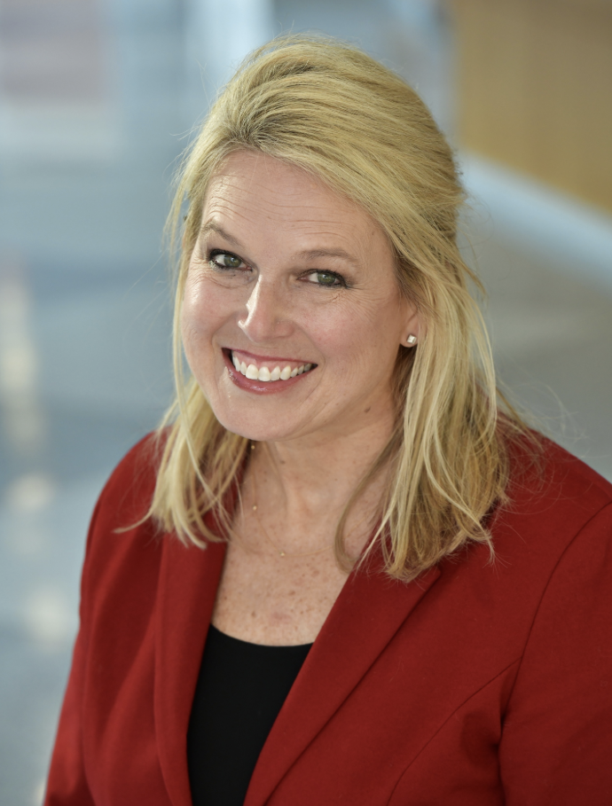
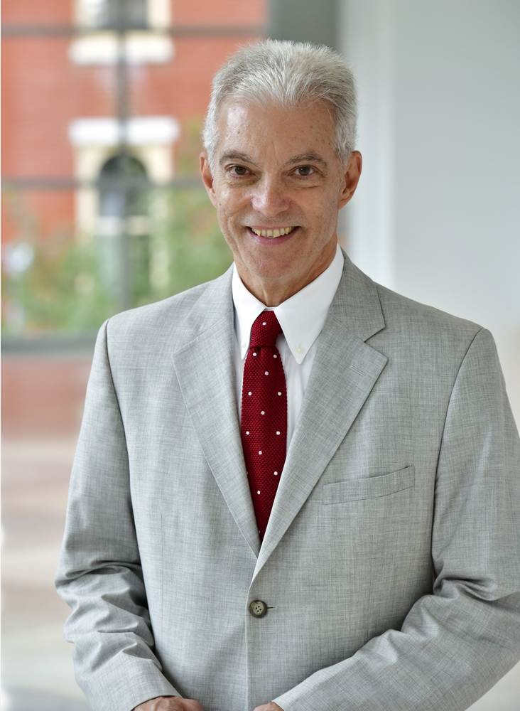
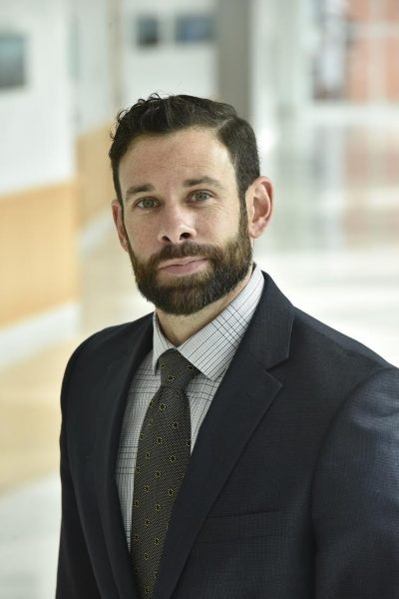
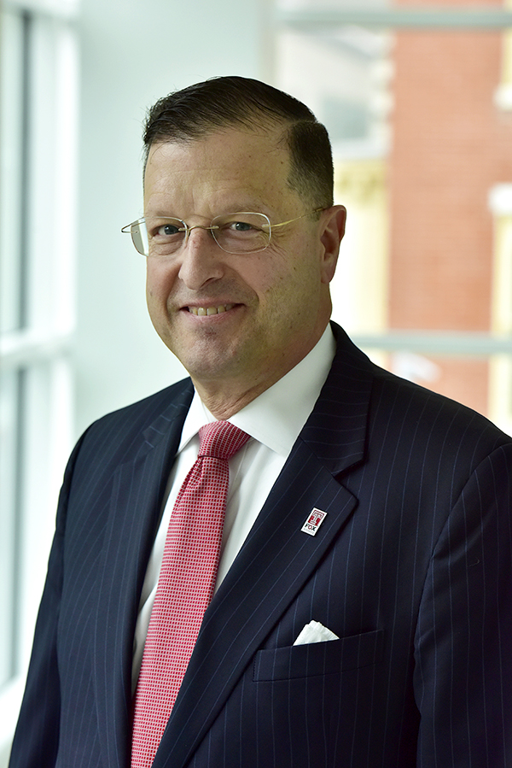
TU-AMA Advisors
Sheri Lambert
Assistant Professor of Marketing
Director of the MS-Market Research & Insights Program
Jim Thompson
Assistant Professor of Marketing
Drew Allmond
Assistant Professor of Marketing
Michael Hughes
Assistant Professor of Marketing
Notes:
Juliette

Slide 10
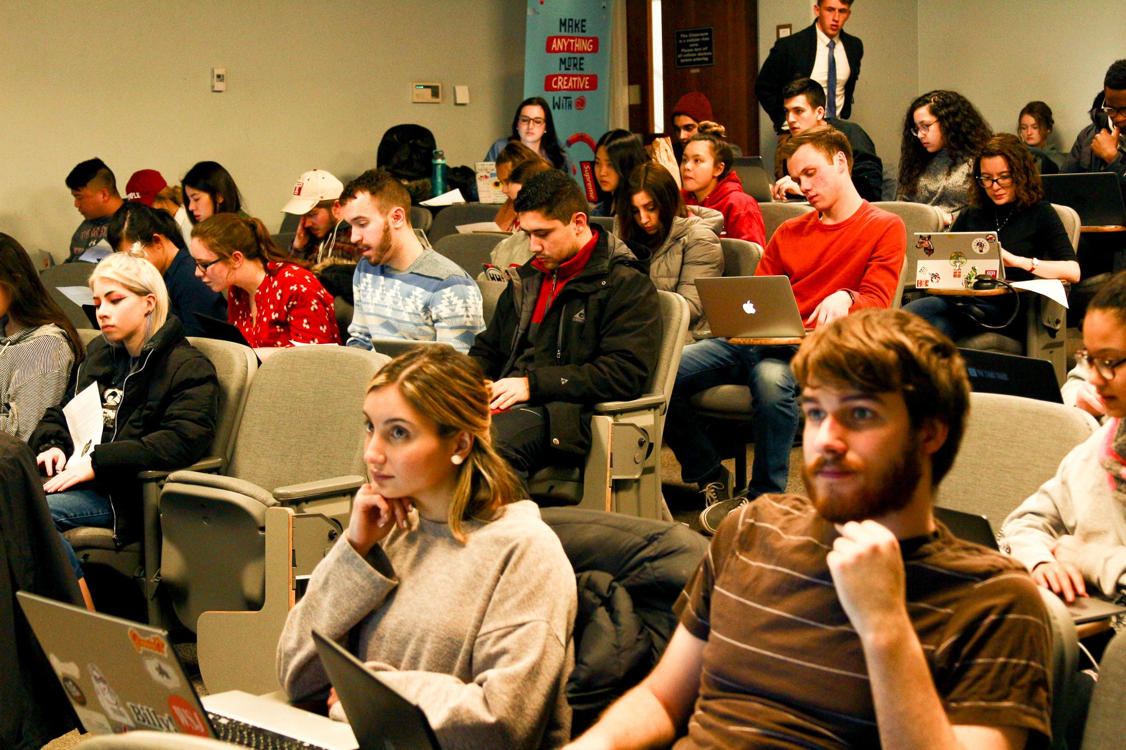
Monday: Workshops
Monday, 12:00 - 12:50 PM
Hear from TU-AMA directors or sponsors
Learn different skills
Networking with professionals
Personal selling
Best interview practices
Adobe
Notes:
Going into our schedule, we meet 3 times a week, Monday, Wednesday, Friday during the school’s business hour from 12:00 to 12:50 pm. Our Monday Workshops are devoted to learning skills used in marketing that are lead by directors or sponsors. This is a great way to learn some skills that will look good on a resume and that you can use in your professional career. We cover topics such as networking, sales, Adobe, and interview prep

Slide 11
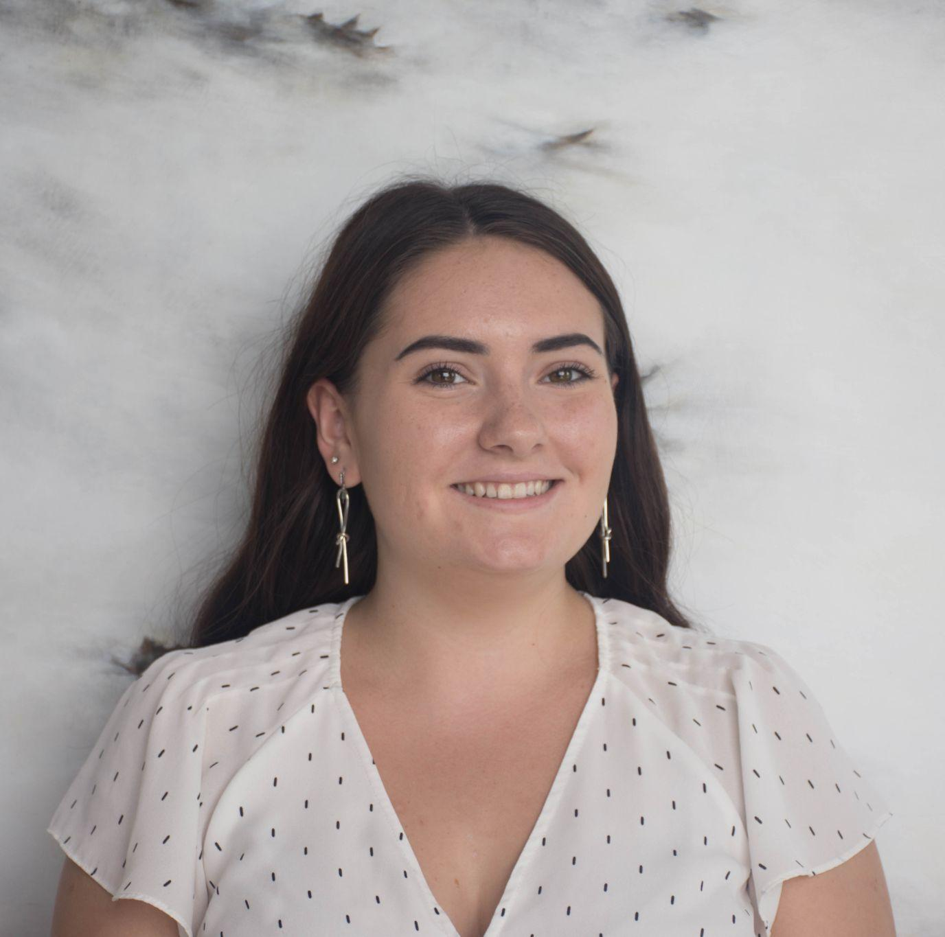
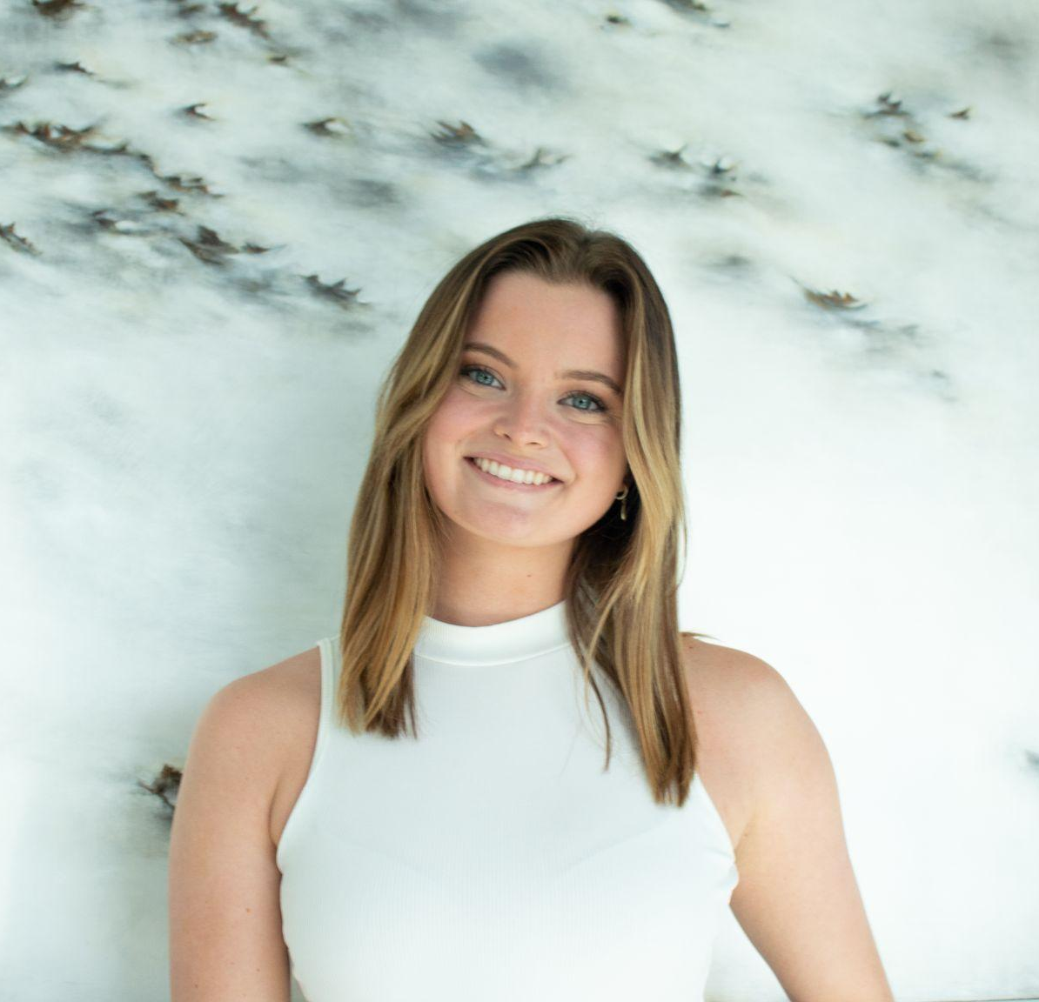
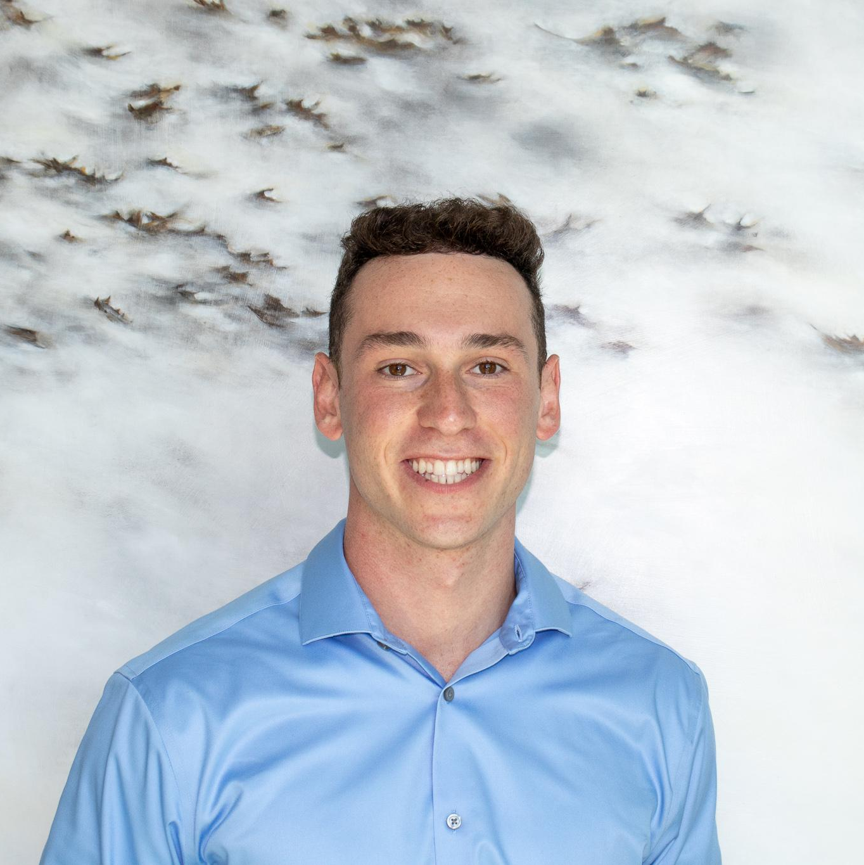
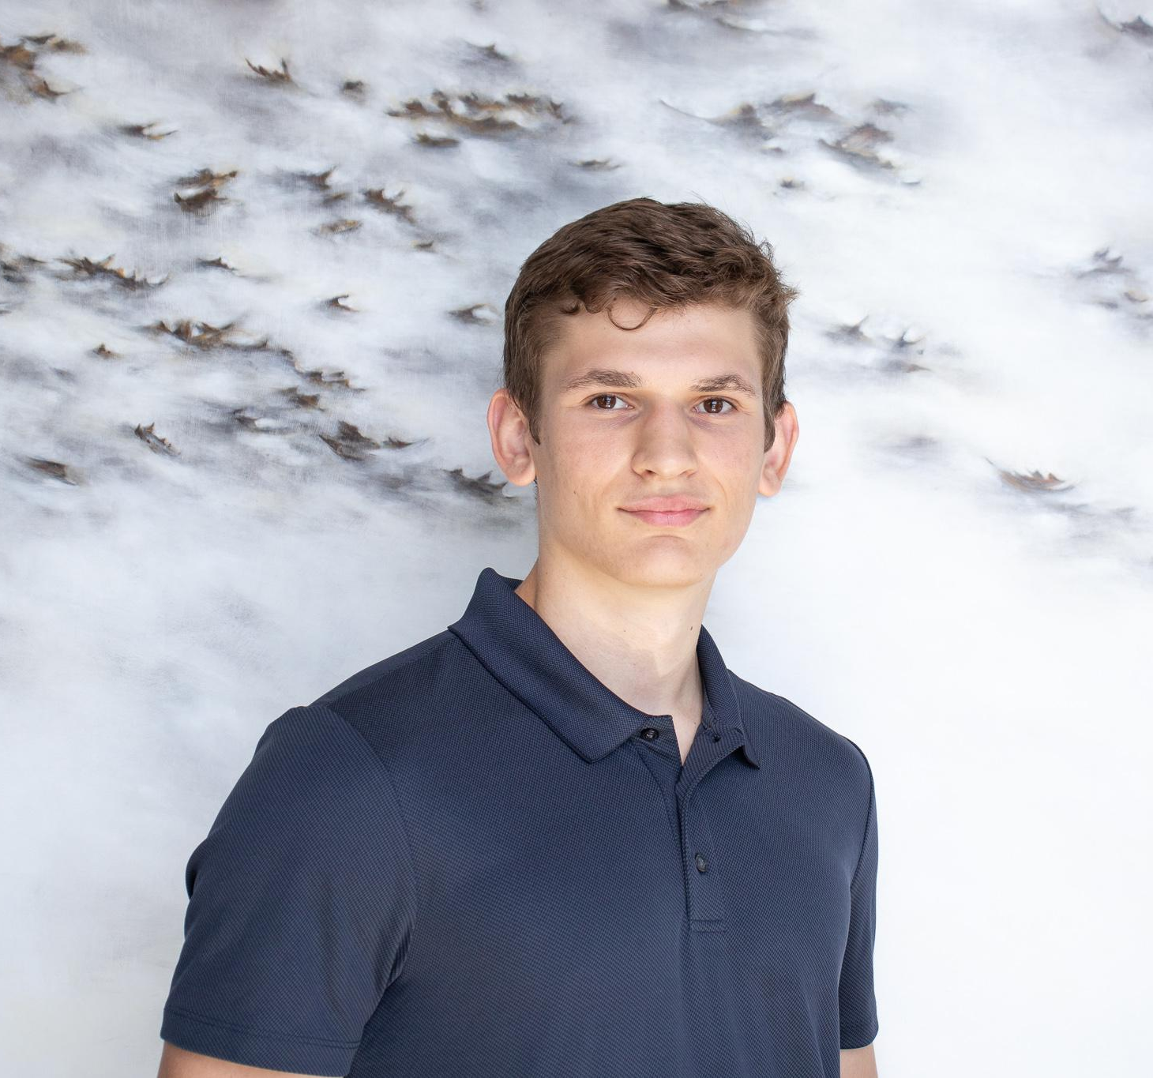
Professional Development
Insert headshot
Maeve Coogan
Senior
Marketing Major & MIS Minor
Devon Robinson
Junior
MIS Major & Biz Analytics Minor
Adam Foster-Baird
Sophomore
MIS & Real Estate Minor
Notes:
PD

Slide 12
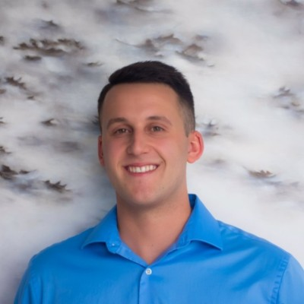
Social Impact
Insert headshot
Mallory Secher
Senior
Advertising Major & Business Minor
Helen Chmiel
Senior
Marketing Major
Notes:
SI

Slide 13
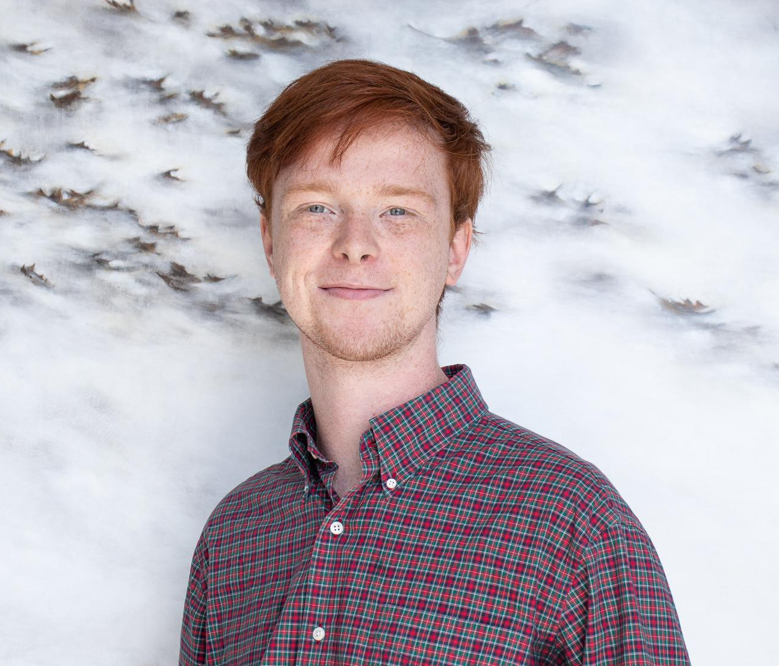
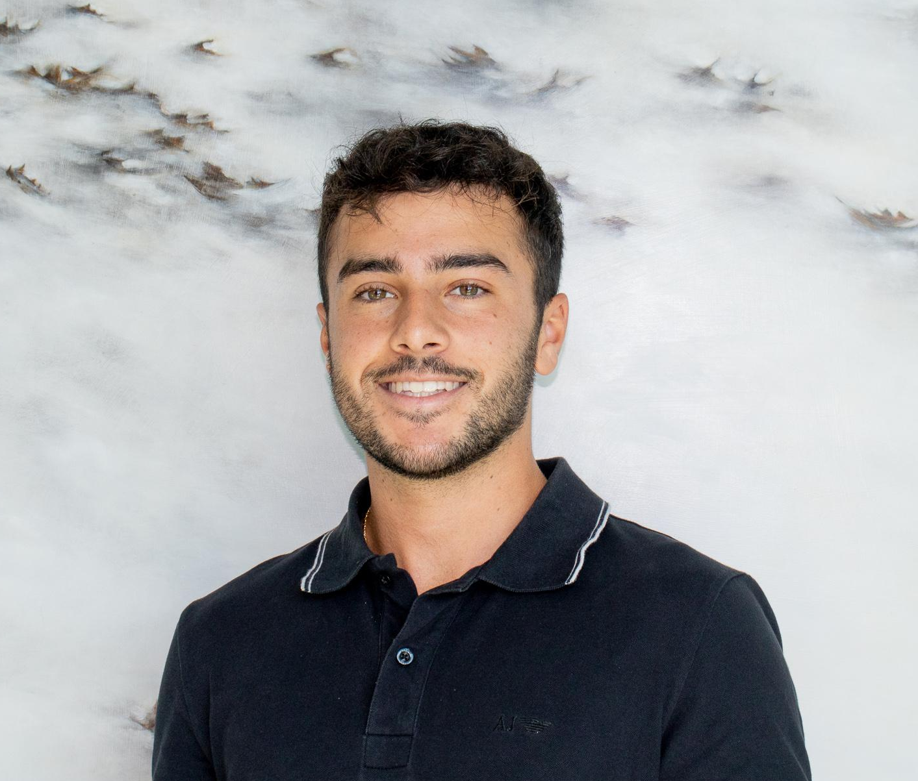
Sponsorship
Keon Morley
Senior
Comm Studies & Political Science Major
Nicholas Pugliese
Senior
Marketing Major
Notes:
Sponsorship

Slide 14
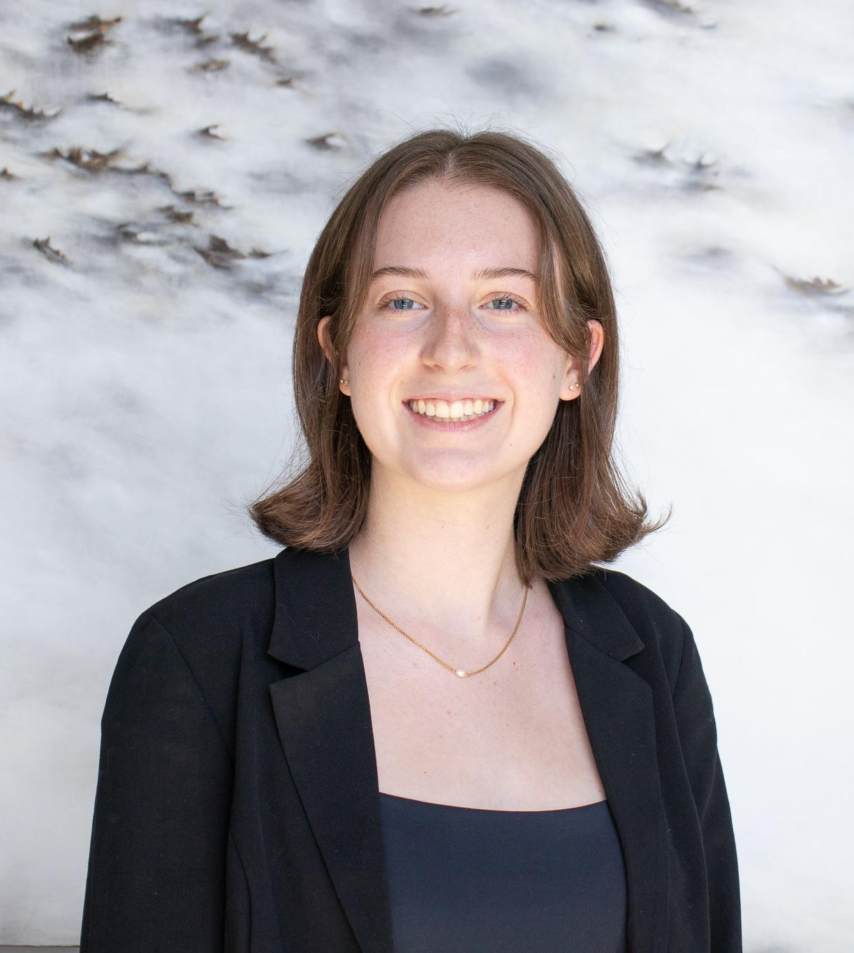
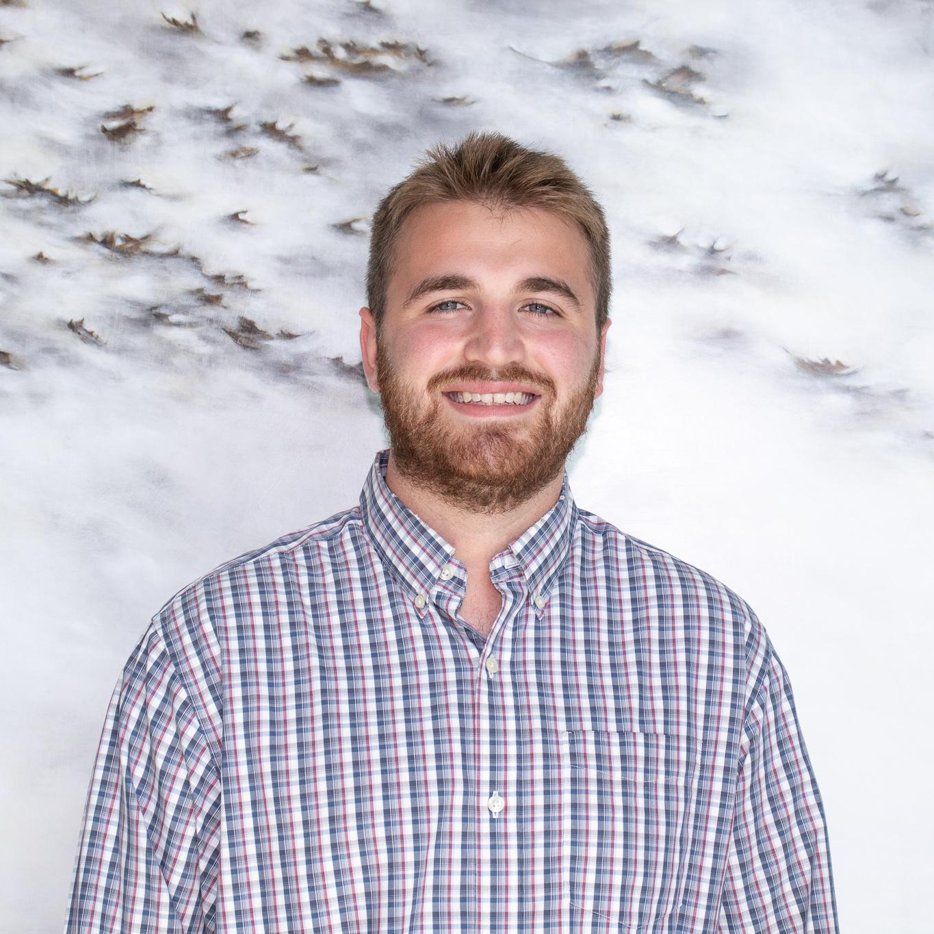
Chapter Communications
Avery Bumsted
Sophomore (External)
Advertising Major
Jane Kobylinski
Junior (External)
Marketing & MIS Major
Aden Kaye
Senior (Internal)
Marketing Major
Communications & Activsim Minor
Notes:
Chapter Comms

Slide 15
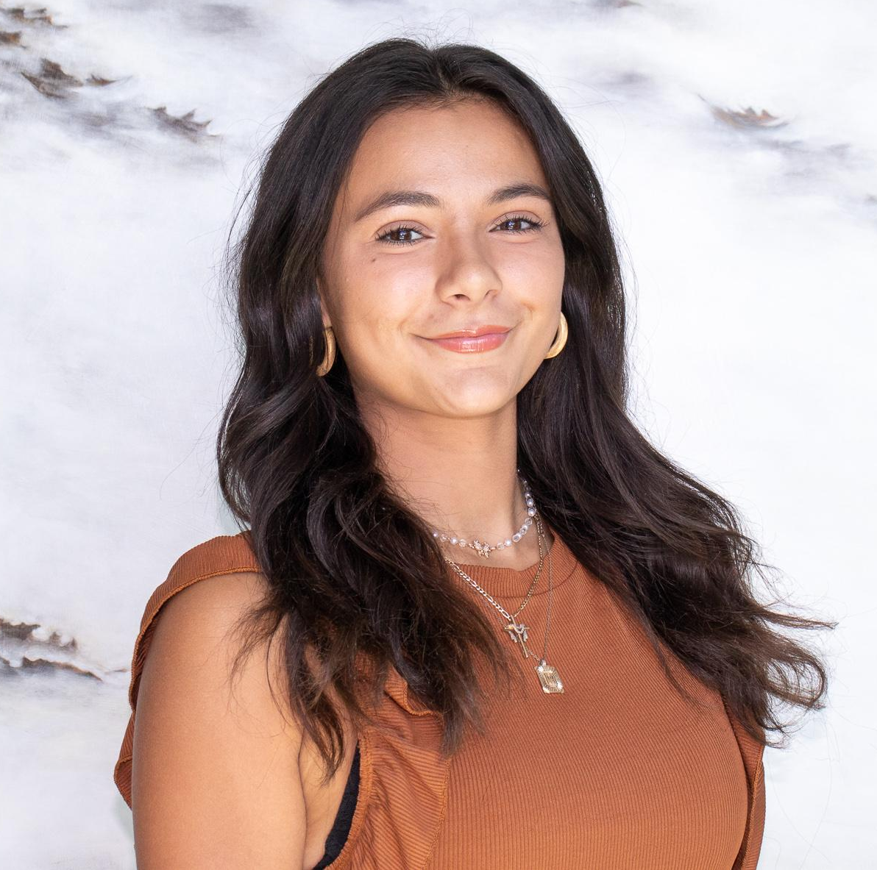
Media Relations
Madeline Collyer
Sophomore
Marketing Major, MIS minor
Maria Mihalopoulos
Junior
Marketing & Legal Studies Major
Notes:
MR

Slide 16
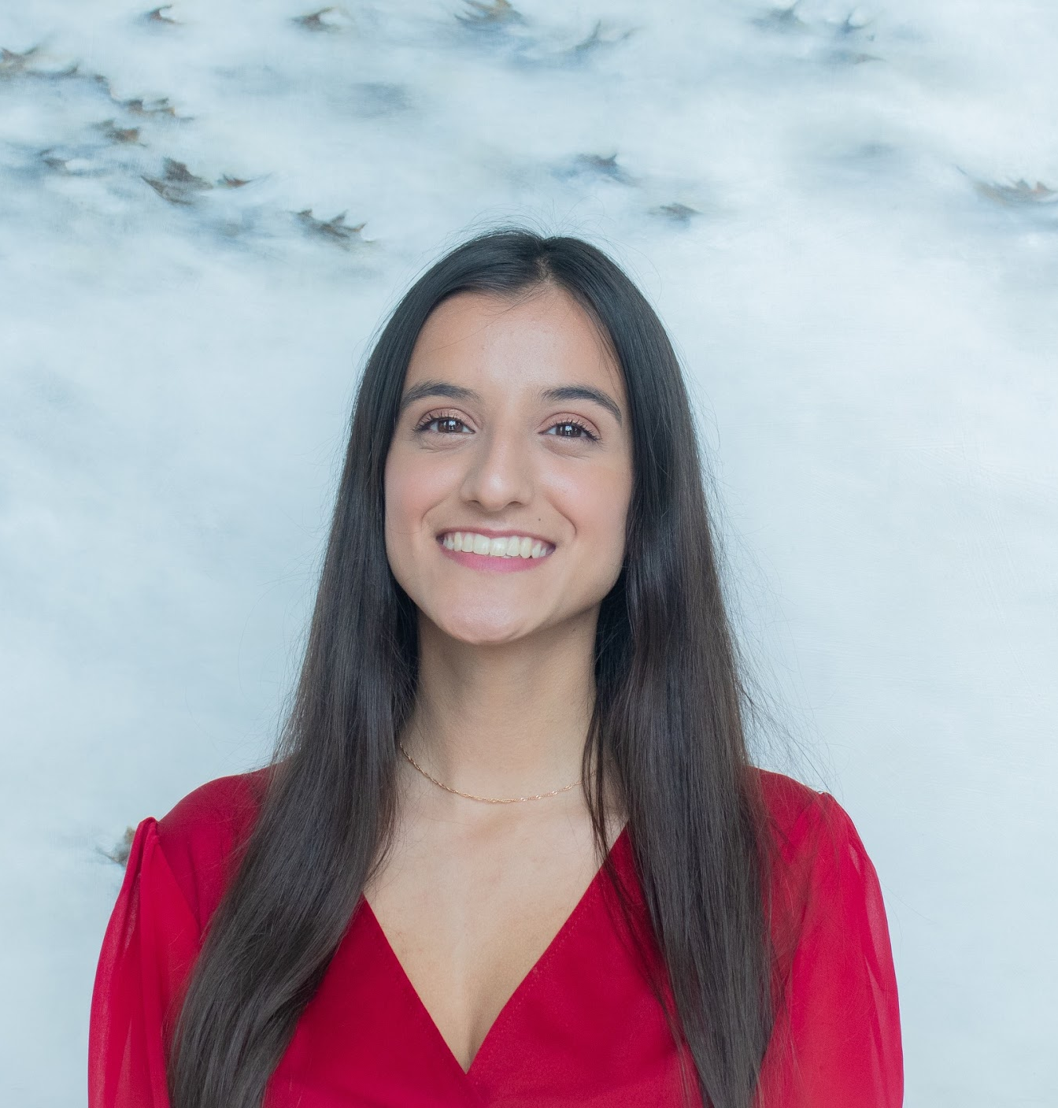
Chapter Operations
Anjali Popli
Junior
Marketing Major, MIS Minor
Notes:
Chapter Ops

Slide 17
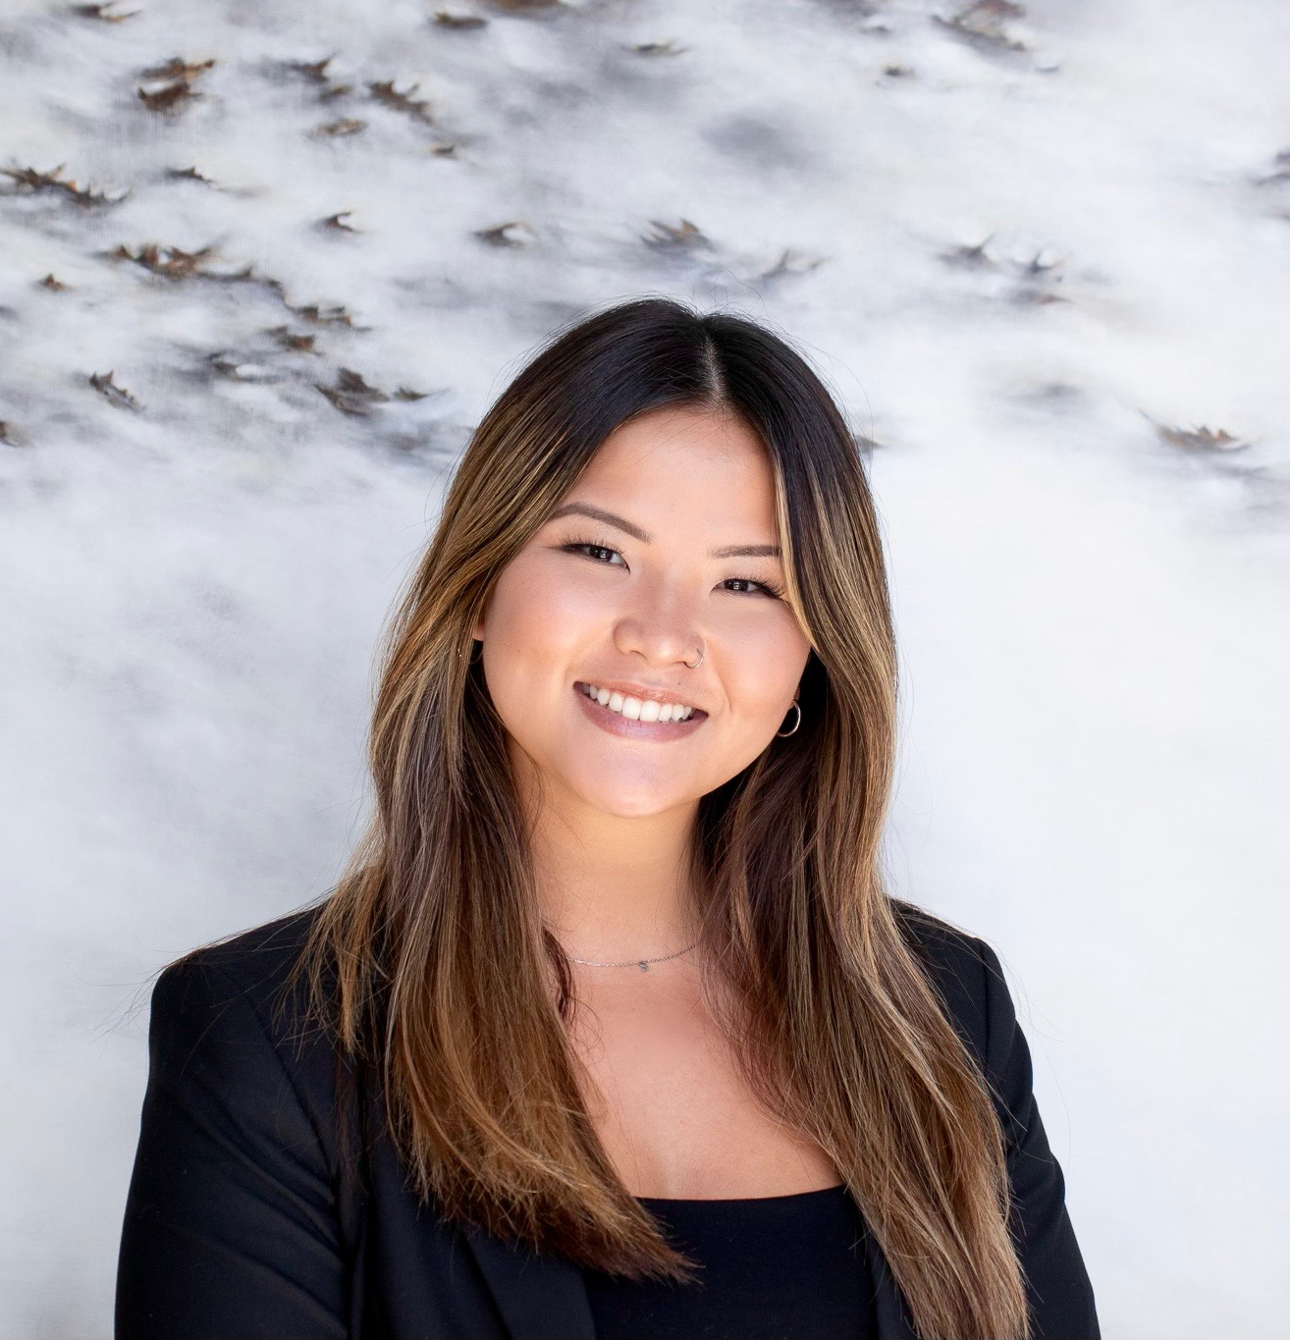
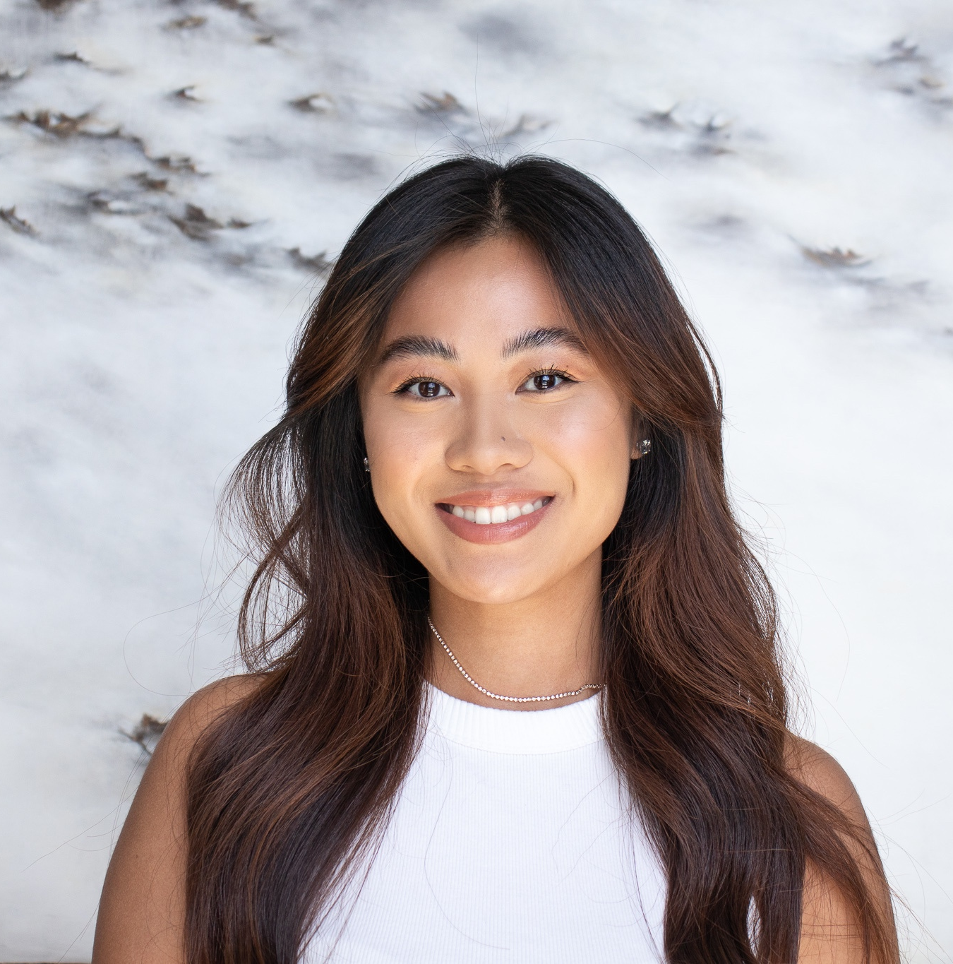
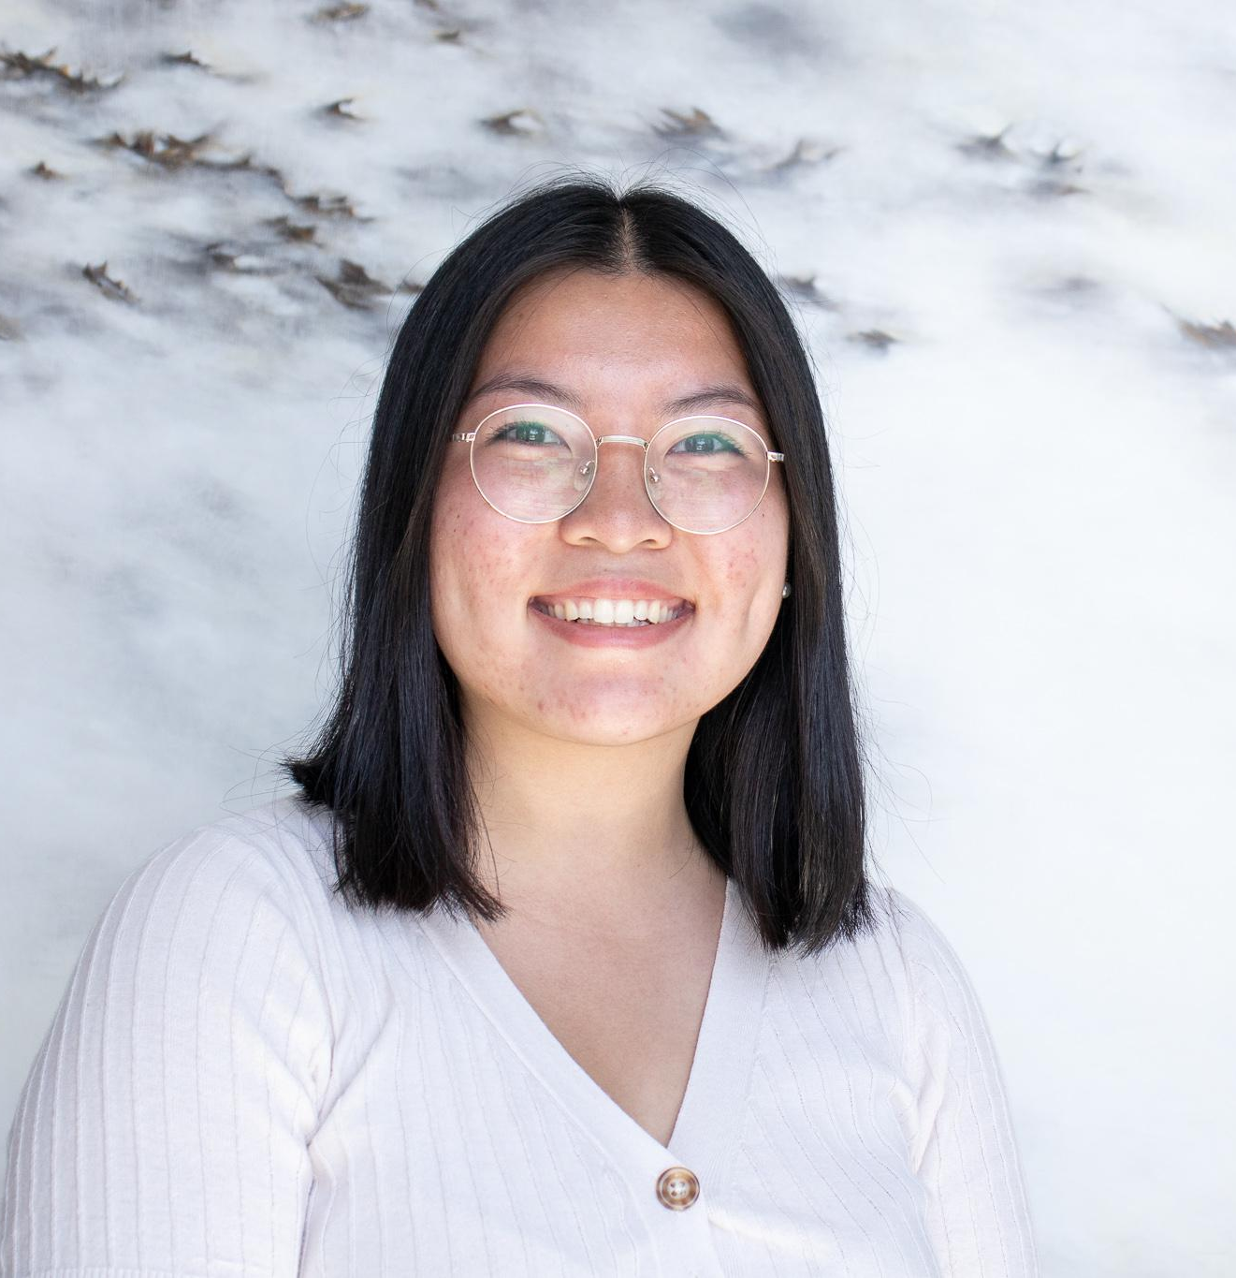
Cherry Consulting
Skylar Sheely
Junior
Marketing Major & MIS Minor
Marianne Kornelius
Senior
Marketing Major
Cathy Nguyen
Senior
Marketing Major
Notes:
Cherry
Skylar, Marianne, Cathy Intros.

Slide 18
Wednesday: Cherry Consulting
Benefits:
Gain real-life marketing skills that can apply to future classes, internships, and careers
Opportunities to use marketing tools and services for Brand Development, Social Media Marketing, Content Creation, SEO, CRM, Website Development, etc.
Notes:
Cherry

Slide 19
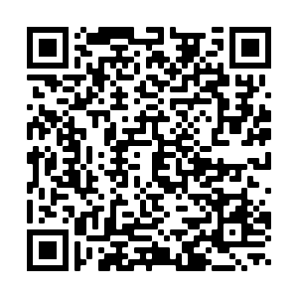
Wednesday: Cherry Consulting
Intent to Interview:
Apply at bit.ly/CherryInterview2022
The deadline for submissions is Thursday, September 8th at 11:59 PM
*Reach out to marianne.kornelius@temple.edu, skylar.sheely@temple.edu or cathy.nguyen@temple.edu with any questions!
Notes:
Cherry
The Search for Project Leaders “ We are looking for Project leaders to take on our clients for this semester (Even if you have little to no experience, or experience through other clubs or internships, we are open to for interviews)The QR code is up there for you to scan as well as the link, Deadline to submit on the 09/08 Thursday.
Something that we’re offering is Cherry 101, which is for Project Leaders to get an understanding on how to lead this semester.
Cathy:
Closing: If you have any questions or concerns, please stay back after this meeting and we can talk further!

Slide 20
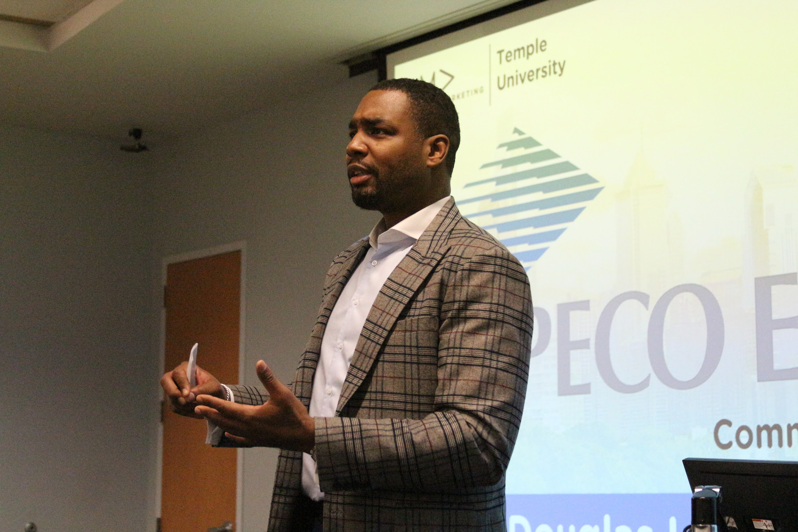
Friday: Speaker Sessions
Industry professionals speak about their experience in the business world
Business casual - be a great representation of this organization!
Both virtual & in-person
Some, but not ALL sessions will be recorded
Notes:
PD

Slide 21
Notes:
PD

Slide 22
Notes:
PD

Slide 23
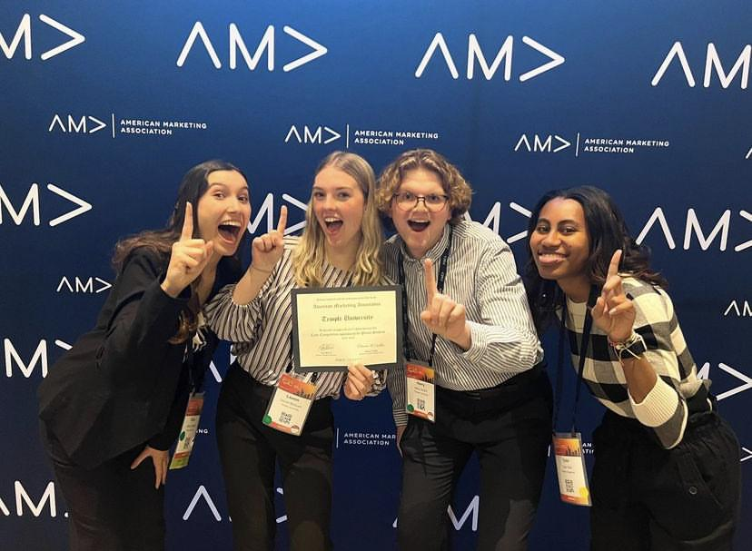
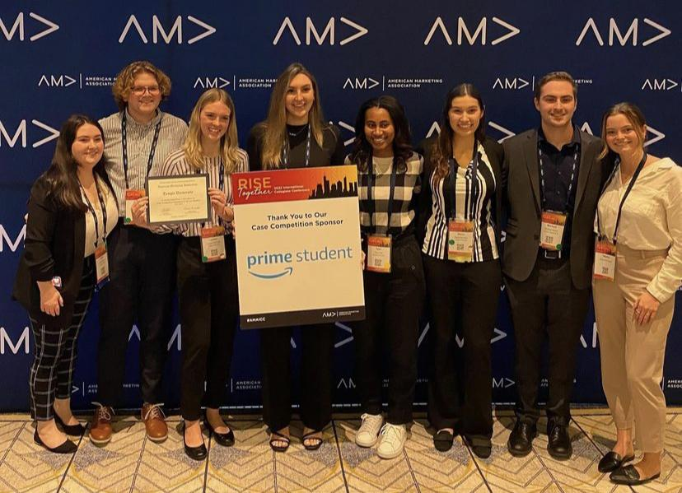
TU-AMA International Case Competition Team
Notes:
keon

Slide 24
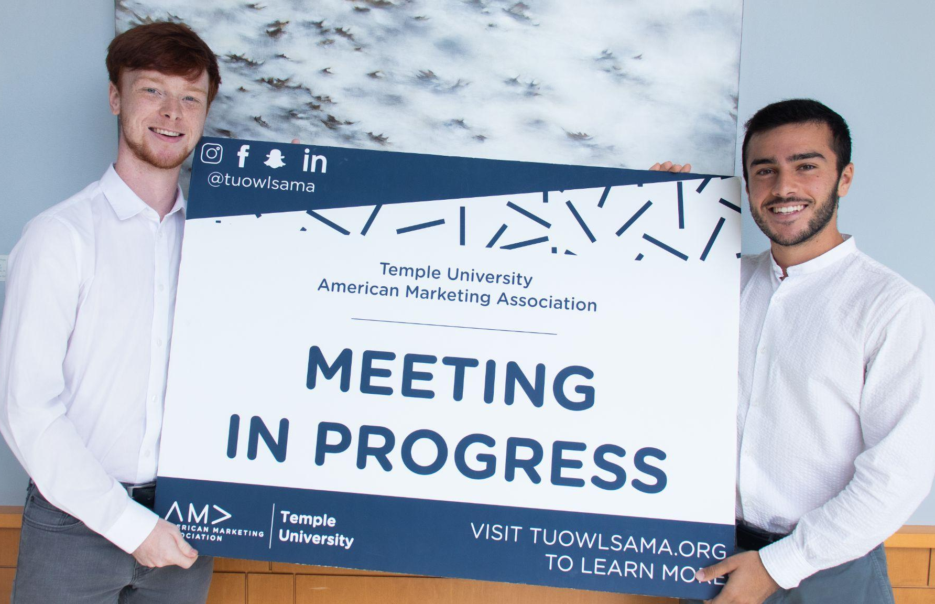
Scholarship Opportunity
Ability to receive up to $1000
Provides current TU-AMA members tuition support, who demonstrate a dedication to the marketing industry within our chapter, the classroom, and the community
Application-Based
Gold Membership
Good Academic Standing
Notes:
keon

Slide 25
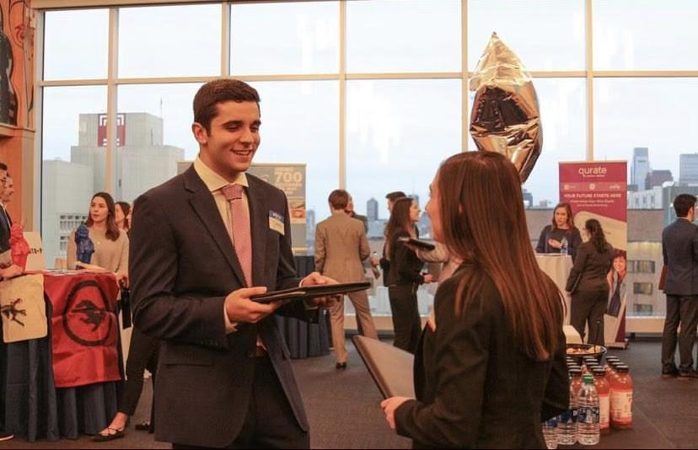
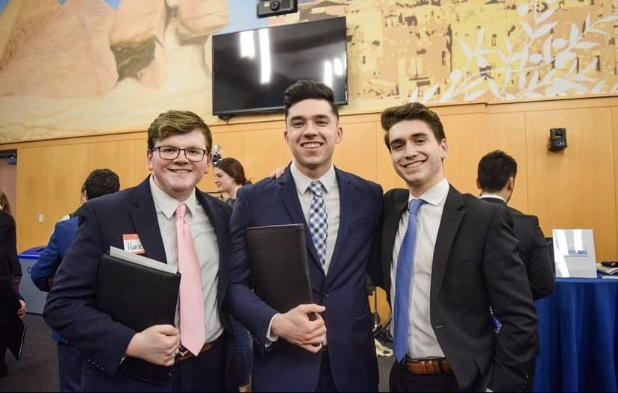
Career and Internship Reception
Looking for a summer internship or a job?
Biggest networking event of the year!!!
Opportunity to introduce yourself to companies
1 on 1 face time with our sponsors
Spring 2023
Notes:
nick

Slide 26
How to Join TU-AMA
*Must be completed in order*
1
Fill out TU-AMA Application
Visit tuowlsama.org/join and complete the electronic chapter application
2
Become a National Member
Go to ama.org, click the menu on the right, and click “Join AMA”
Purchase your National AMA “Undergrad Student Membership” and pay $29
3
Get Approval
Forward the confirmation email or send a screenshot to elenarossetti@temple.edu
4
Pay Dues
Venmo (@tuowlsama) / Credit/Debit to PayPal (owlsama@gmail.com)
Check to “Temple University American Marketing Association”
Notes:
Elena
If you’re interested in TU-AMA you can go to our website listed here, go to Membership and from the pop down menu select Join AMA. From that screen these same directions are listed but you want to click the box at the top that says apply to TU-AMA, once you fill that out you will have to become a national member of the organization ($29), and then please forward that email to me (email is listed). Once that is confirmed then all you need to do is pay the Chapter dues and you will be a full member. We accept Venmo, PayPal or Check if needed.

Slide 27
Chapter Dues:
Semester – $30
Year – $55
Office: Alter 502c
Deadline:
Friday, September 30th
Please consider adding an additional $5 to your dues to donate to our Charity of Choice (Grace Cafe)!
Notes:
Elena
As far as the dues go, they are $30 for the Semester or $55 if you pay for the full year and the deadline for these is Friday September 30th so please try to have them in by then. Another great initiative and way to help with our social impact is to add $5 to your dues that will be donated to our Charity of choice for this year which is Grace Cafe. For those who don’t know what Grace Cafe is they provide meals to people in the area who suffer from food insecurity or homelessness, and they also offer weekly wellness clinic so we’re very exciting to work with them this year and while the donation is not mandatory if you would like to add the additional $5 onto your dues it will be going towards them so a really great cause.

Slide 28
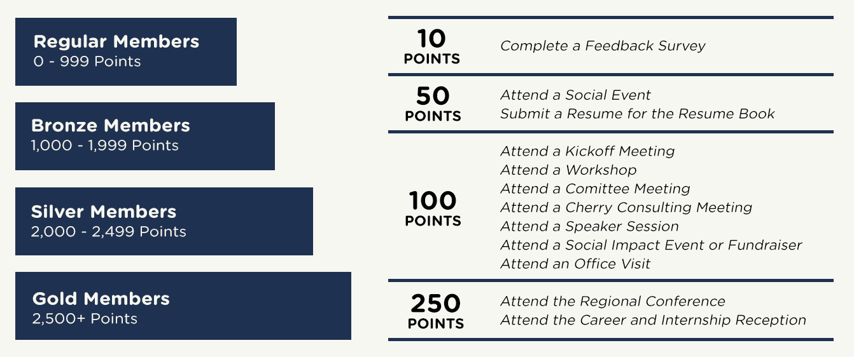
Citizenship Point Program
Notes:
elena
Like I mentioned earlier we do monitor attendance at social events, meetings, and just other participation in general. Citizenship Points are different from your FLDP points for Fox, this is AMA specific and something that is part of my role as membership admin. When u came in today you should’ve scanned a QR code and filled out a Google form, if you didn’t see me after the meeting, this tells me that you were present so I can give you citizenship points. As you can see all members fall into 4 categories and as you get more points there are more opportunities for you. For example Eboard is gold members, and ICC will likely be open to gold members who are more involved and have more citizenship points

Slide 29
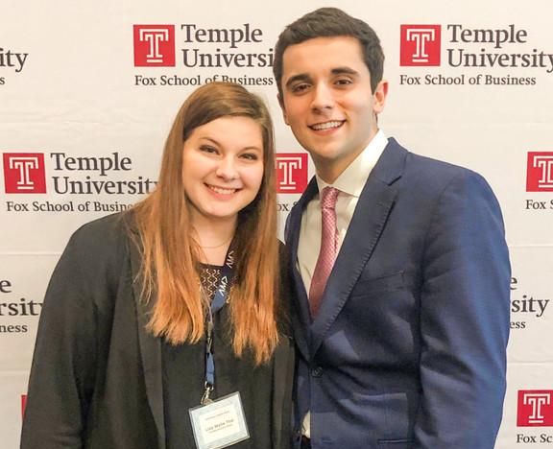
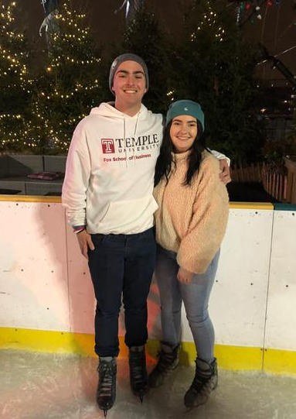
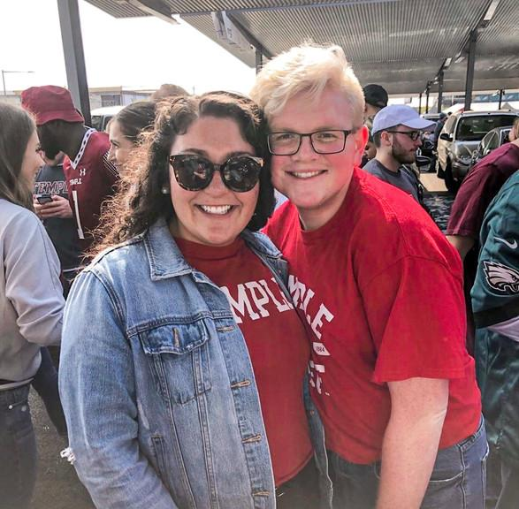
Mentorship Program
General body members are paired with an executive board director
Opportunity to work on your personal and professional goals
Ability to learn skills such as LinkedIn, Resume Building, Graphic Design, Personal Branding, etc.
Sign ups are on a rolling basis
*Must be a paid member
Notes:
General body members are paired with an executive board member where the opportunity to work on either personal or professional goals.

Slide 30
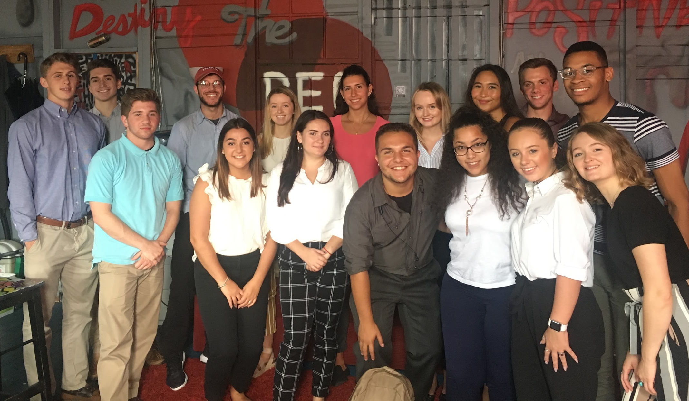
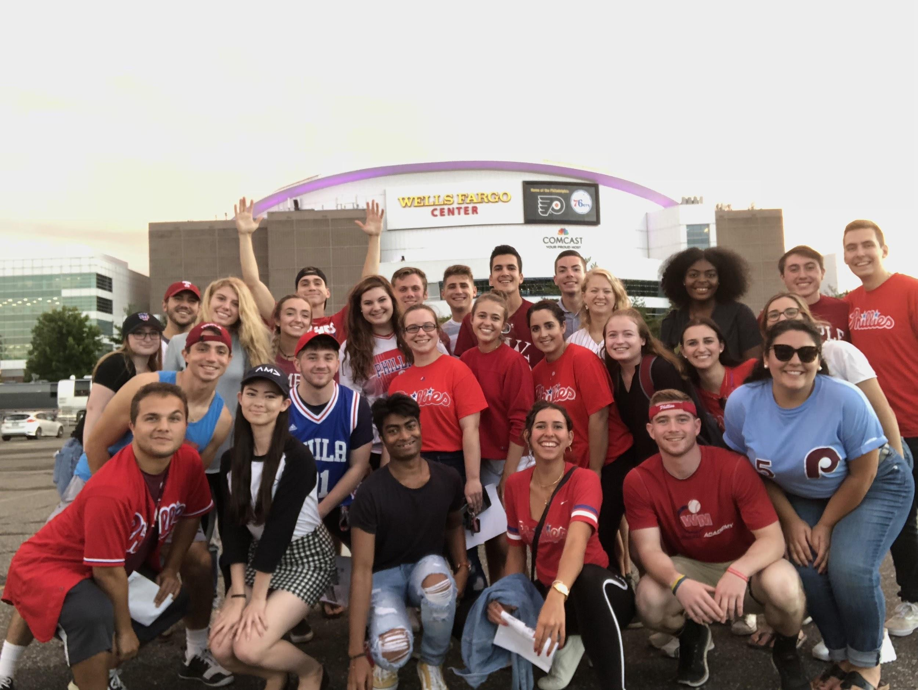
Other Opportunities
Socials
Volunteering Events
Office Tours
Resume Book & Job Listings
Marketing Week
Regional Marketing Conference
Career & Internship Reception
Notes:
Outside of meeting times, we host events where you can meet other people inside and outside of the org. through socials, volunteer events, office tours, and more. Overall, TU-AMA is a great way to grow your network and build connections with your peers and business professionals, learn more about the marketing industry, and gain real-world experience.

Slide 31
What’s Coming Up?
Kick-Off Meeting
Friday, 9/1 from 12 – 12:50 pm (Alter LL35)
Cherry Consulting Kick-Off Meeting
Wednesday, 9/7 from 12 – 12:50 pm (Alter LL35)
Kick-Off Speaker Session Meeting
Friday, 9/9 from 12 – 12:50 pm (Alter LL35)
Notes:
Juliette

Slide 32
Notes:
Juliette

Slide 33
Questions?
Notes:
mike/lauren

Slide 34
tuowlsama.org
@tuowlsama
Notes:
mike/lauren

Slide 35
Thank you so much for coming!
Notes:
mike/lauren

