Slide 1
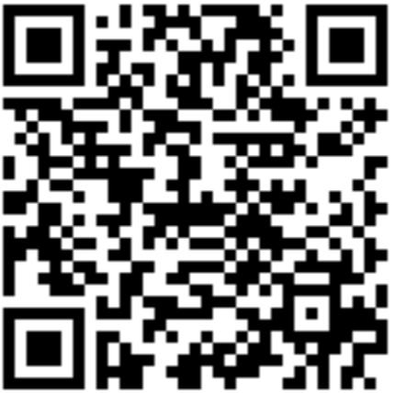
Scan with your Suitable App!

Slide 3
What’s Coming Up?
Cherry Consulting
Wednesday, 9/28 from 12 – 12:50 pm (Alter LL35)
Speaker Session: Boeing
Friday, 9/30 from 12 – 12:50 pm (Alter LL35)

Slide 4
Notes:
PD

Slide 5
Chapter Dues:
Semester – $30
Year – $55
Office: Alter 502c
@tuowlsama
Deadline:
Friday, September 30th
Please consider adding an additional $5 to your dues to donate to our Charity of Choice (Grace Cafe)!
Notes:
Elena
As far as the dues go, they are $30 for the Semester or $55 if you pay for the full year and the deadline for these is Friday September 30th so please try to have them in by then. Another great initiative and way to help with our social impact is to add $5 to your dues that will be donated to our Charity of choice for this year which is Grace Cafe. For those who don’t know what Grace Cafe is they provide meals to people in the area who suffer from food insecurity or homelessness, and they also offer weekly wellness clinic so we’re very exciting to work with them this year and while the donation is not mandatory if you would like to add the additional $5 onto your dues it will be going towards them so a really great cause.

Slide 6
How to Join TU-AMA
*Must be completed in order*
1
Fill out TU-AMA Application
Visit tuowlsama.org/join and complete the electronic chapter application
2
Become a National Member
Go to ama.org, click the menu on the right, and click “Join AMA”
Purchase your National AMA “Undergrad Student Membership” and pay $29
3
Get Approval
Forward the confirmation email or send a screenshot to elenarossetti@temple.edu
4
Pay Dues
Venmo (@tuowlsama) / Credit/Debit to PayPal (owlsama@gmail.com)
Check to “Temple University American Marketing Association”
Notes:
Elena
If you’re interested in TU-AMA you can go to our website listed here, go to Membership and from the pop down menu select Join AMA. From that screen these same directions are listed but you want to click the box at the top that says apply to TU-AMA, once you fill that out you will have to become a national member of the organization ($29), and then please forward that email to me (email is listed). Once that is confirmed then all you need to do is pay the Chapter dues and you will be a full member. We accept Venmo, PayPal or Check if needed.

Slide 7
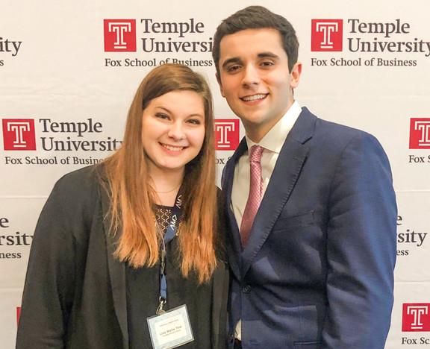
Mentorship Program
General body members are paired with an executive board director
Opportunity to work on your personal and professional goals
Ability to learn skills such as LinkedIn, Resume Building, Graphic Design, Personal Branding, etc.
Sign ups are on a rolling basis
*Must be a paid member
Notes:
Juliette
We also have a mentorship program which elena and I run together. General body members are paired with an executive board member where the opportunity to work on either personal or professional goals.

Slide 8
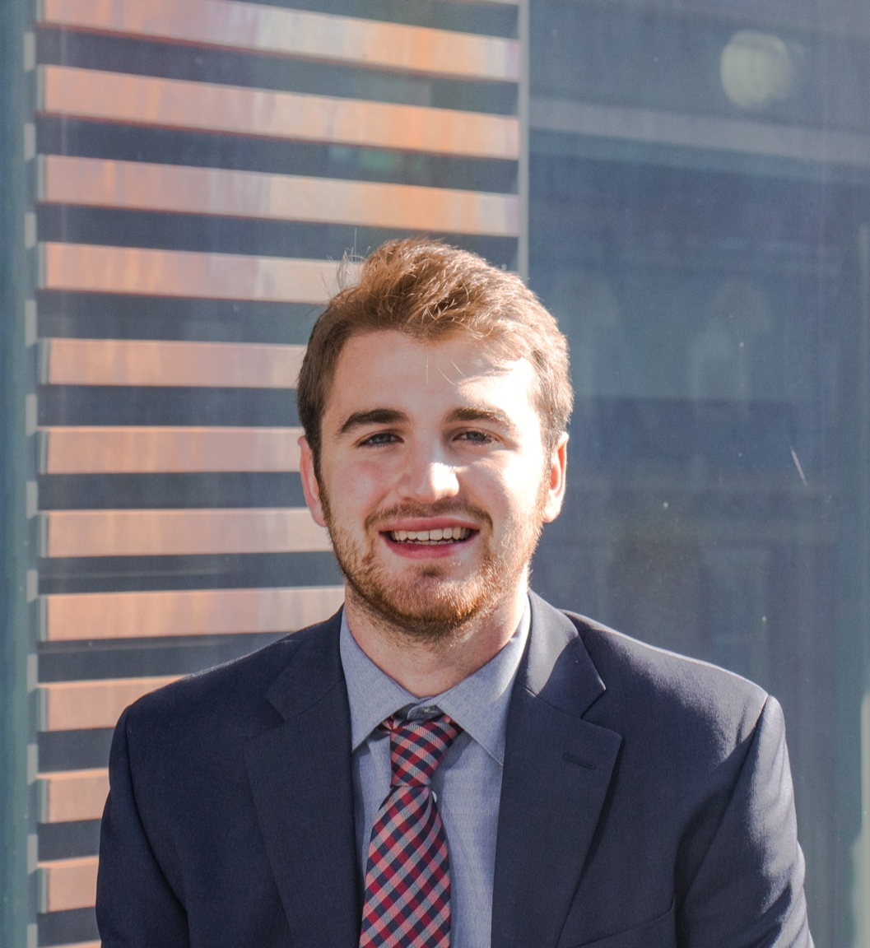
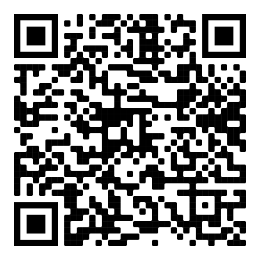
Need a New Headshot?
Need a New Headshot?
Need a new headshot?
$5 for Non-Gold Members
Slack or Email michael.breen@temple.edu

Slide 9
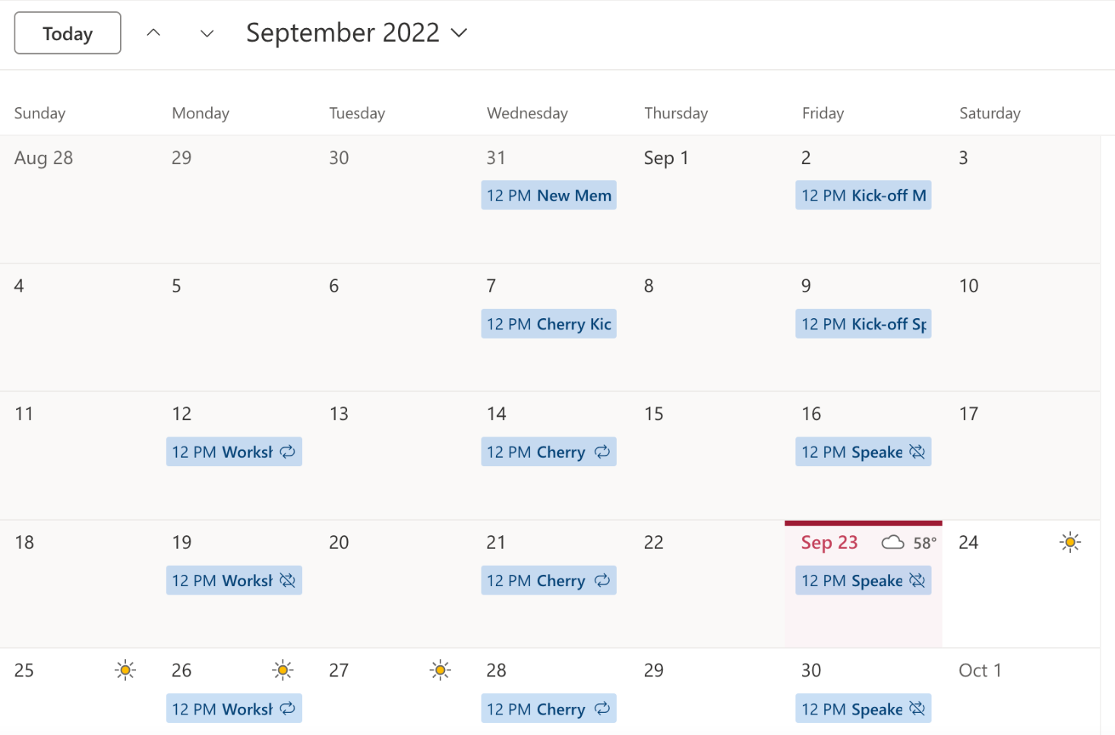
Member Calendar

Slide 10
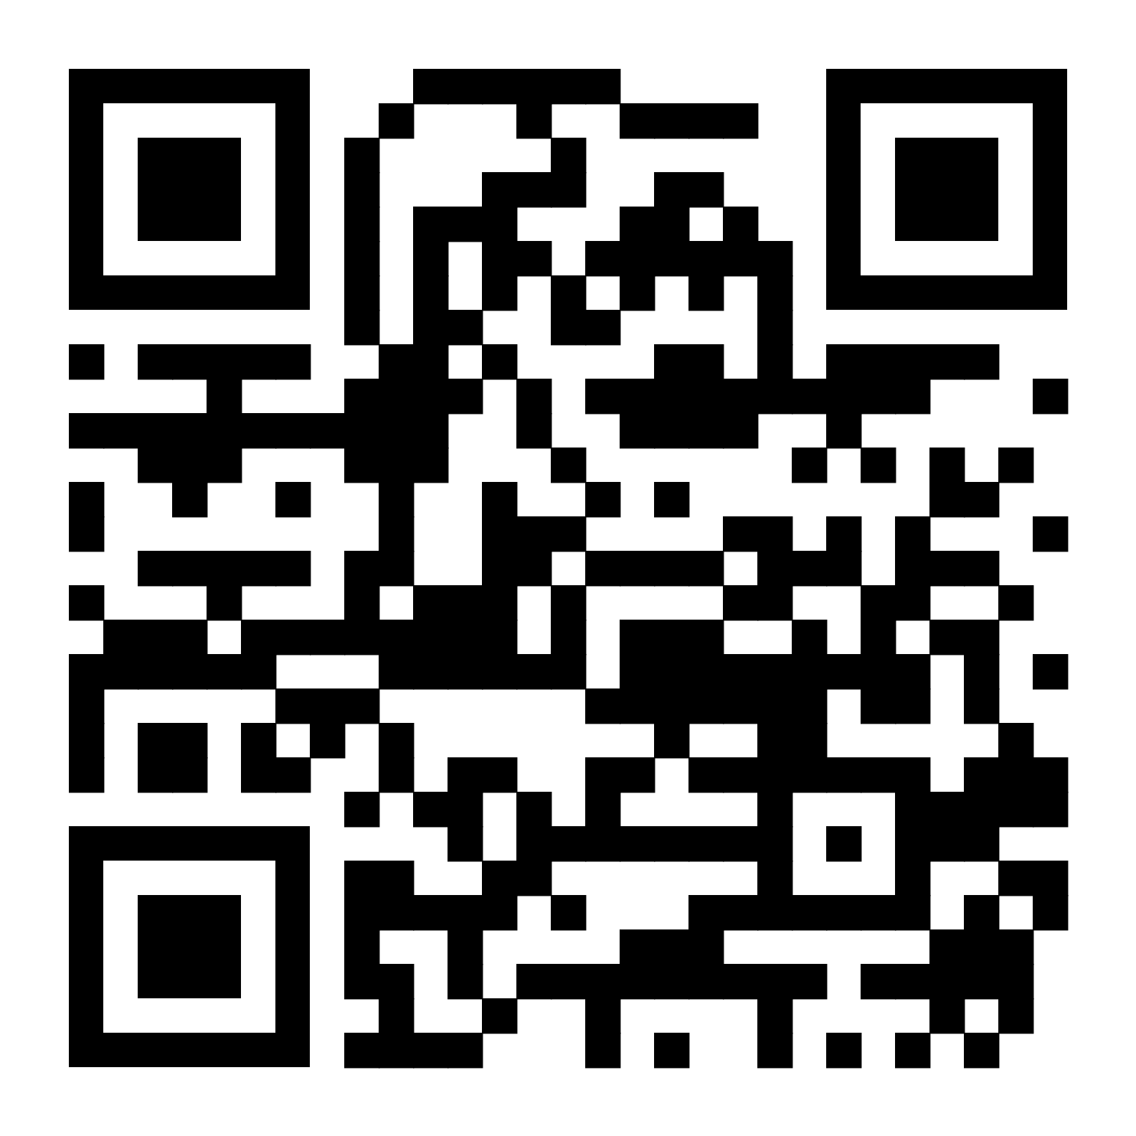
Join our Slack Channel!
:
https://bit.ly/TU-AMA-general-body-slack
Notes:
Aden

Slide 13
Adobe Lightroom
Workshop

Slide 14
Hello!
Michael Breen
Madeline Collyer
President
Director of Media Relations- Content Creation

Slide 15
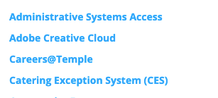
Did you download Adobe Creative Cloud?
Go to your TU PORTAL
2. Click "Access Adobe Creative Cloud"
3. Log in with your TUX email
(as a student account)
4. "Open Creative Cloud" and click DOWNLOAD to desktop
5. Install LIGHTROOM (not classic)

Slide 16
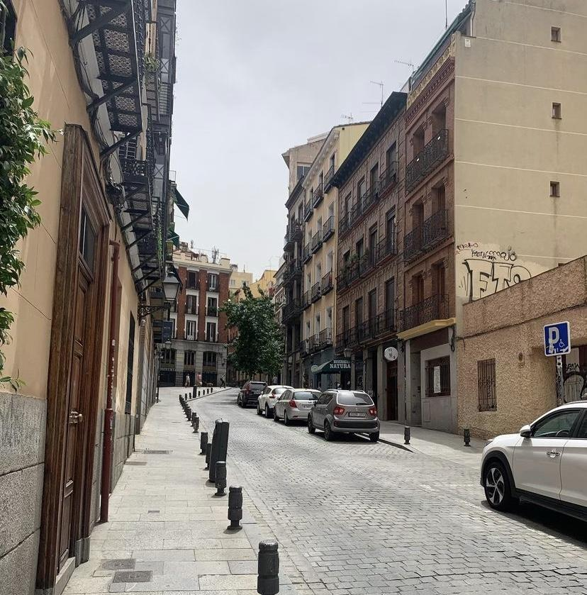
Let's get started!
Go to:
bit.ly/amalightroomworkshop
and download all 6
of these photos!

Slide 17
Ctrl + Shift + C - Edit copy settings
Useful Shortcuts
\ - Show before/after
J - Show clipping
F - Show full screen

Slide 18
Thanks for
coming!
Send us your photos on Slack and follow us
@tuowlsama

