Slide 1

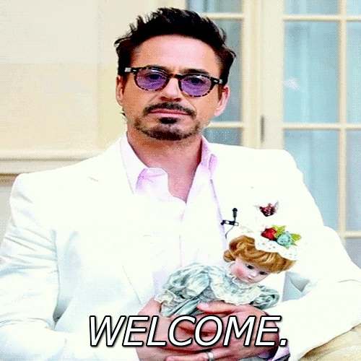
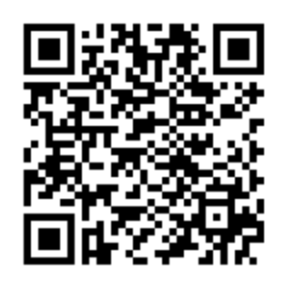
Scan with your Suitable App!
Notes:
Julia/Kevin

Slide 2

Notes:
Julia/Kevin

Slide 3
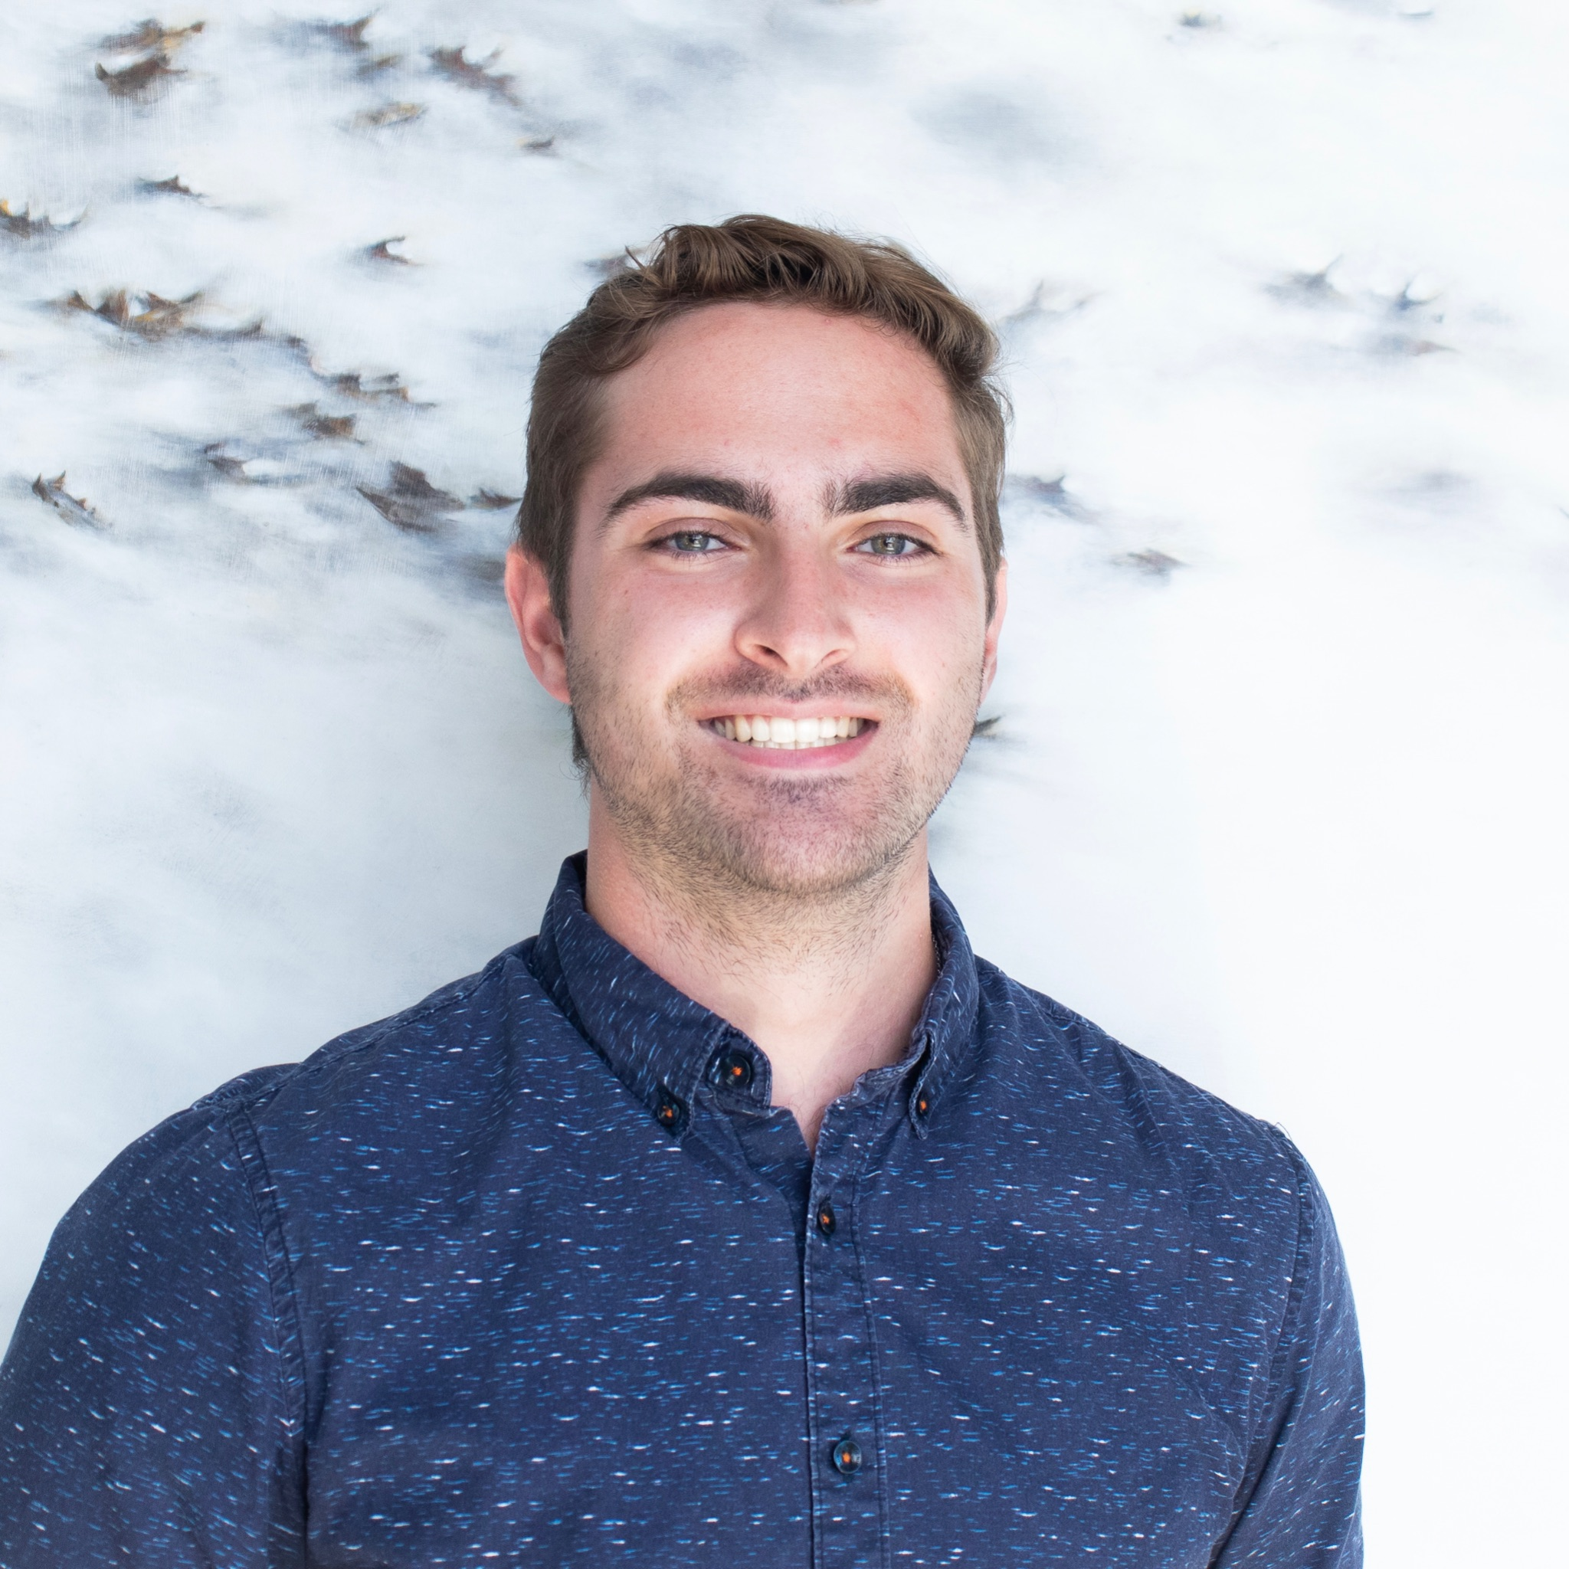
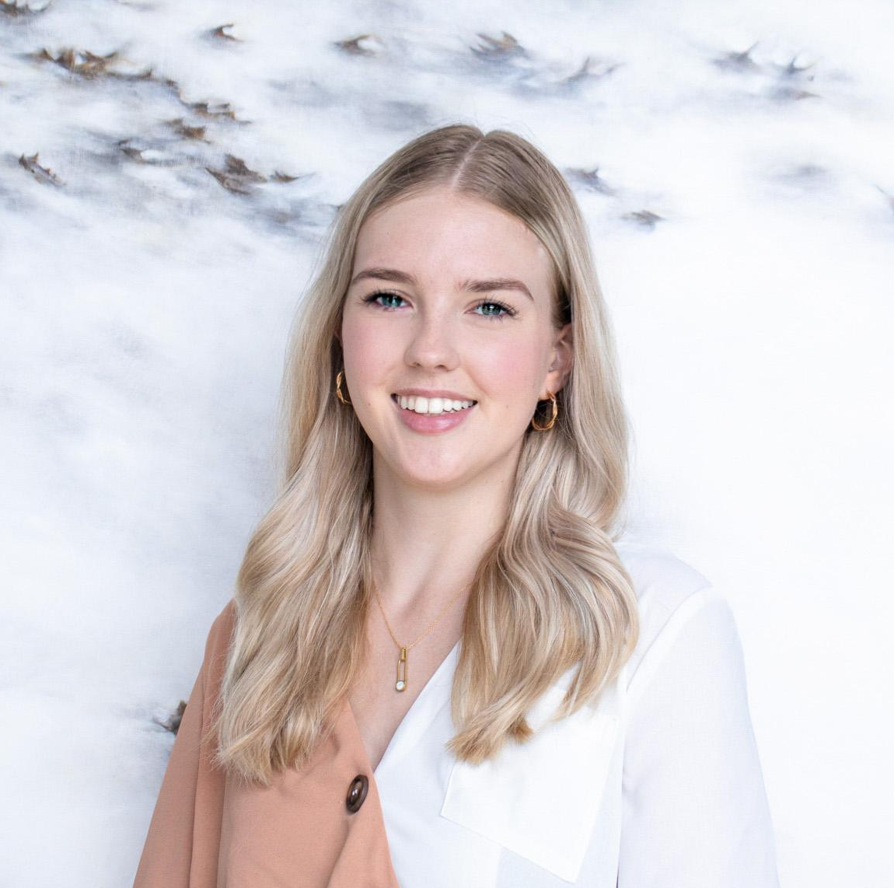
President & Vice President
Michael Breen
President
Senior
Marketing Major & Economics Minor
michael.breen@temple.edu
Lauren McGrath
Vice President
Senior
Marketing Major & Sociology Minor
lauren.mcgrath@temple.edu
Notes:
Julia and Kevin introductions. Then introduce Nina and Juliette who will go through presentation.

Slide 4
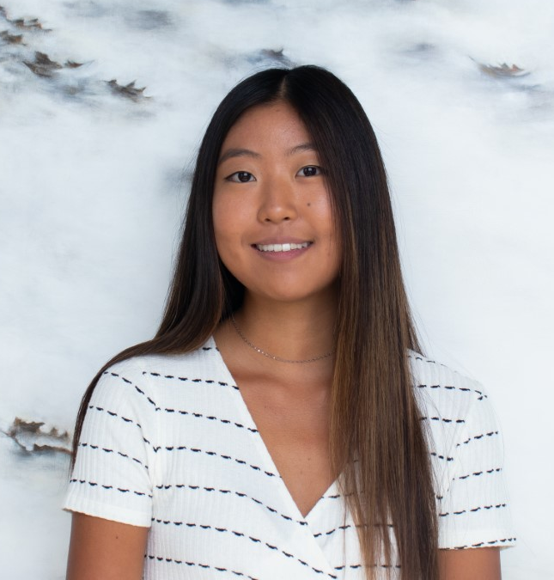
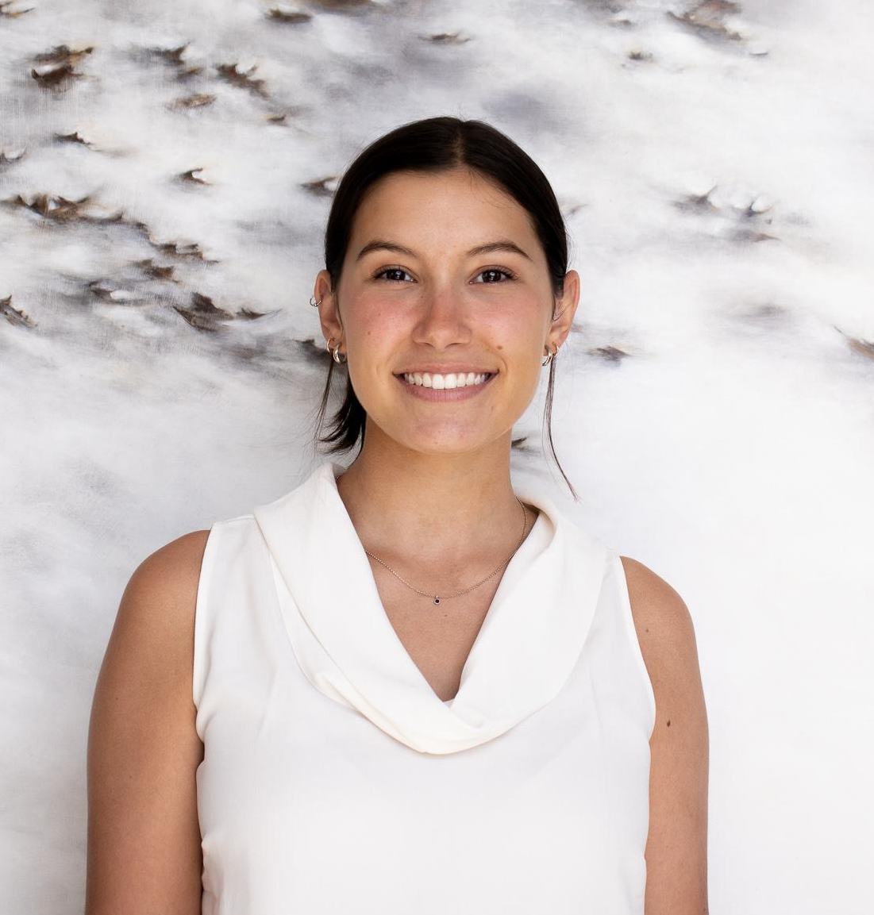
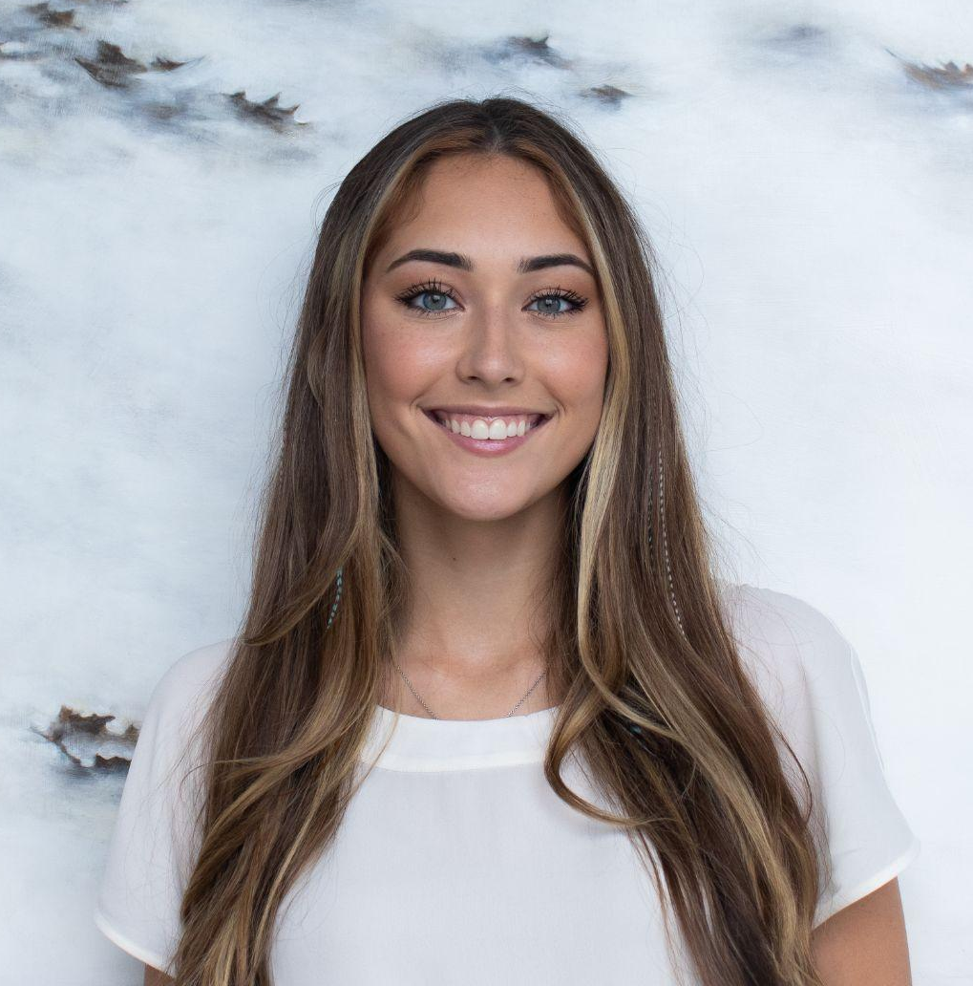
Membership
Insert headshot
Elena Rossetti
Junior
Marketing Major
Juliette Plummer
Junior
Marketing Major & MIS Minor
Notes:
Membership

Slide 5

Our Mission & Goal
TU-AMA aims to transform students’ lives.
We offer our members opportunities to become experienced marketers and proven leaders by advancing their business knowledge, enhancing their skill sets, and expanding their personal networks.
Notes:
Jul
First we will start by going over our mission and goals: TU-AMA aims to transform students’ lives. We offer our members opportunities to become experienced marketers and proven leaders by advancing their business knowledge, enhancing their skill sets, and expanding their personal networks.

Slide 6
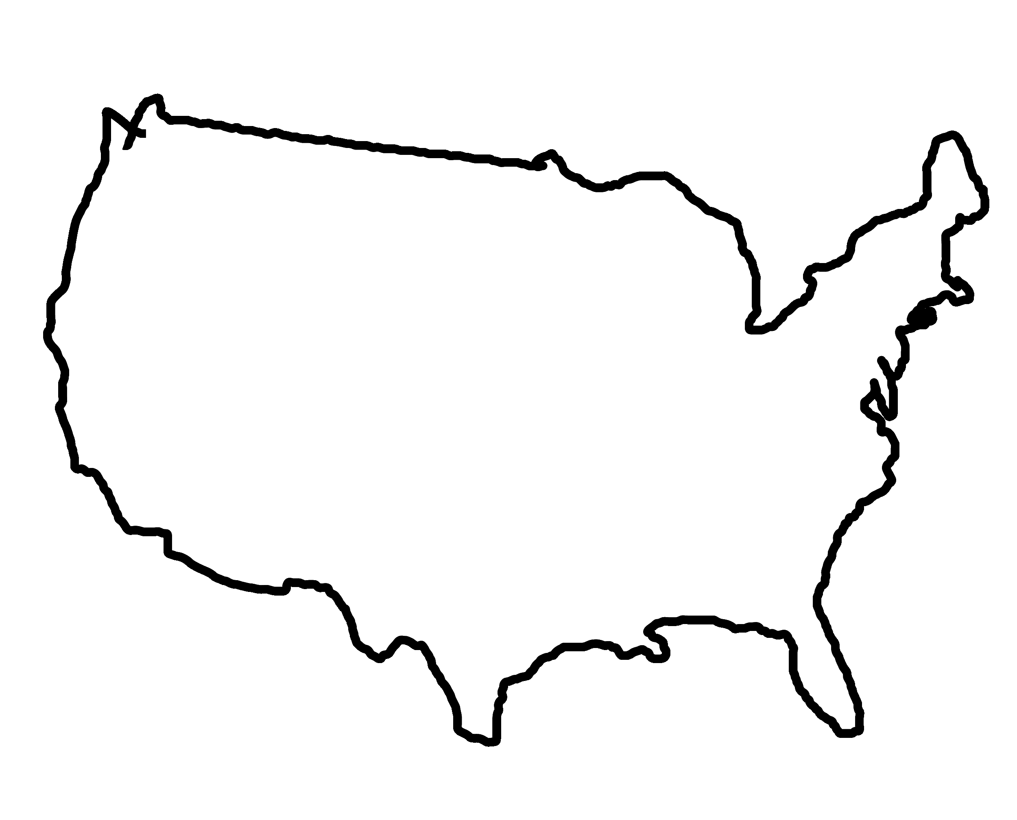






1 of 340+
collegiate chapters
Notes:
jul
Going into our schedule, we meet 3 times a week, Monday, Wednesday, Friday during the school’s business hour from 12:00 to 12:50 pm. As AMA is a national organization, Temple’s chapter is just one out of over 340 chapters in the country. Each year, we attend AMA’s International Conference where we are ranked and compete against the other chapters.

Slide 7
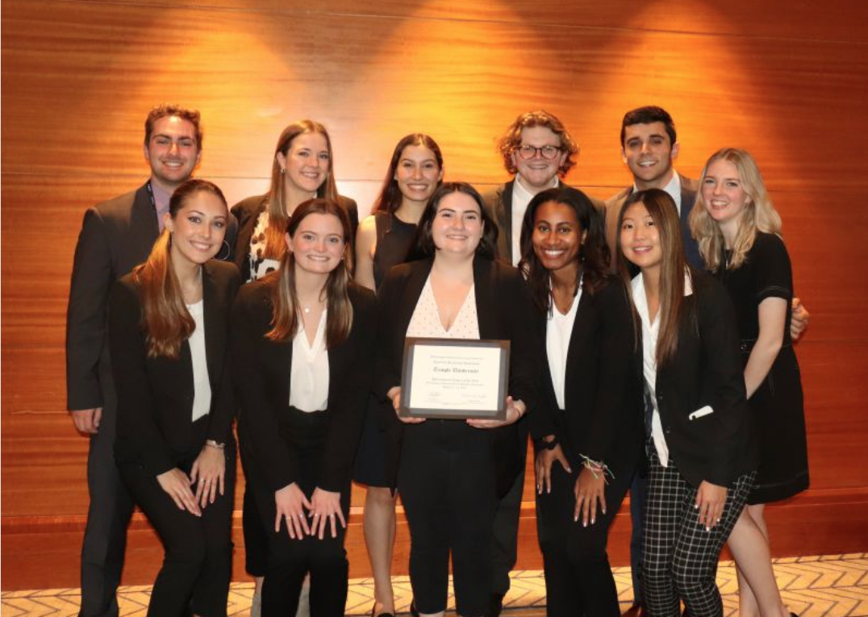
AMA National
Awards
International Chapter of the Year - 2022 AMAICC
1st Place - Amazon Prime Student International Collegiate
Case Competition
1st Place - Collegiate Chapter Website
1st Place - Chapter T-Shirt Design Competition
Notes:
Elena
Every year the American Marketing Association hold an Intercollegiate Conference where all the chapters come together to compete in various competitions, hear industry professionals, and network with members with other schools. This past year the conference was held in Chicago where our chapter took home Top International Chapter of the Year, 1st place in the Case Competition which was sponsored by Amazon Prime, and we have also won 1st place for our Chapter Website design and the t-shirt competition that also takes place at ICC

Slide 8
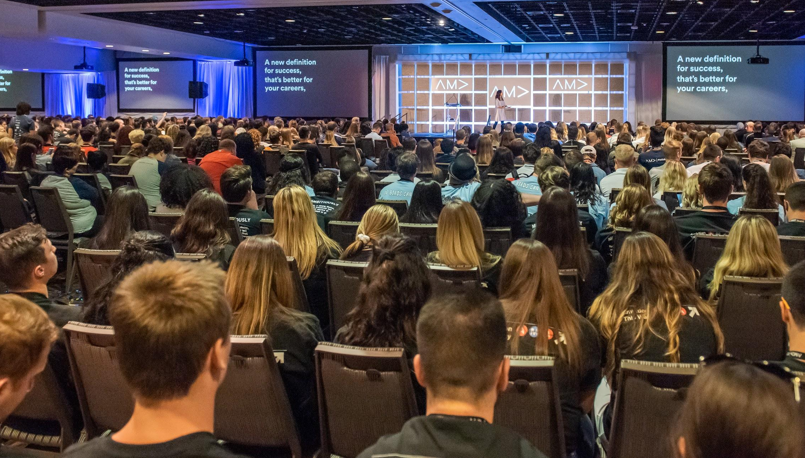
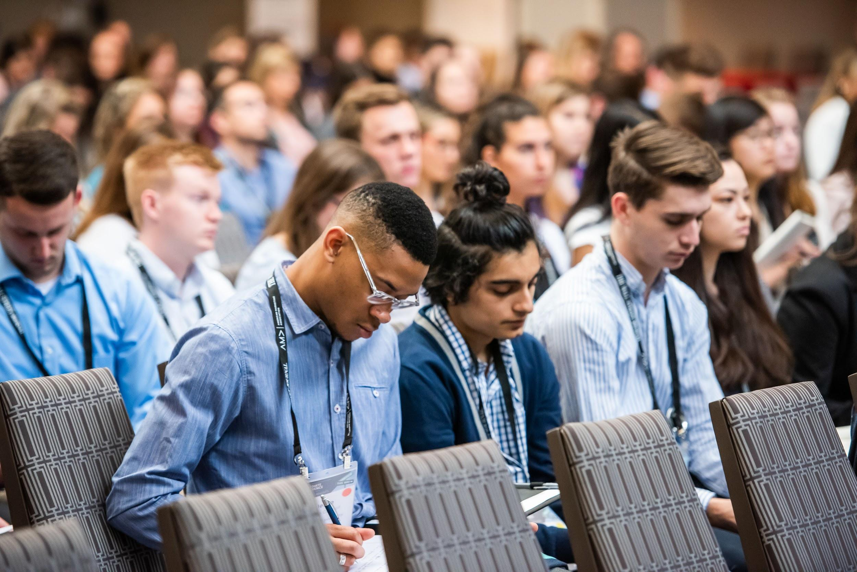
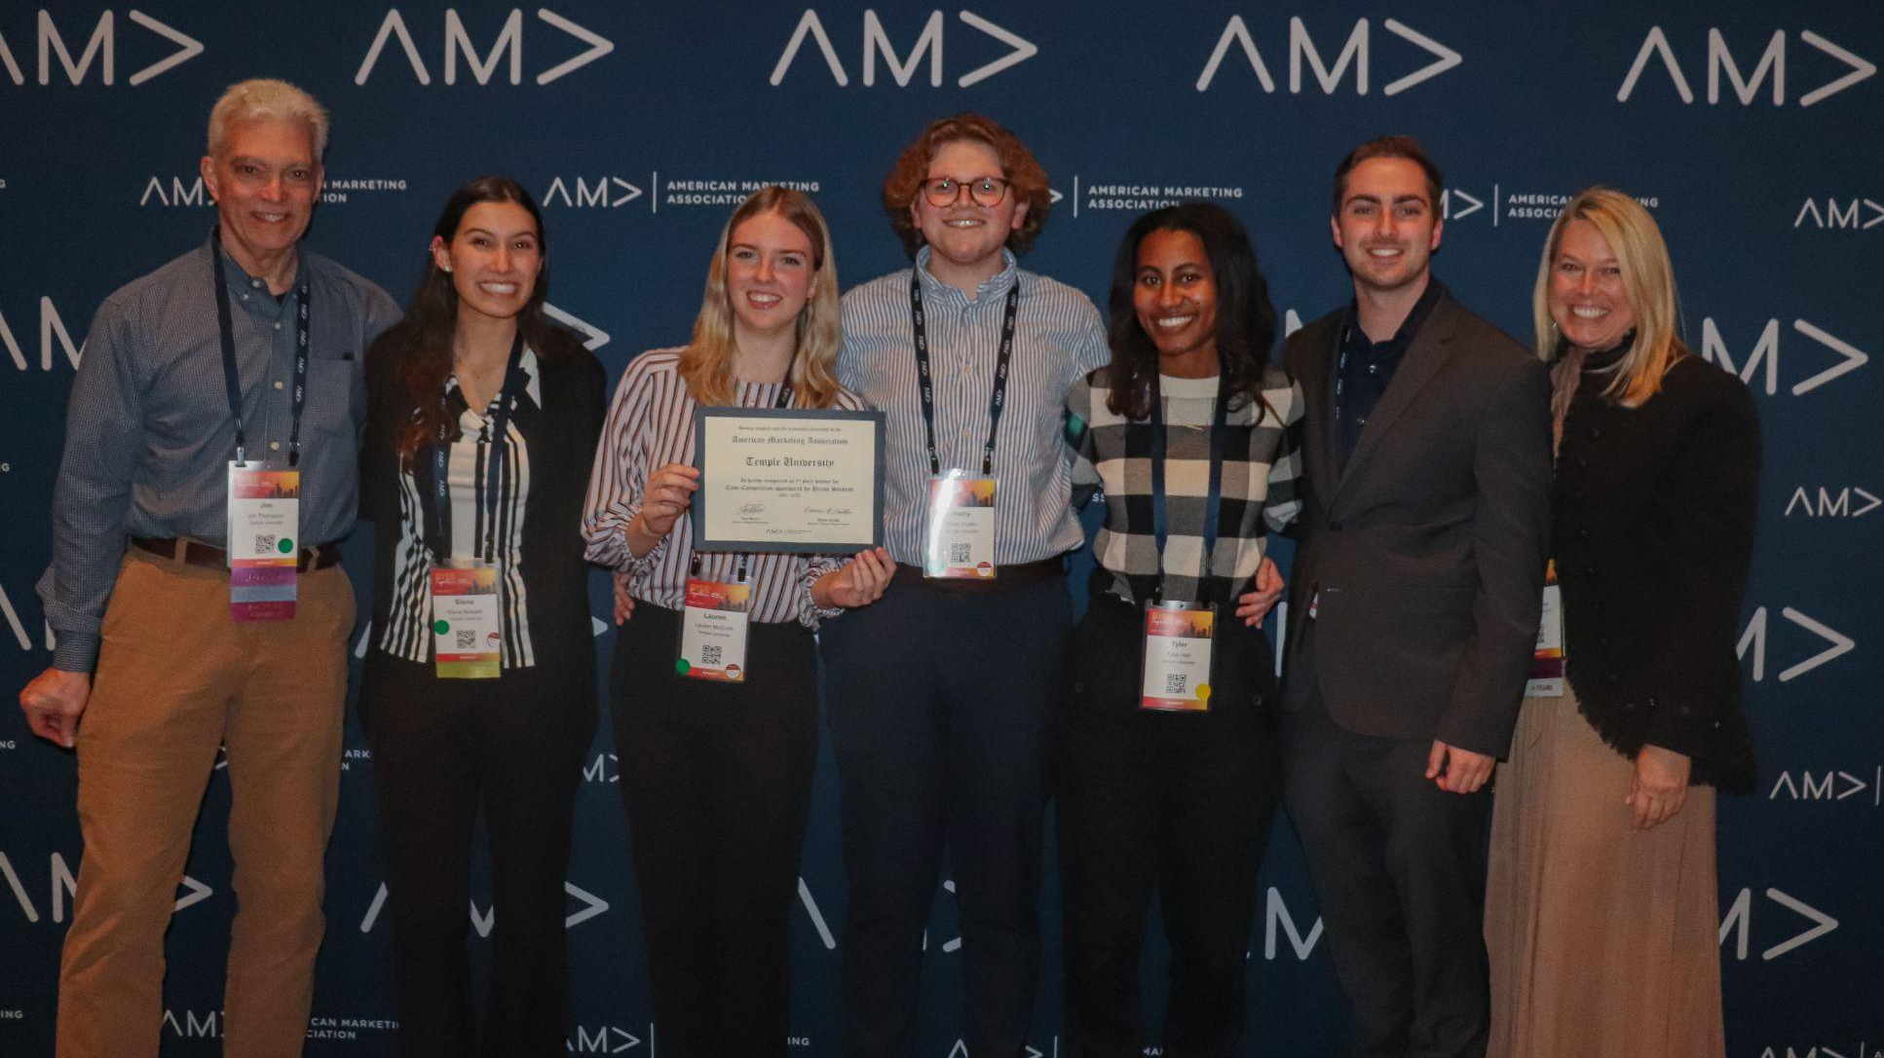
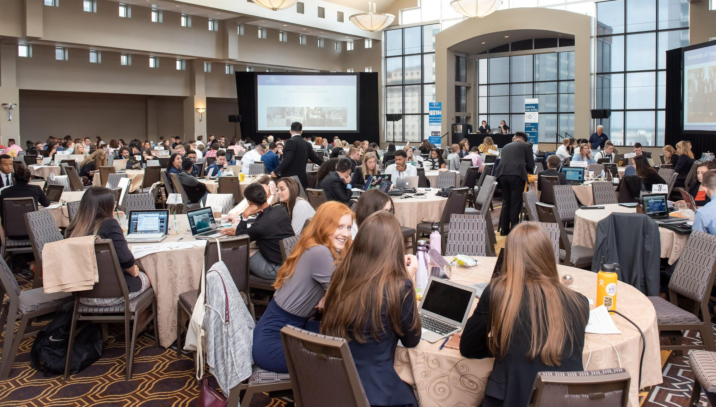
Notes:
elena
This year, the AMA International Collegiate Conference Competitions (ICC) will be in New Orleans, and since we were one of the Top International Chapters last year that means we actually get to host this year. Our chapter will be playing a big role in leading the conference and also representing Temple as a top chapter. (Photos of what to expect). It’s a lot of fun you get to travel with your other members and get great resume skills- I’ll touch more upon bringing general body members in the Citizenship points but attendance does play a role on your ability to attend.

Slide 9
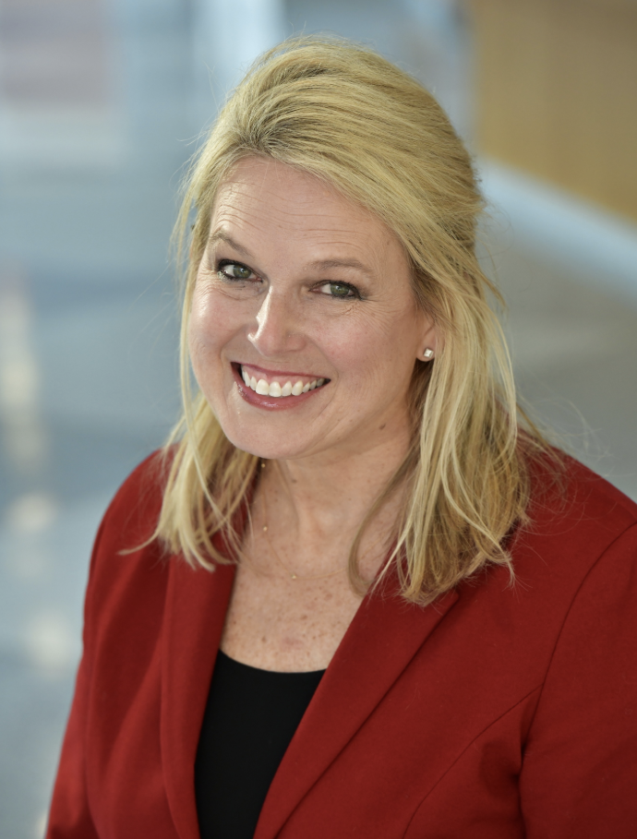
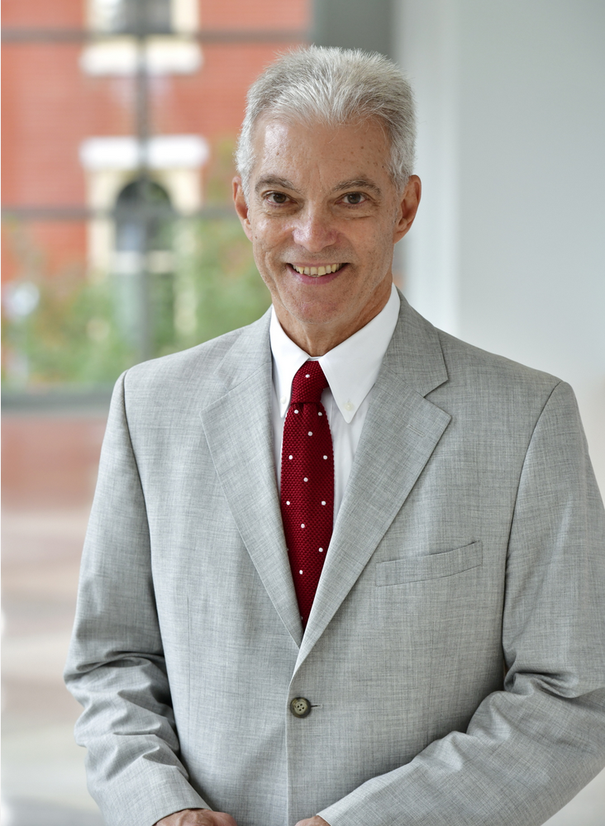
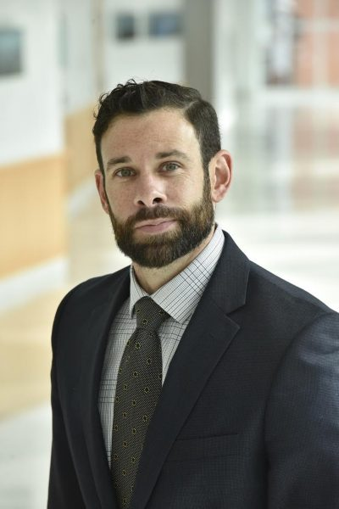
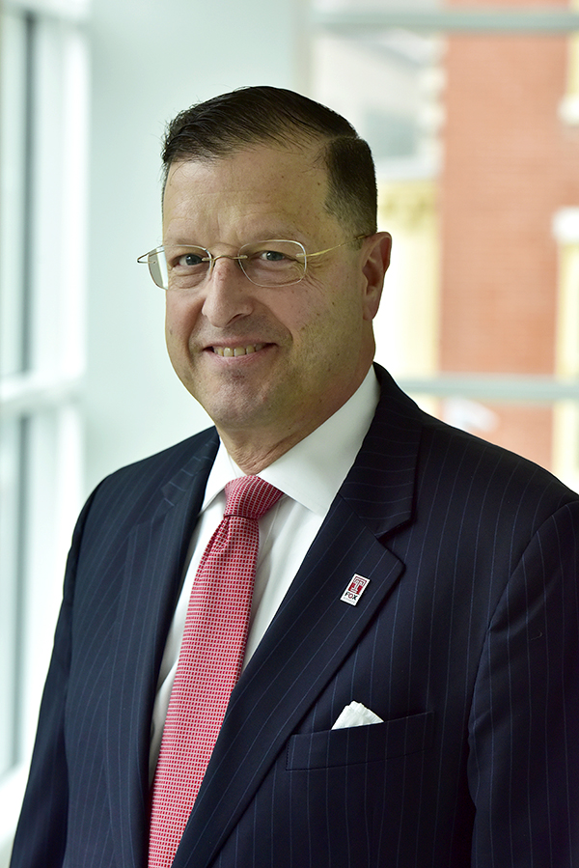
TU-AMA Advisors
Sheri Lambert
Assistant Professor of Marketing
Director of the MS-Market Research & Insights Program
Jim Thompson
Assistant Professor of Marketing
Drew Allmond
Assistant Professor of Marketing
Michael Hughes
Assistant Professor of Marketing
Notes:
Juliette

Slide 10
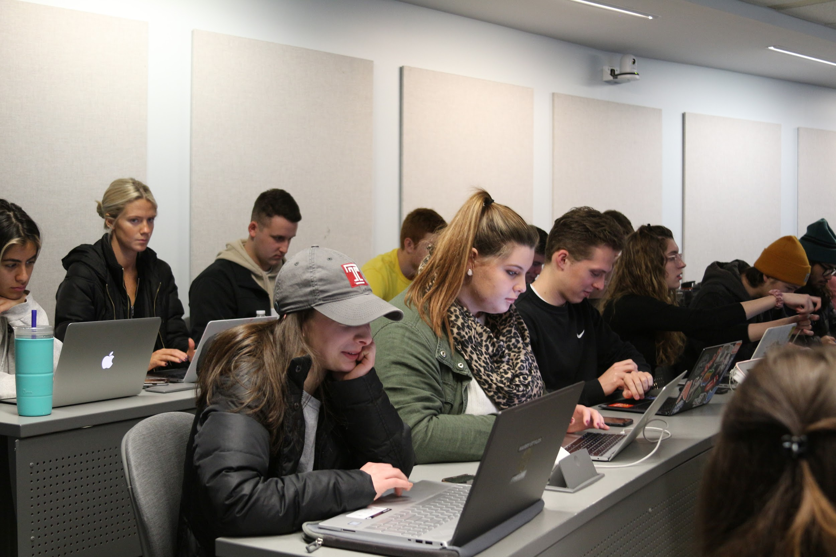
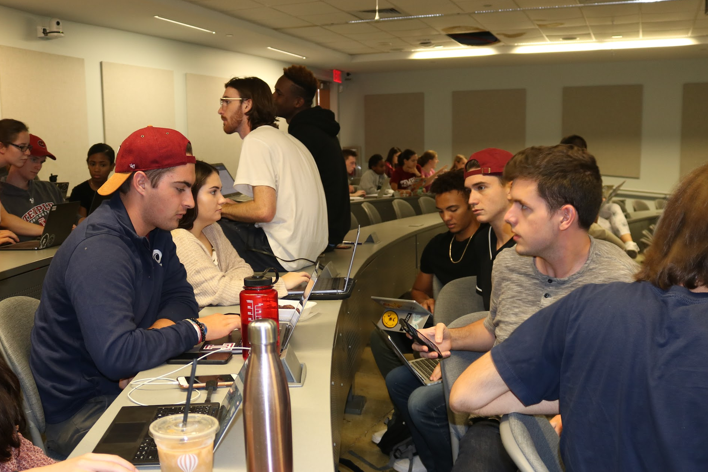
Opportunities to Get Involved!
Offering unique opportunities for leadership and development.
Notes:
Elena- we’re excited to show you what we’ve been working on and the opportunities that we have for you this year, we hope that you all stay involved (next)

Slide 11
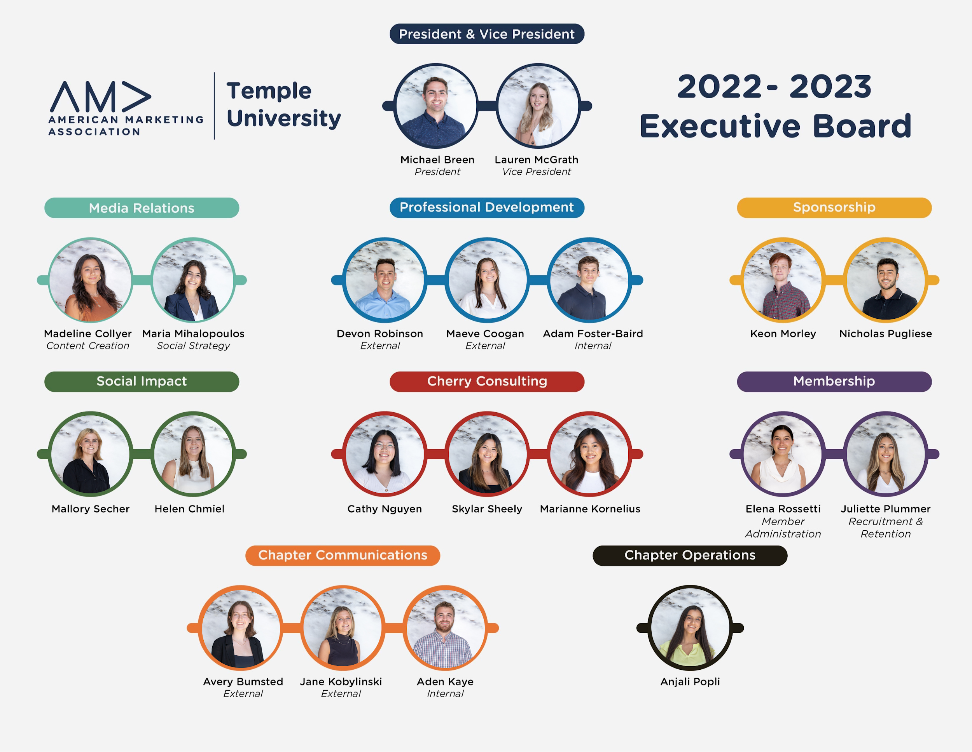
TU-AMA Directors
Our Directors have been working super hard to plan a bunch of opportunities for you all this year...now let’s meet them!
Notes:
Elena hand it off to Social Impact

Slide 12
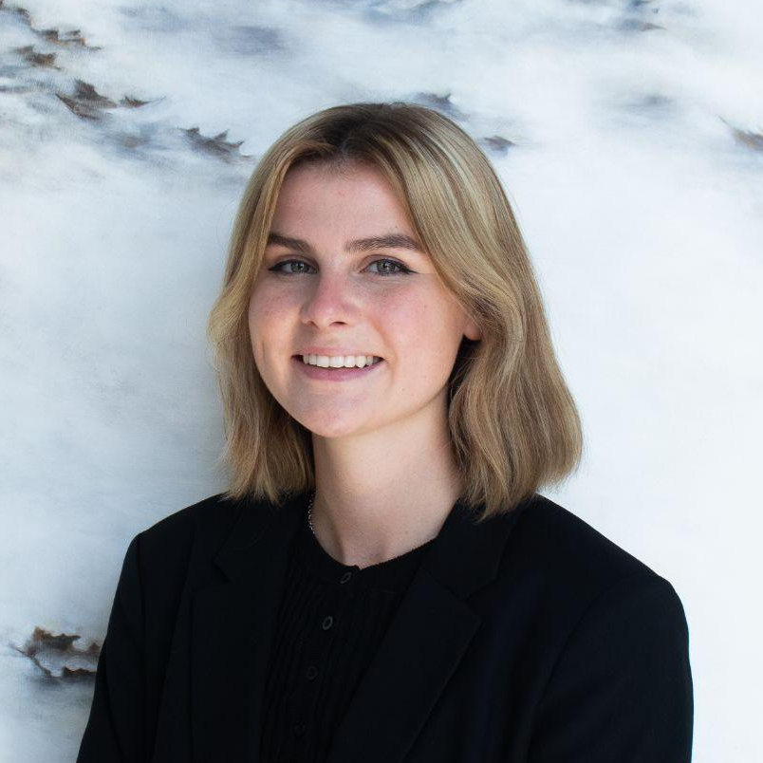
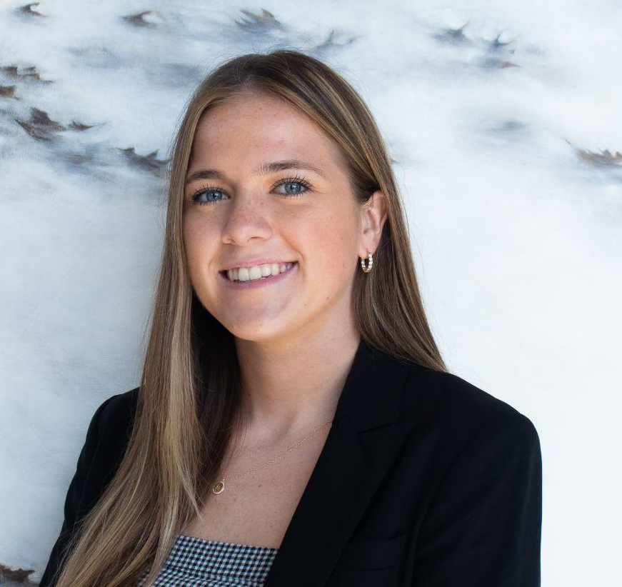
Directors of Social Impact
Mallory Secher
Senior
Advertising Major & Bus Minor
Helen Chmiel
Senior
Marketing Major

Slide 13
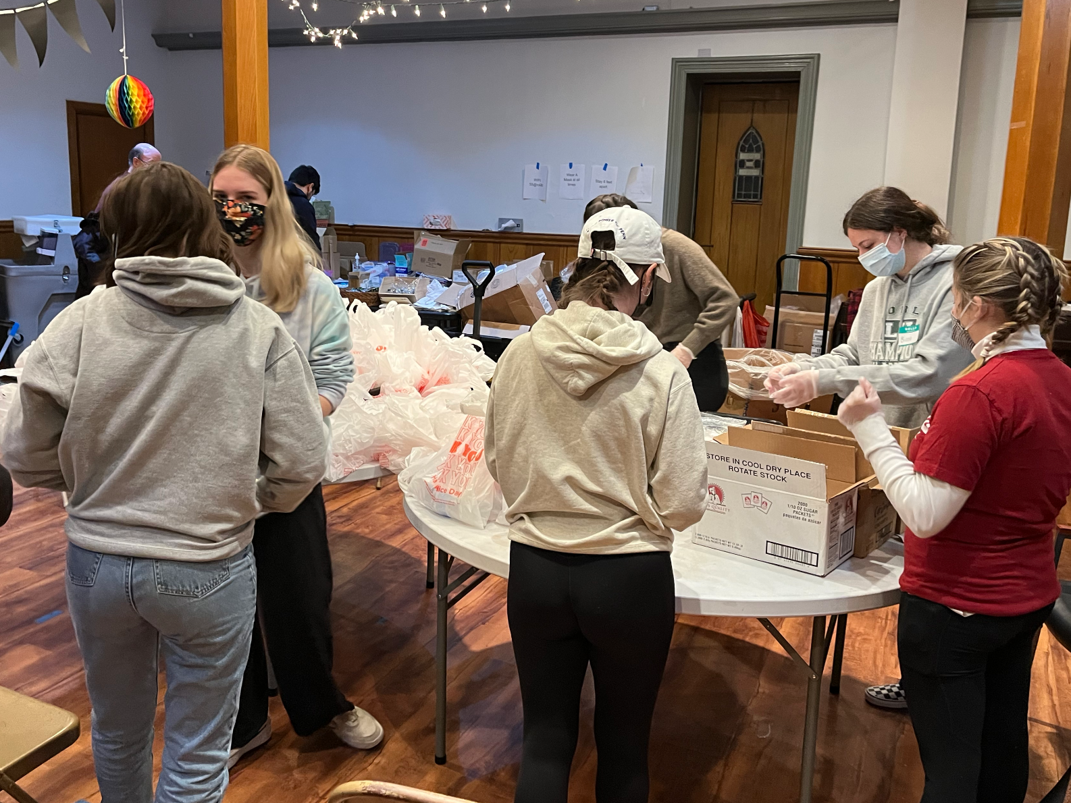
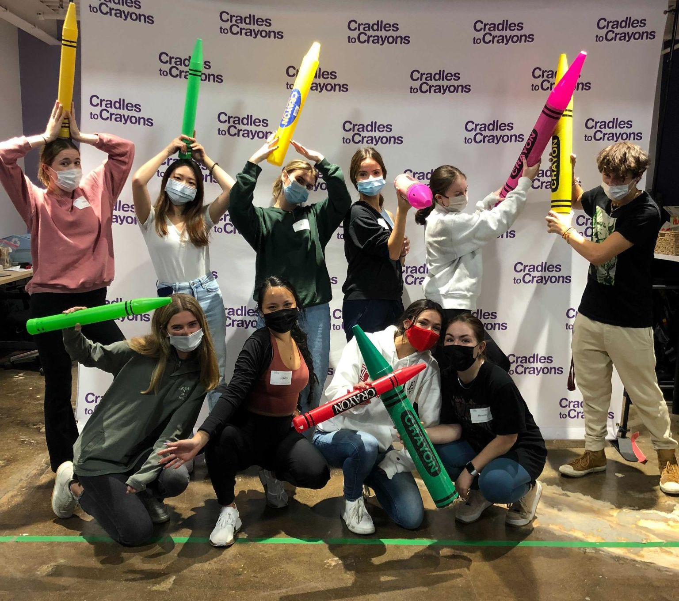
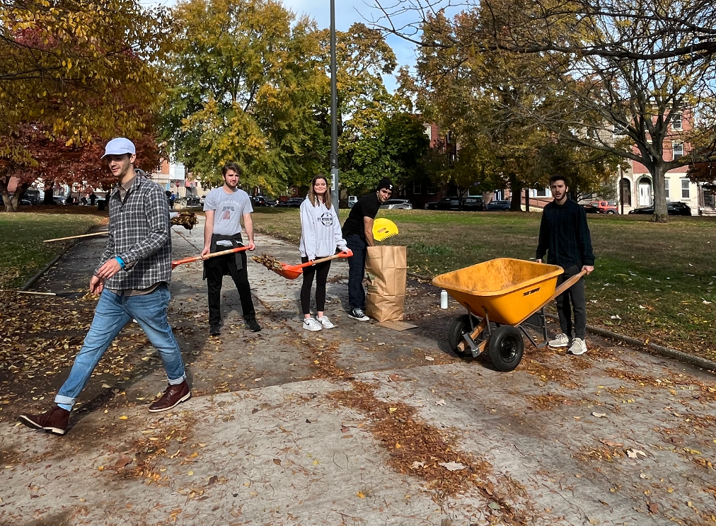
Commitment to Our Community
Fundraise for local charities
Write blogs that spark conversation
Connect with your community & inspire the next generation
Provide marketing solutions to initiate change

Slide 14
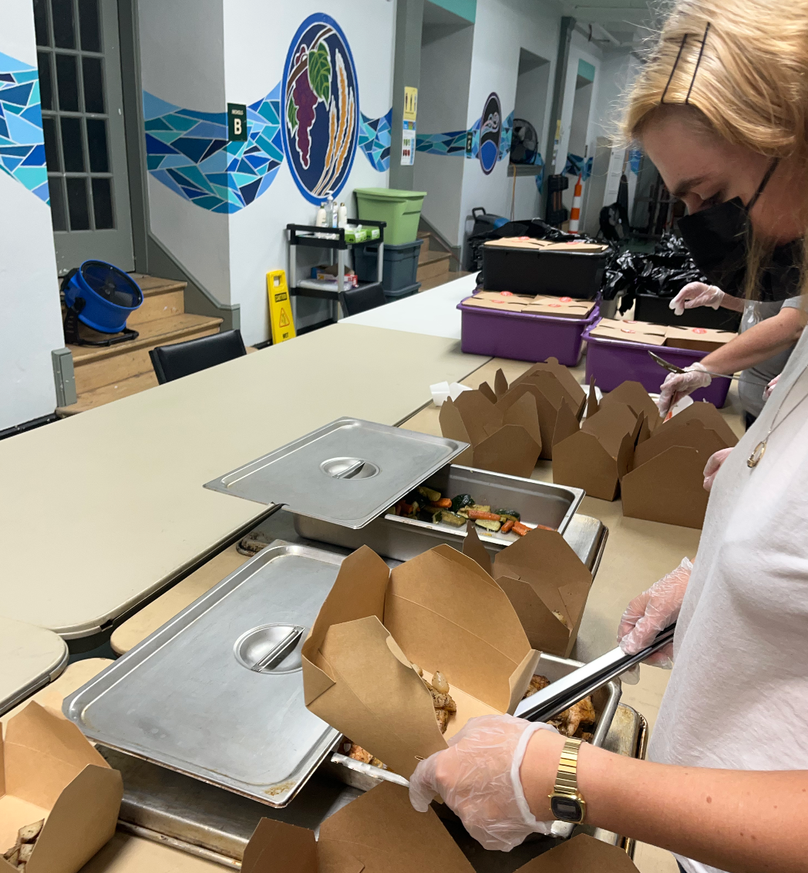

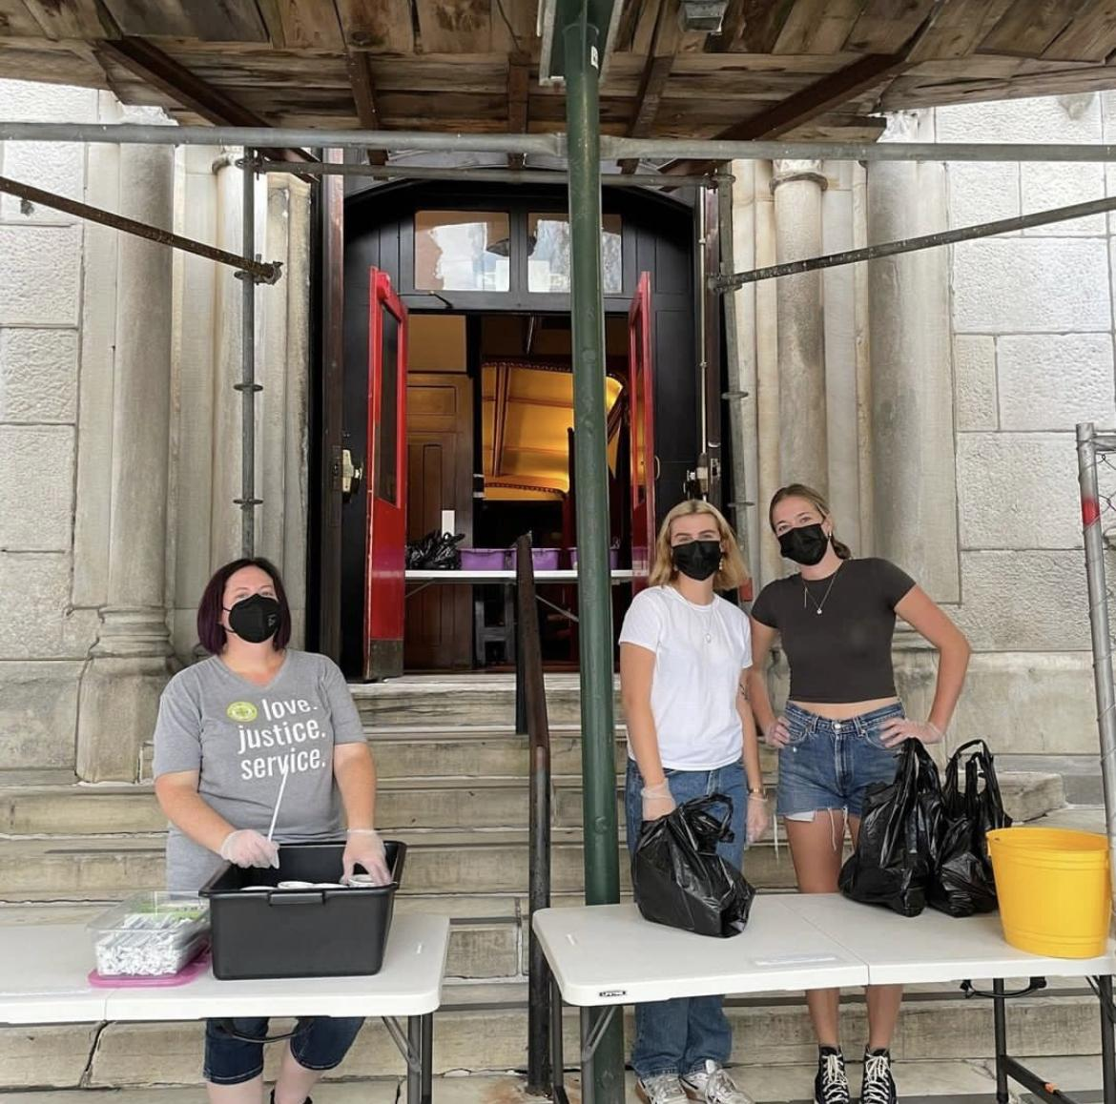
Charity of Choice
Grace Cafe! A safe space for Philly’s homeless or food insecure
Clothing drives, wellness clinic, meal serves, and other services!
Tack on $5 to your Membership Dues to help reach our fundraising goal!

Slide 15
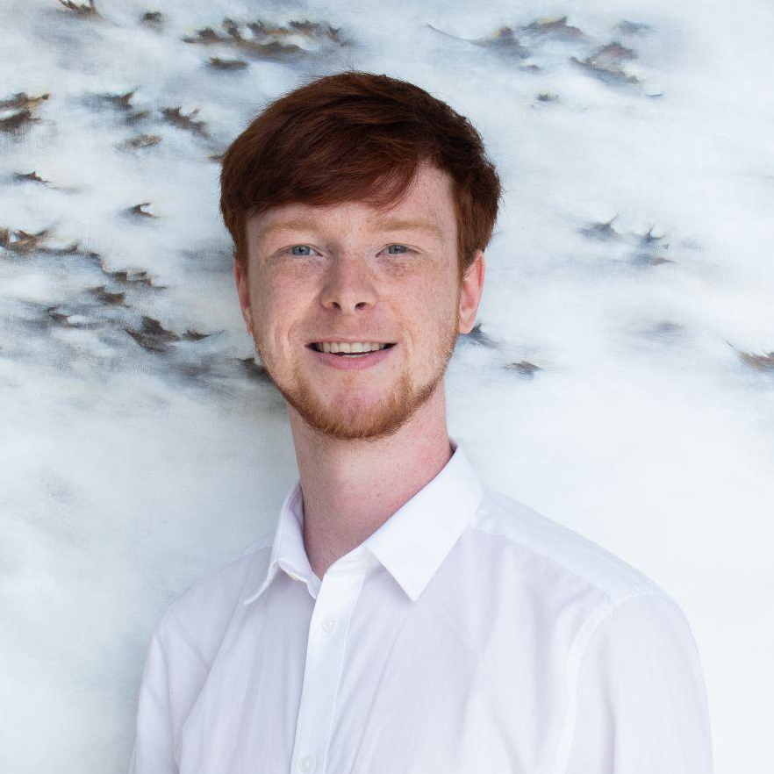
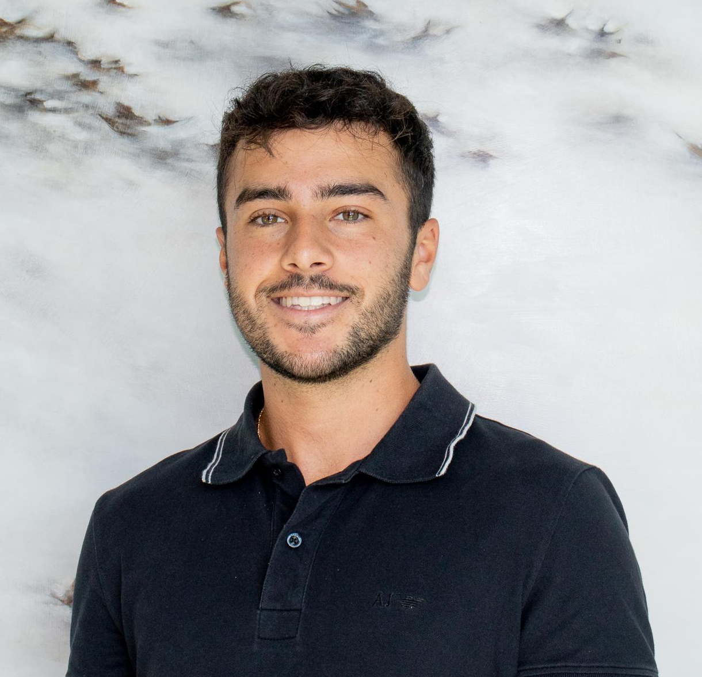
Directors of Sponsorship
Keon Morley
Senior
Communications & Political Science Major
Nicholas Pugliese
Senior
Marketing Major

Slide 16





Our Sponsors

Slide 17
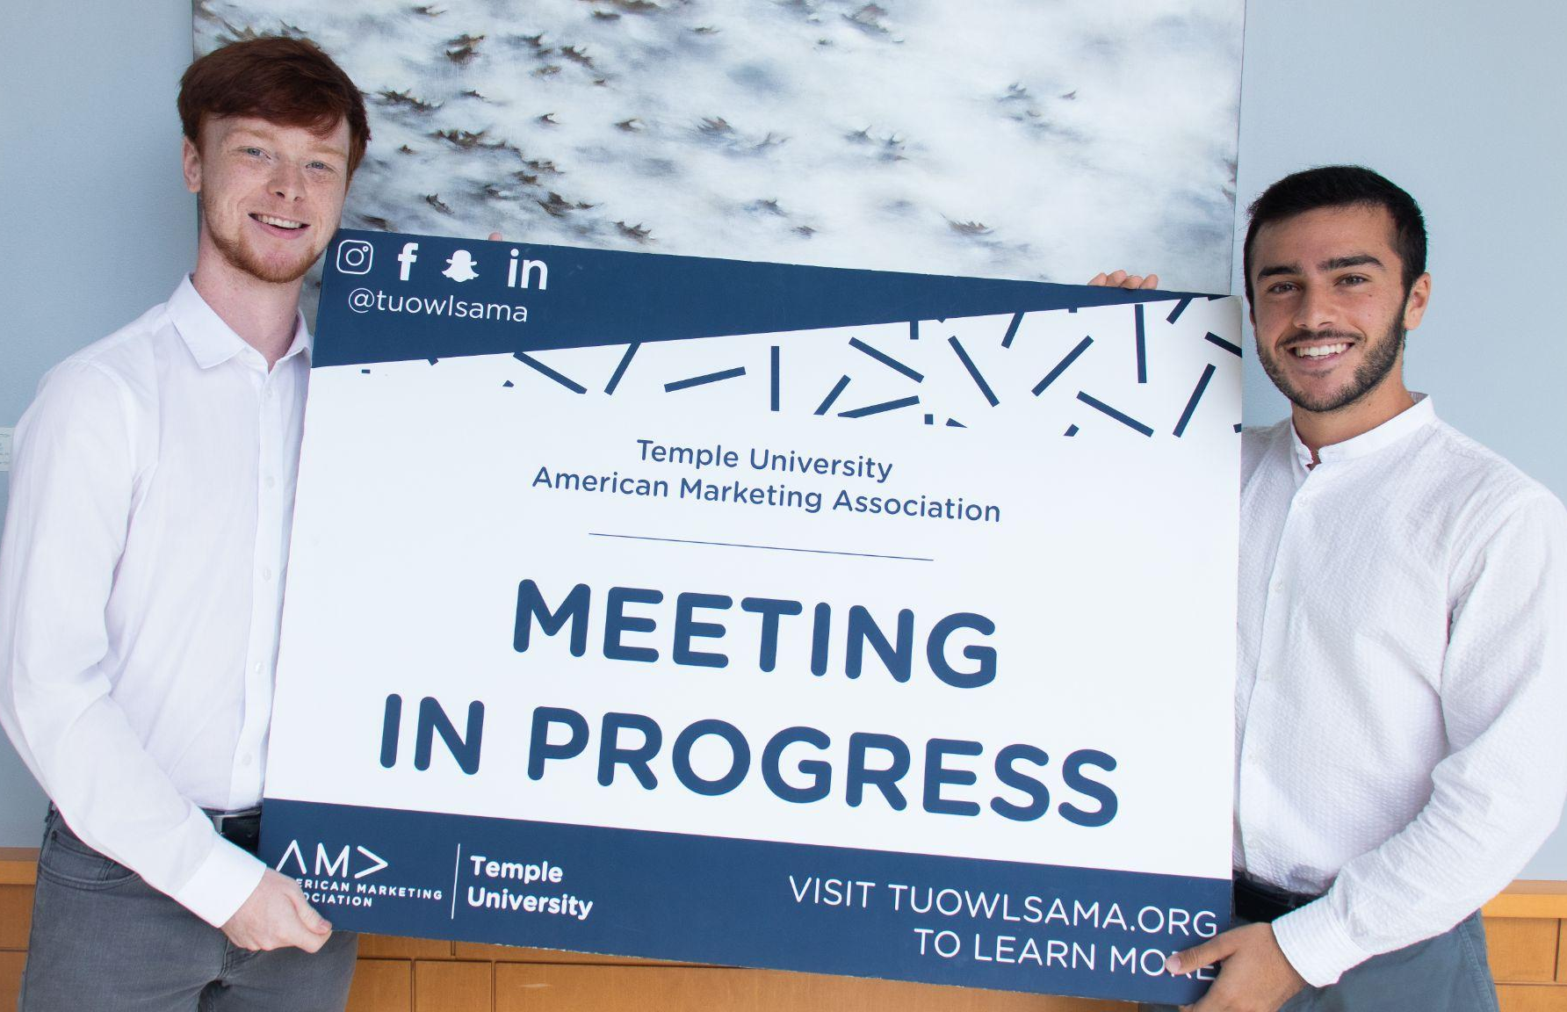
Scholarship Opportunity
Ability to receive up to $1000
Provides current TU-AMA members tuition support, who demonstrate a dedication to the marketing industry within our chapter, the classroom, and the community
Application-Based
  Gold Membership
  Good Academic Standing
Notes:
keon

Slide 18
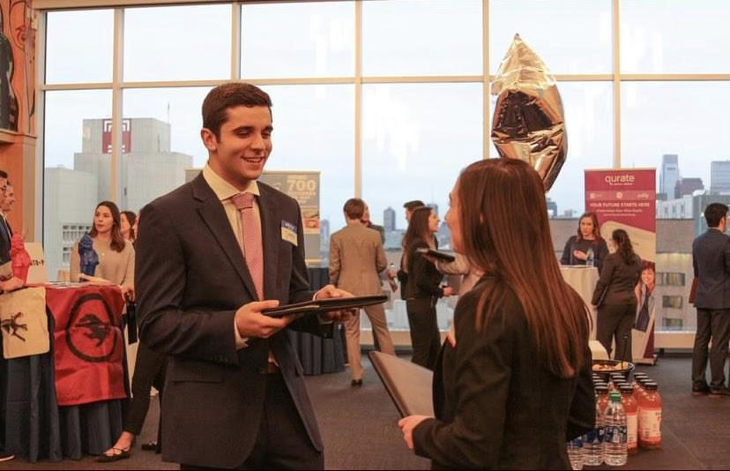
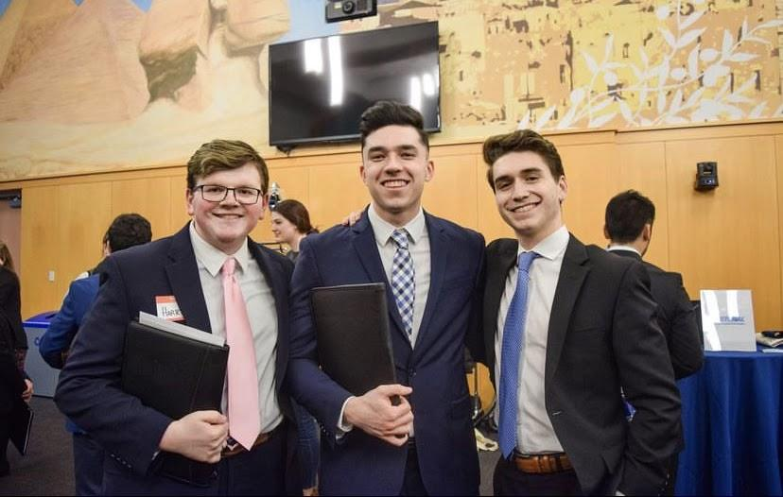
Career and Internship Reception
Looking for a summer internship or a job?
Biggest networking event of the year!!!
Opportunity to introduce yourself to companies
1 on 1 face time with our sponsors
Spring 2023
Notes:
nick

Slide 19
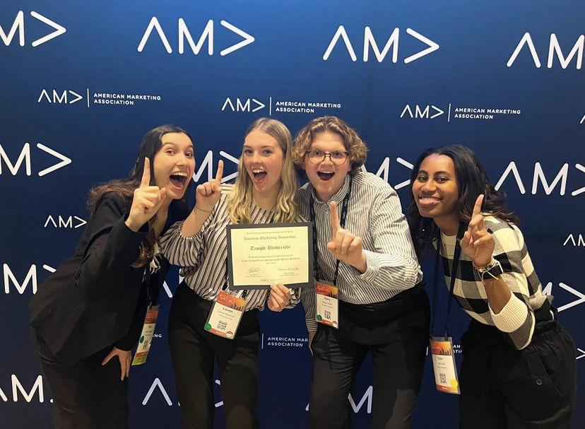
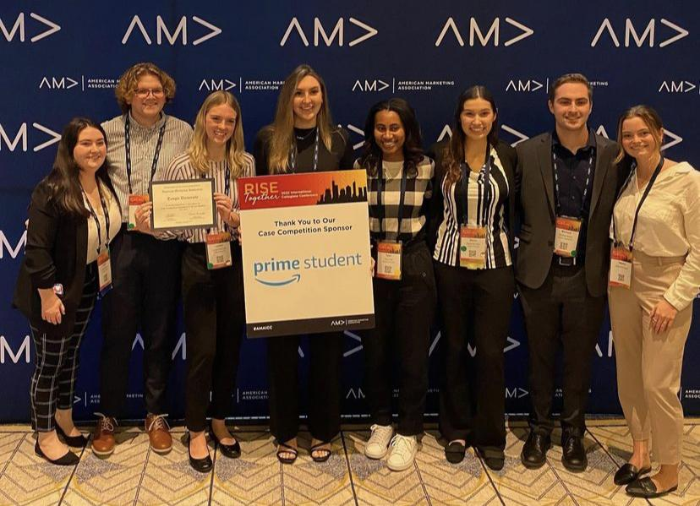
TU-AMA International Case Competition Team
Notes:
keon

Slide 20
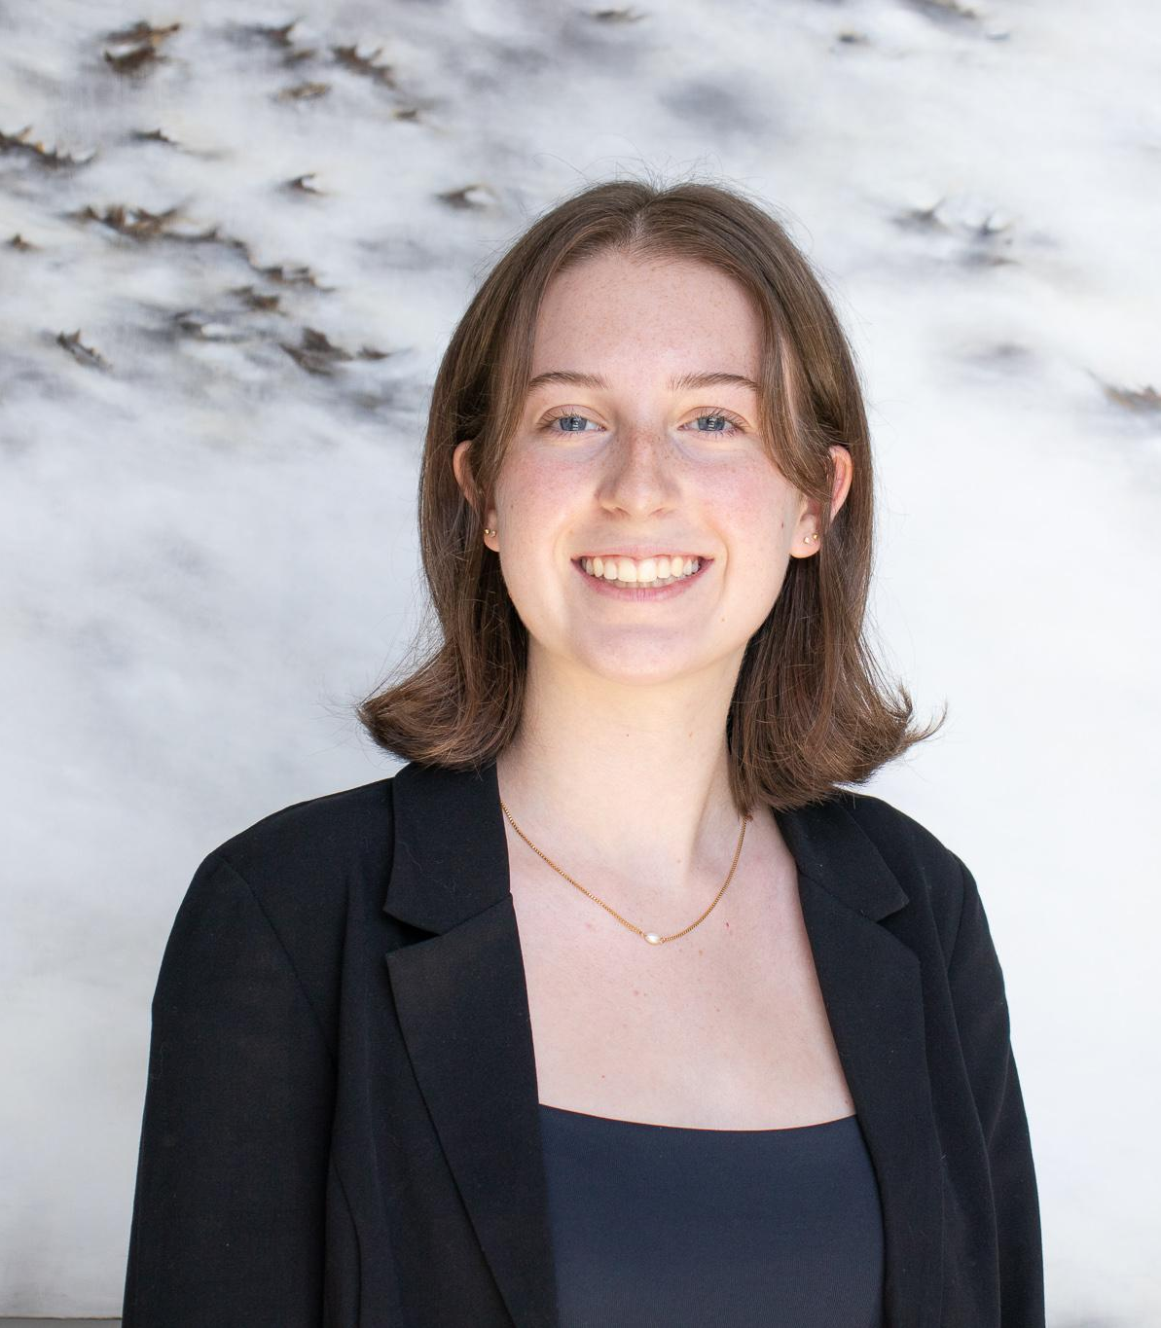
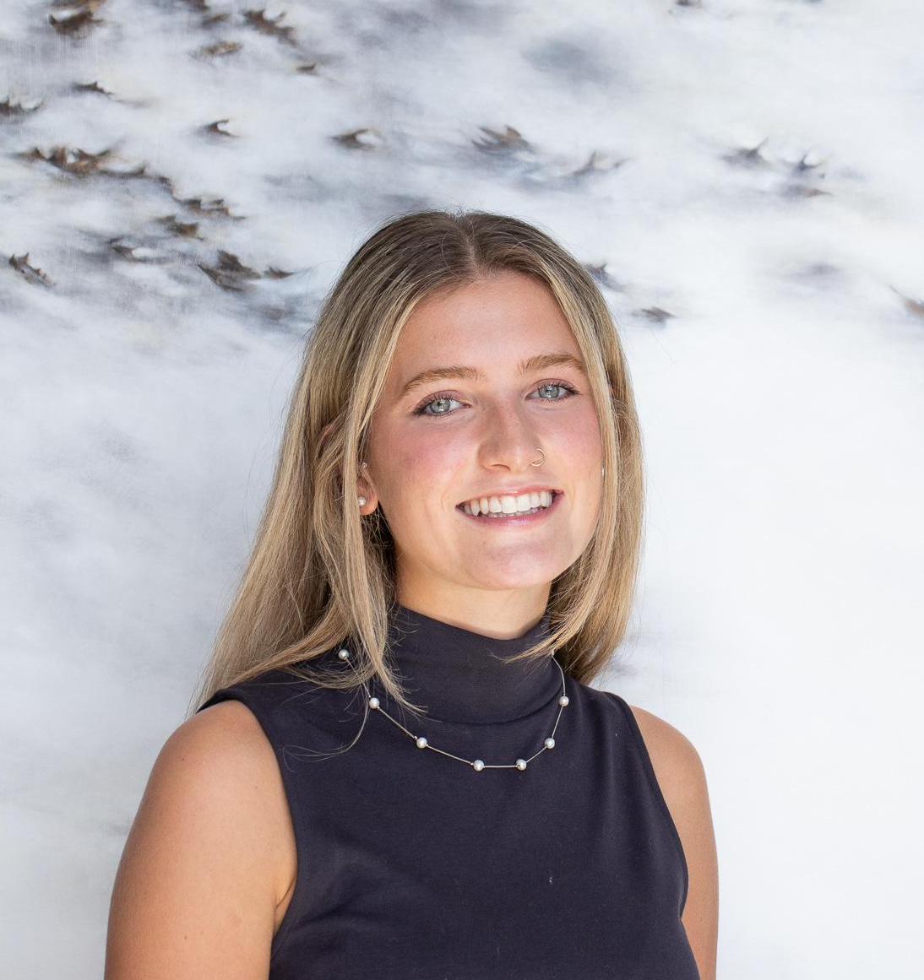
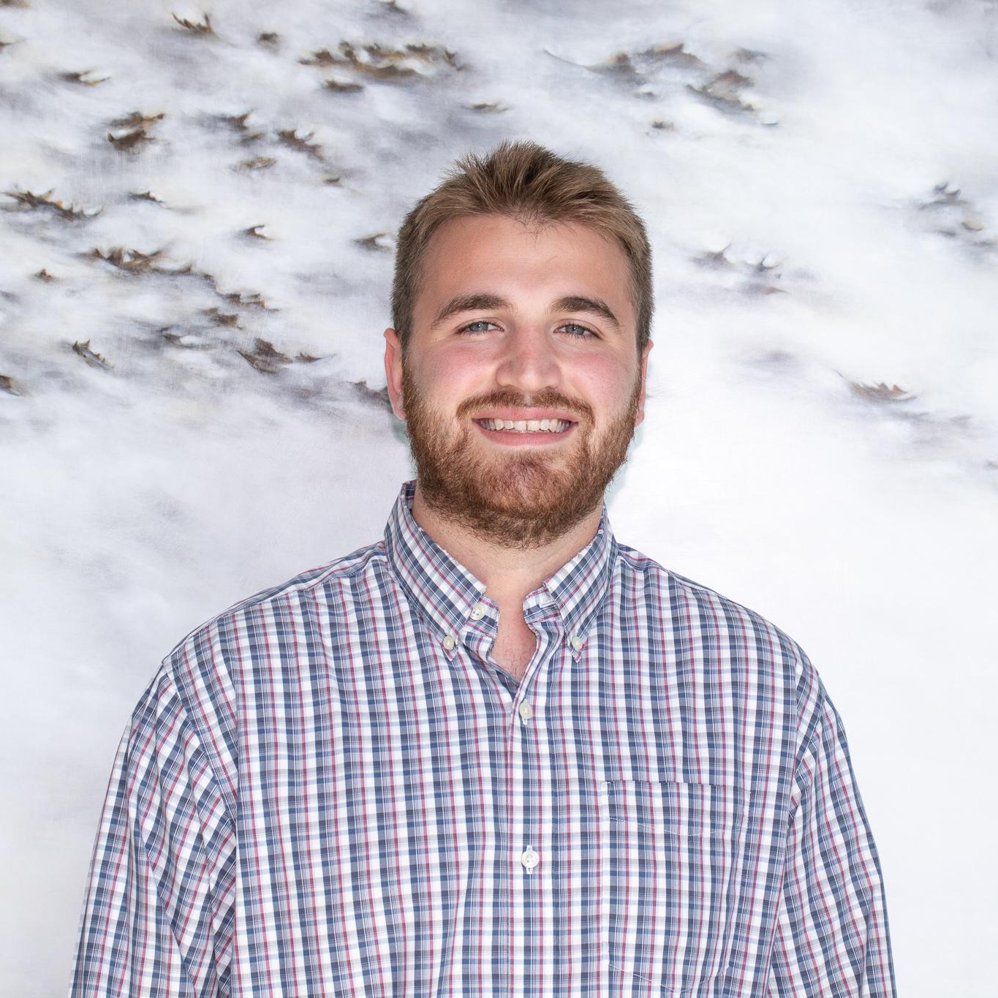
Directors of Chapter Communications
Avery Bumsted
Sophomore (External)
Advertising Major
Jane Kobylinski
Junior (External)
Marketing & MIS Majors
Aden Kaye
Junior (Internal)
Marketing Major
Communications & Activism Minor

Slide 21
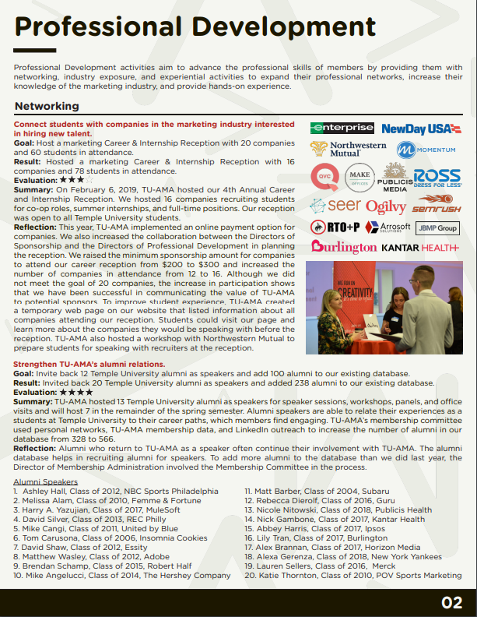
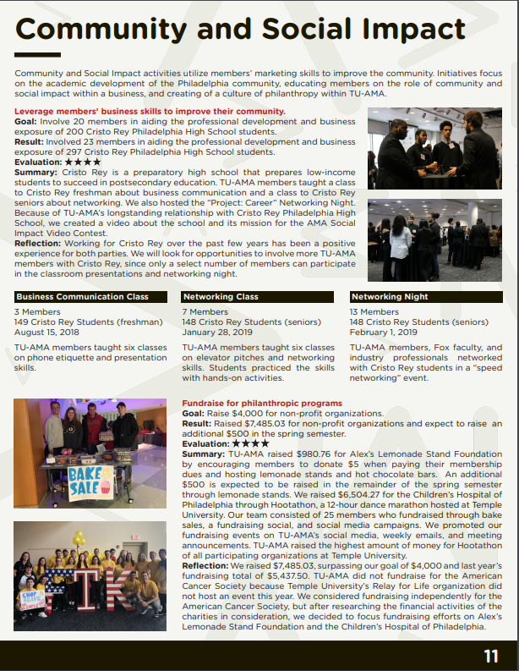
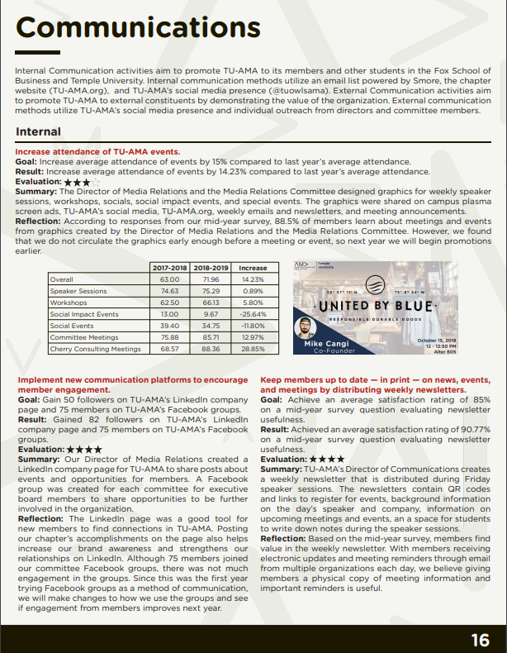
Reporting & Ranking

Slide 22
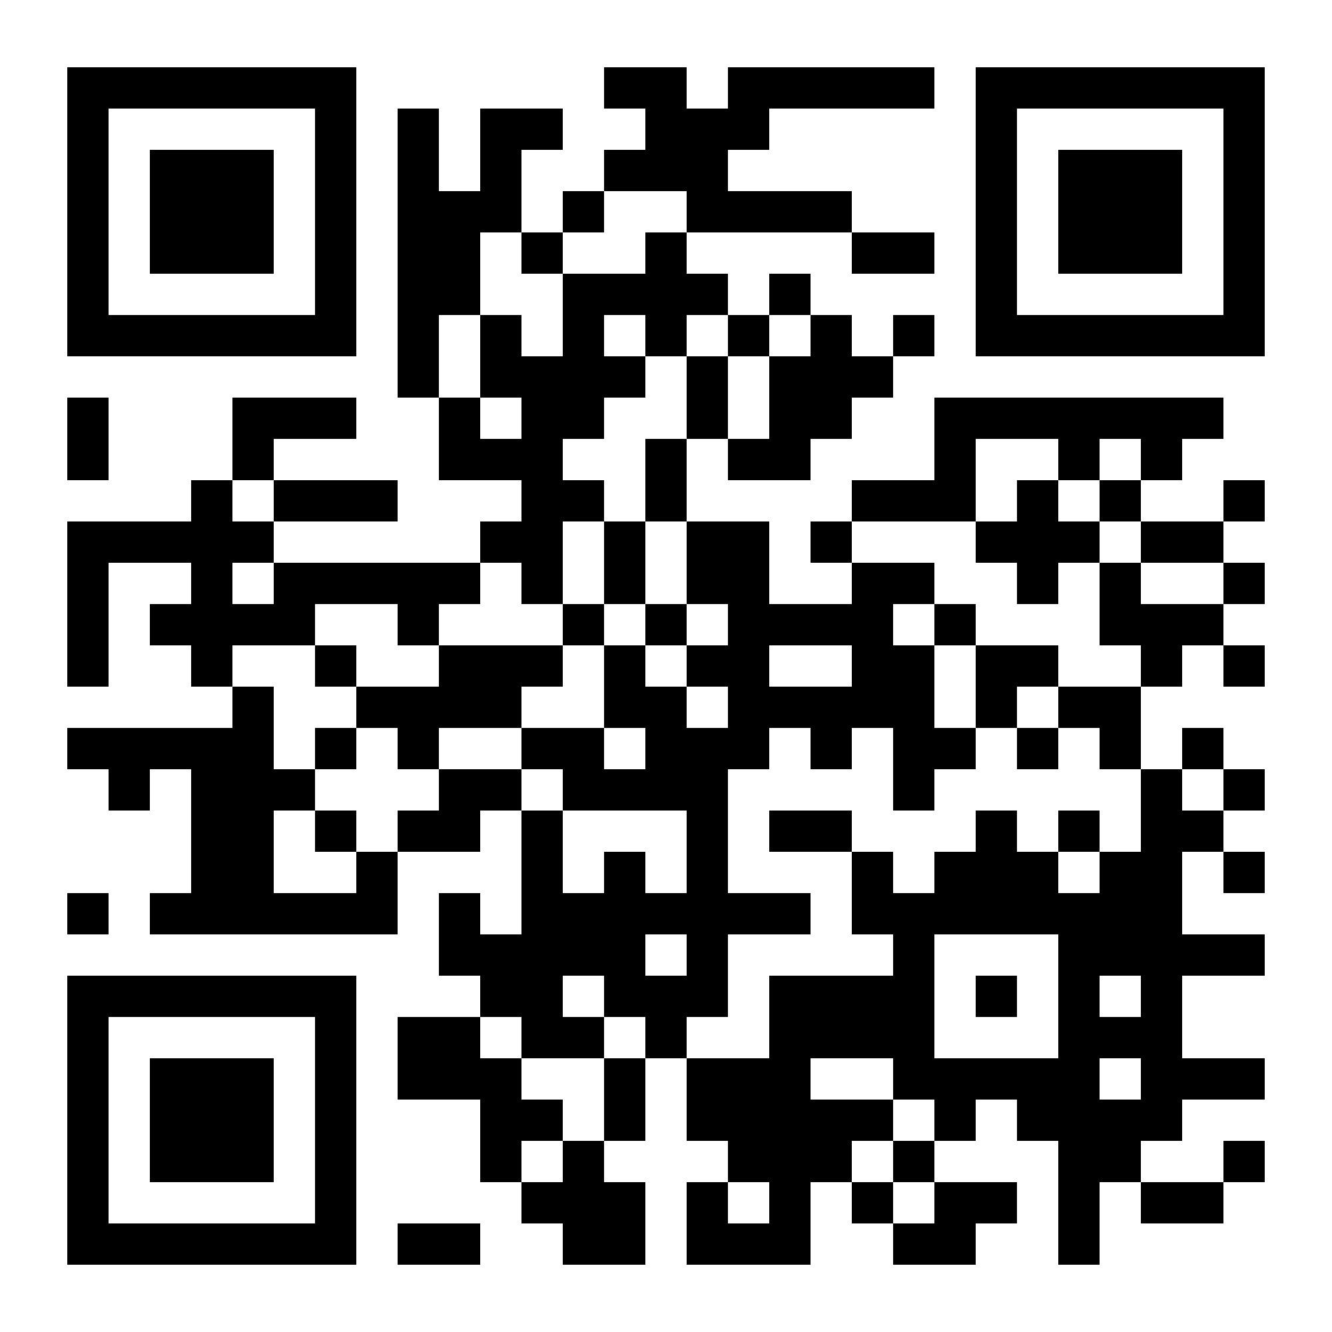
Join our Slack Channel!
:
https://bit.ly/TU-AMA-general-body-slack
Notes:
Juliette

Slide 23
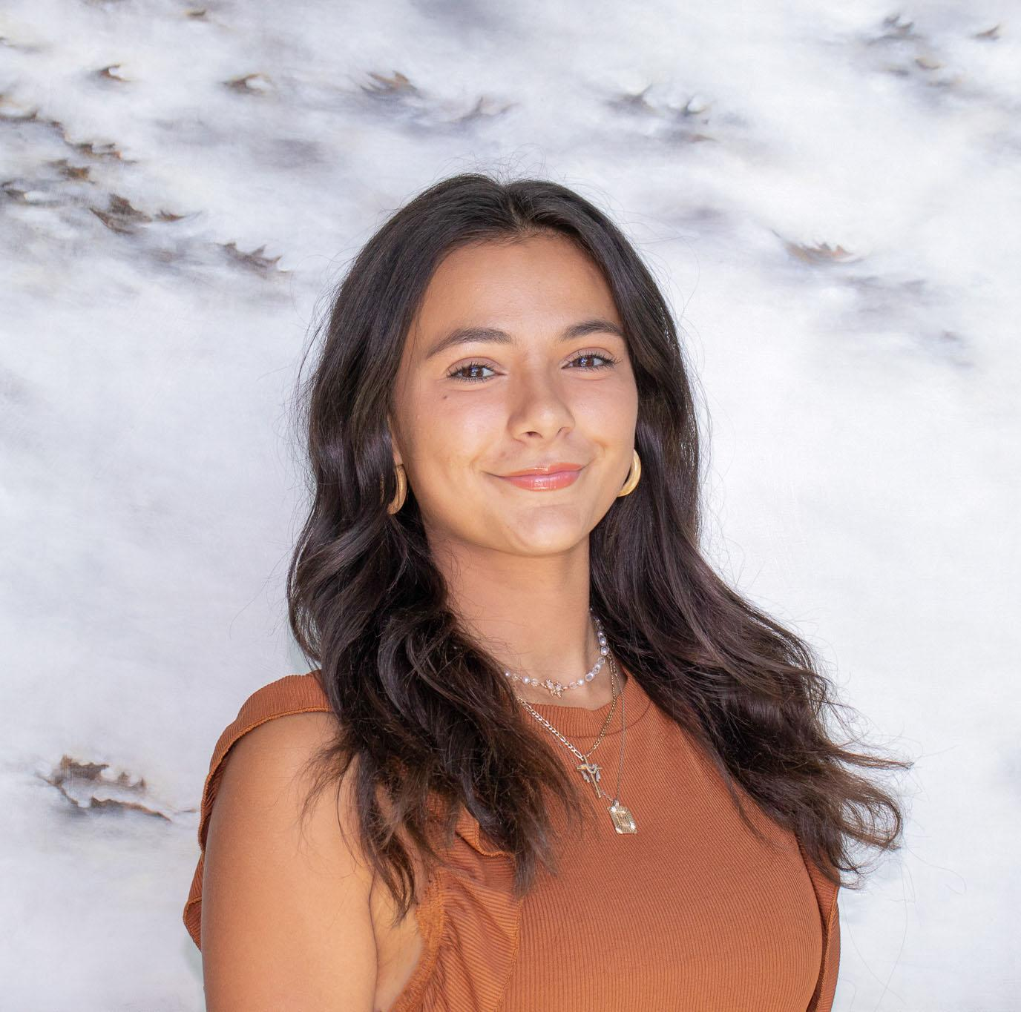
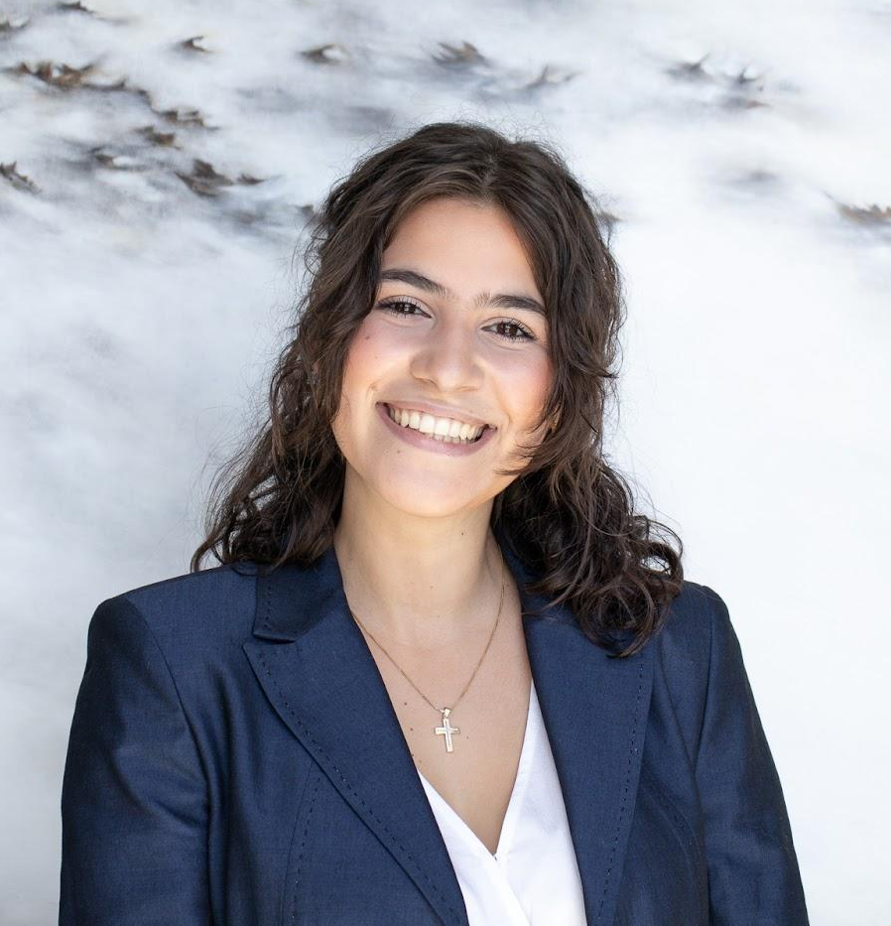
Media Relations
Madeline Collyer
Sophomore
Marketing Major & MIS Minor
Maria Mihalopoulos
Junior
Marketing & Legal Studies Major
Notes:
MR

Slide 24




tuowlsama.org
@tuowlsama
Notes:
Julia/Kevin

Slide 25
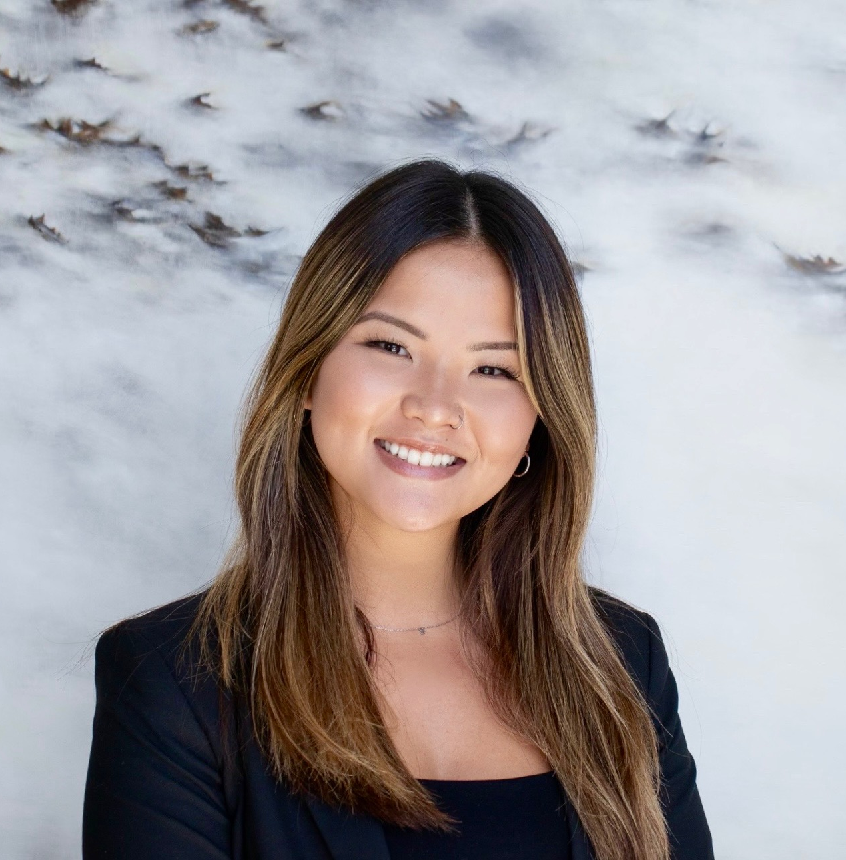
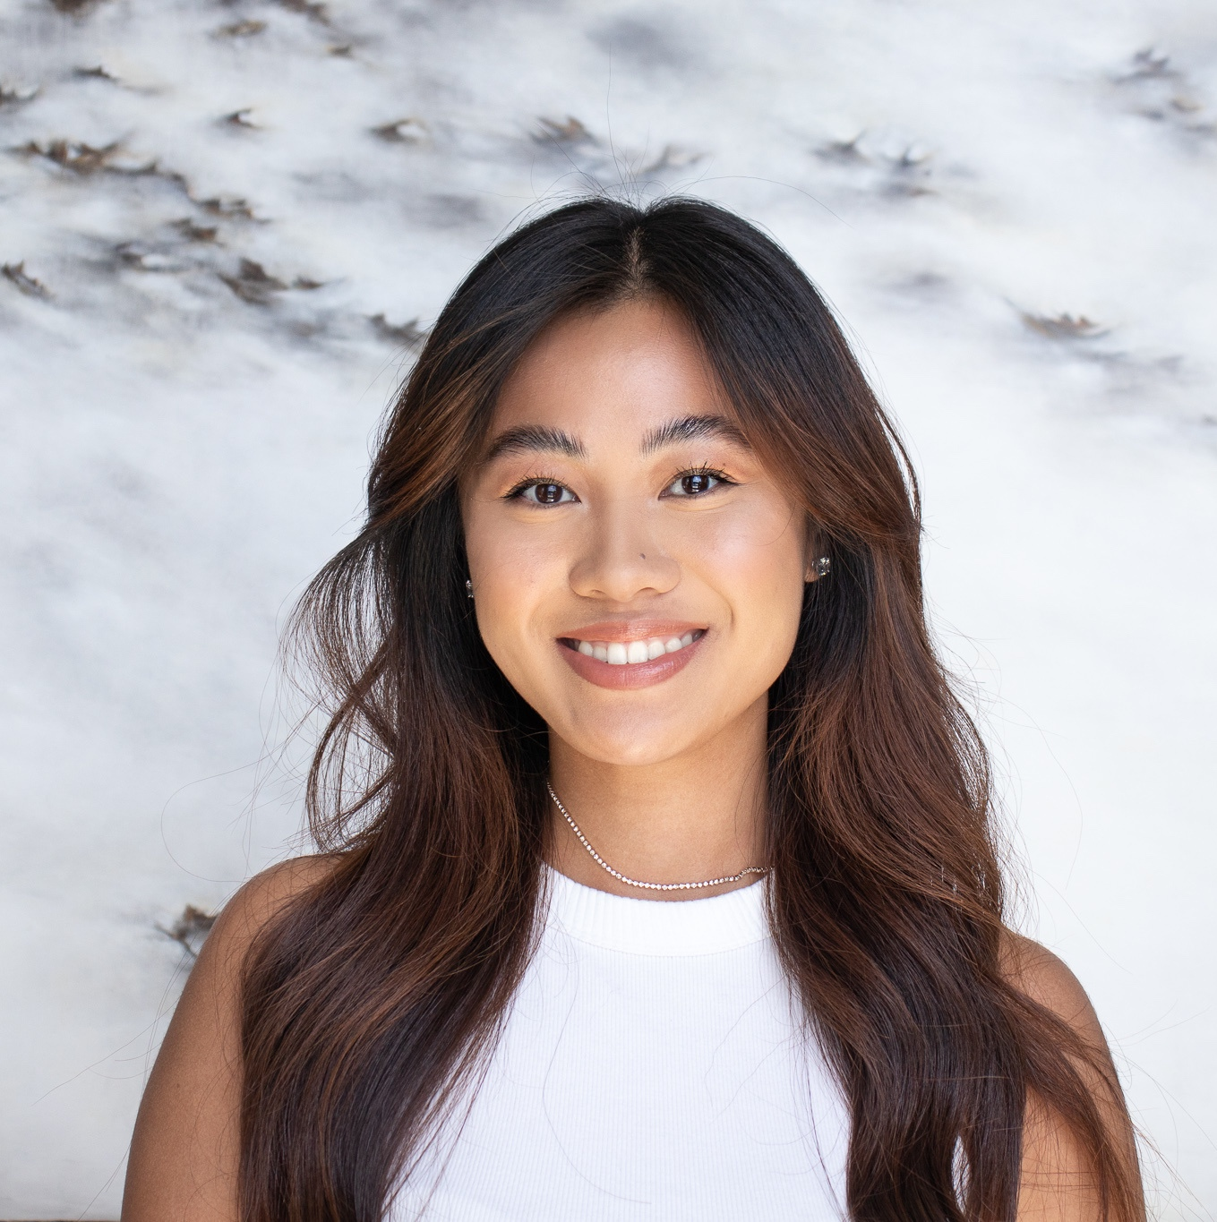
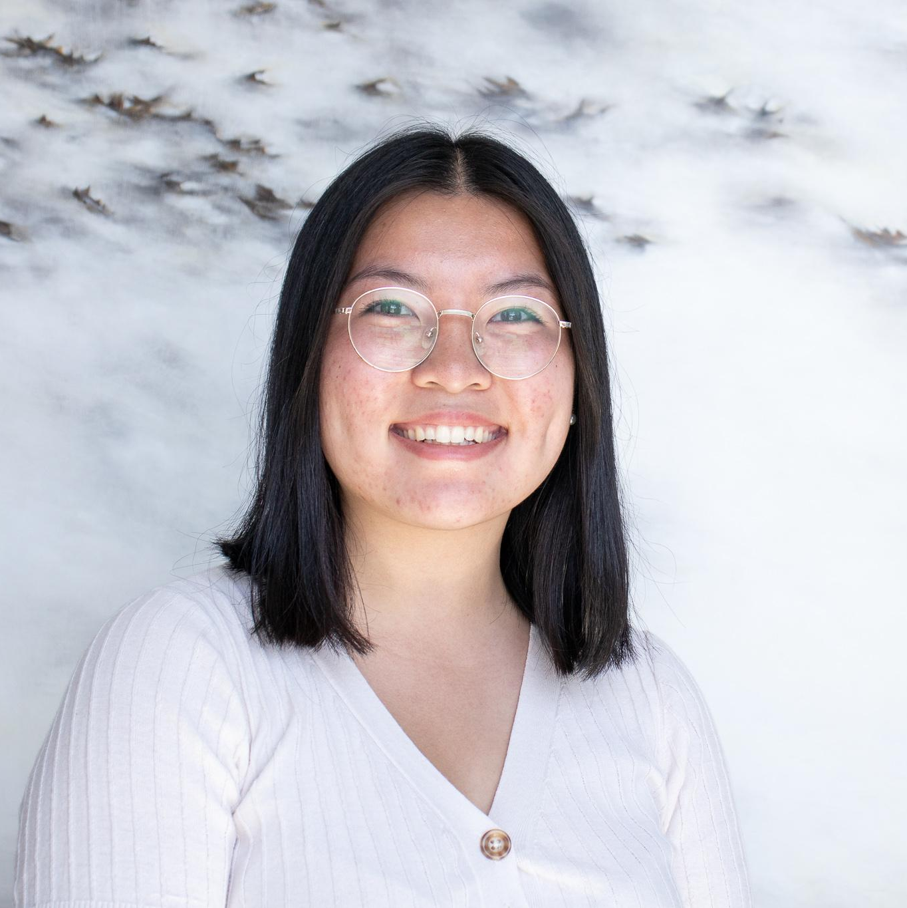
Cherry Consulting
Skylar Sheely
Junior
Marketing Major & MIS Minor
Marianne Kornelius
Senior
Marketing Major
Cathy Nguyen
Senior
Marketing Major
Notes:
Cherry

Slide 26

Cherry Consulting
Benefits:
Gain real-life marketing skills that can apply to future classes, internships, and careers
Opportunities to use marketing tools and services for Brand Development, Social Media Marketing, Content Creation, SEO, CRM, Website Development, etc.
Notes:
CC//skylar

Slide 27
Cherry Consulting
* Interview required
Project Manager * | Associate Project Manager * | Creative Director * | Student Consultant
Splits work 50-50 with APM Handles majority of client communication Ensures that MOU tasks and deliverables are met Organizing and plans future working meetings | Splits work 50-50 with PM Assists with organization and communication Assists in ensuring that projects are effectively planned Assists in running working meetings | Works with fellow Creative Director(s) to hold workshops and fulfill design requests from client projects Utilizes Adobe Creative Cloud, Canva, and other relevant applications | AMA general body members Work on tasks assigned by PM, APM, CD to make progress towards objectives
Notes:
CC- Mar: PM/Apm ( supporting PM, it is an even playing field, very much partners just a few different prioritie, gives different perspective)
Skylar: Creative and student consultant

Slide 28





Cherry Consulting Clients
Notes:
CCSkylar: Skin Devotee
Cathy: mural and only light
Mar: Inlier Learning is a service that is geared in helping institutions and schools that educate immigrant students who are learning English as a second language. Their goal is to improve school structure for immigrants, help students to feel comfortable
Philanthrofi is a non profit marketplace connects companies with orgs that are dedicated to sustainability. They provide a place where Companies can invest and donate directly with charities and organizations.
We are going to go in more depth ab

Slide 29
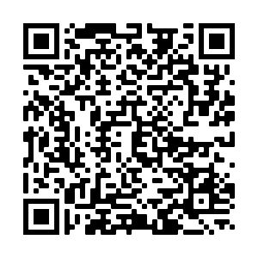
Cherry Consulting Intent To Interview
Intent to Interview:
Apply at bit.ly/CherryInterview2022
The deadline for submissions is Thursday, September 8th at 11:59 PM
Check out Clients on Instagram or LinkedIn
*Reach out to skylar.sheely@temple.edu, marianne.kornelius@temple.edu, or cathy.nguyen@temple.edu with any questions!
Notes:
CC: Mar

Slide 30
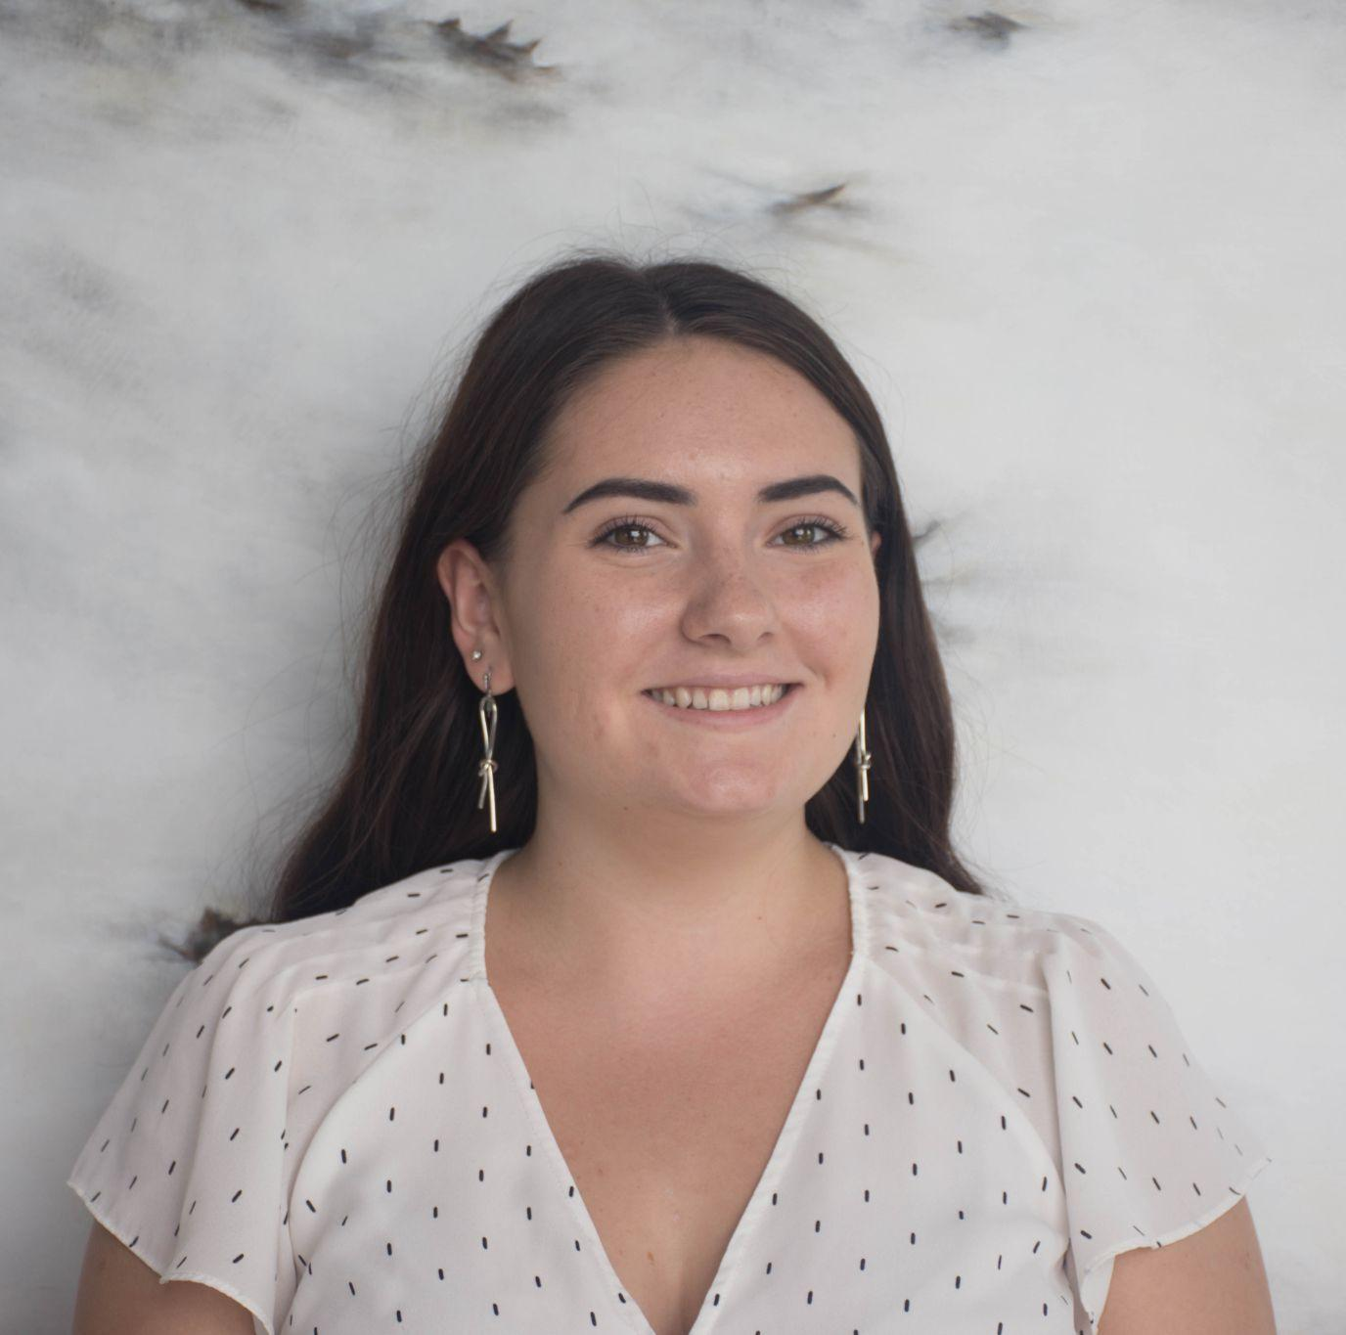
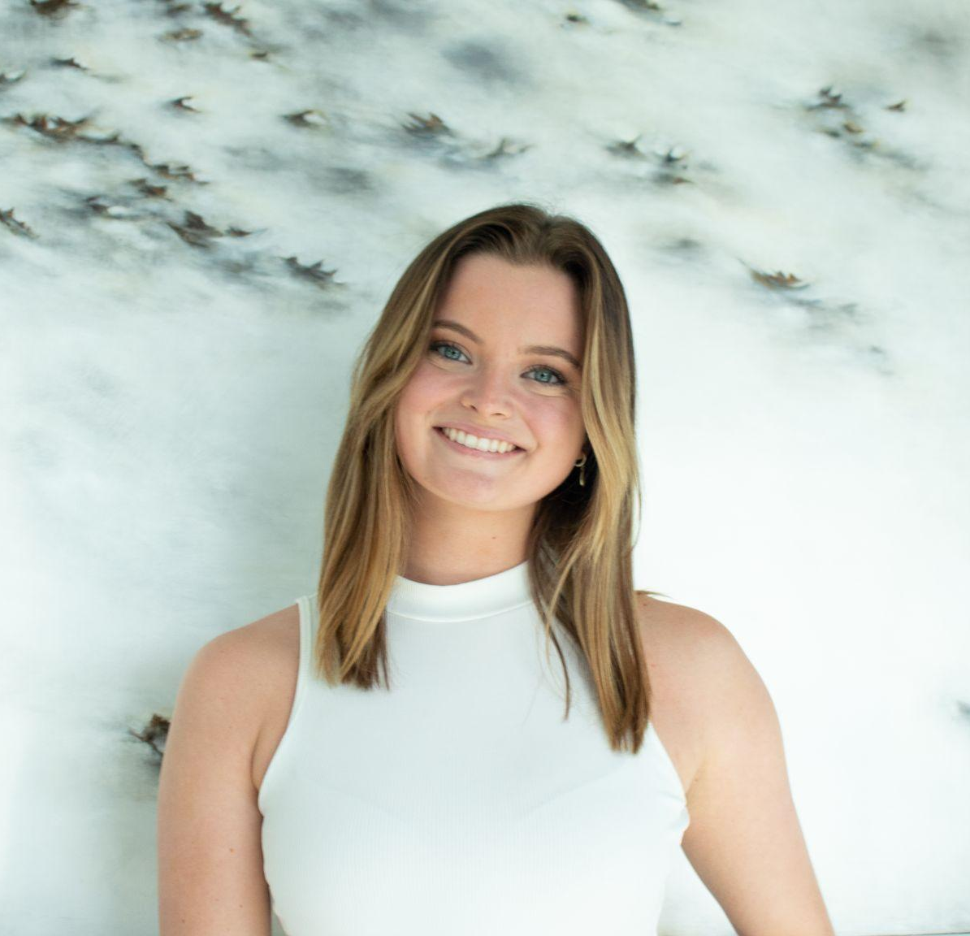
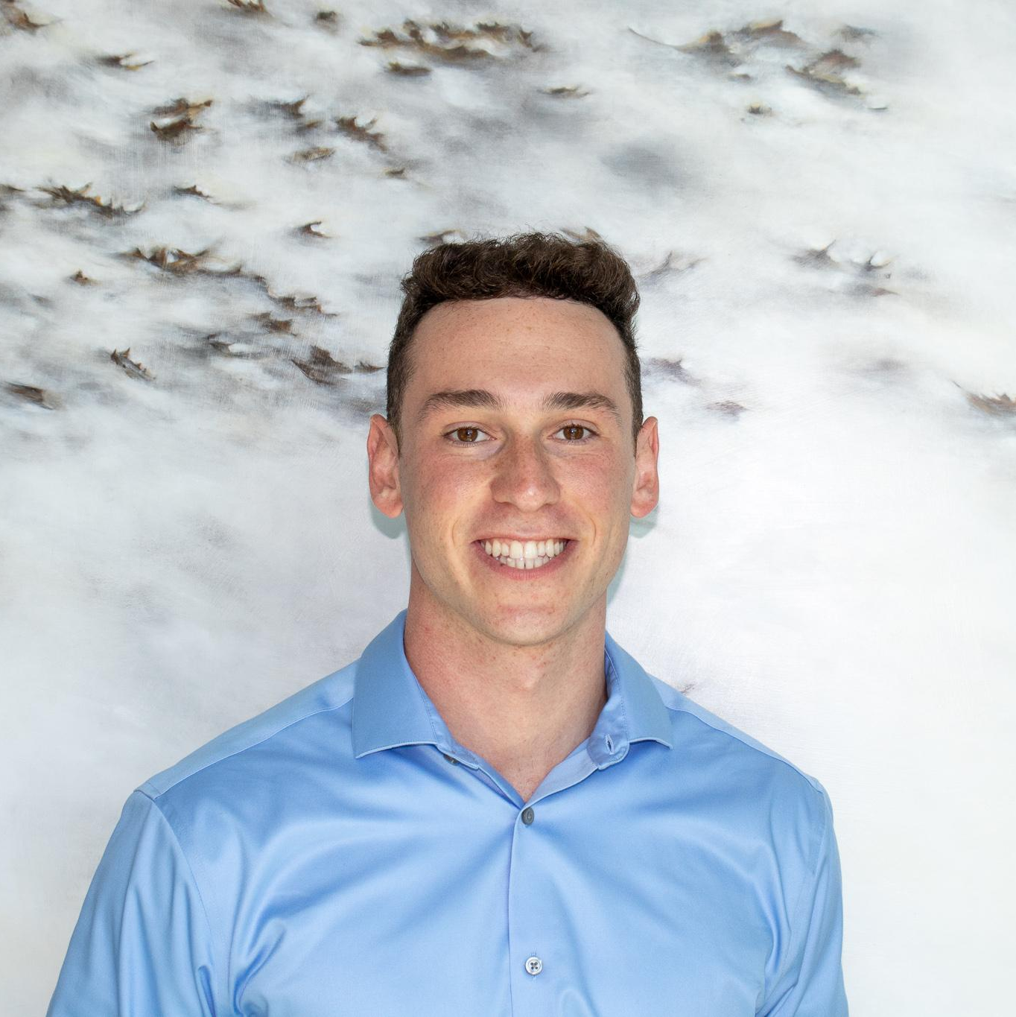

Professional Development
Insert headshot
Maeve Coogan
Senior
Marketing Major & MIS Minor
Devon Robinson
Junior
MIS Major & Biz Analytics Minor
Adam Foster-Baird
Sophomore
Marketing & MIS Minor
Notes:
PD

Slide 31

Notes:
PD

Slide 32

Notes:
PD

Slide 33

Chapter Operations
Anjali Popli
Junior
Marketing Major, MIS Minor
Notes:
Chapter Ops

Slide 34
How to Join TU-AMA
*Must be completed in order*
1
Fill out TU-AMA Application
Visit tuowlsama.org/join and complete the electronic chapter application
2
Become a National Member
Go to ama.org, click the menu on the right, and click “Join AMA”
Purchase your National AMA “Undergrad Student Membership” and pay $29
3
Get Approval
Forward the confirmation email or send a screenshot to elenarossetti@temple.edu
4
Pay Dues
Venmo (@tuowlsama) / Credit/Debit to PayPal (owlsama@gmail.com)
Check to “Temple University American Marketing Association”
Notes:
Elena
If you’re interested in TU-AMA you can go to our website listed here, go to Membership and from the pop down menu select Join AMA. From that screen these same directions are listed but you want to click the box at the top that says apply to TU-AMA, once you fill that out you will have to become a national member of the organization ($29), and then please forward that email to me (email is listed). Once that is confirmed then all you need to do is pay the Chapter dues and you will be a full member. We accept Venmo, PayPal or Check if needed.

Slide 35

Chapter Dues:
Semester – $30
Year – $55
Office: Alter 502c
@tuowlsama
Deadline:
Friday, September 30th
Please consider adding an additional $5 to your dues to donate to our Charity of Choice (Grace Cafe)!
Notes:
Elena
As far as the dues go, they are $30 for the Semester or $55 if you pay for the full year and the deadline for these is Friday September 30th so please try to have them in by then. Another great initiative and way to help with our social impact is to add $5 to your dues that will be donated to our Charity of choice for this year which is Grace Cafe. For those who don’t know what Grace Cafe is they provide meals to people in the area who suffer from food insecurity or homelessness, and they also offer weekly wellness clinic so we’re very exciting to work with them this year and while the donation is not mandatory if you would like to add the additional $5 onto your dues it will be going towards them so a really great cause.

Slide 36

Citizenship Point Program
Notes:
elena
Like I mentioned earlier we do monitor attendance at social events, meetings, and just other participation in general. Citizenship Points are different from your FLDP points for Fox, this is AMA specific and something that is part of my role as membership admin. When u came in today you should’ve scanned a QR code and filled out a Google form, if you didn’t see me after the meeting, this tells me that you were present so I can give you citizenship points. As you can see all members fall into 4 categories and as you get more points there are more opportunities for you. For example Eboard is gold members, and ICC will likely be open to gold members who are more involved and have more citizenship points

Slide 37
Citizenship Point Incentives
Bronze
Eligible for Member of the Month
Silver
Write a Membership Monday Blog for the website and featured on social media
Gold
Sit-in on an Executive Board meeting
Apply to be an Executive Board member
Apply to attend AMAICC
Notes:
elena
Leadership opportunities (e-board), case teams, ...

Slide 38


Mentorship Program
General body members are paired with an executive board director
Opportunity to work on your personal and professional goals
Ability to learn skills such as LinkedIn, Resume Building, Graphic Design, Personal Branding, etc.
Sign ups are on a rolling basis
*Must be a paid member
Notes:
Juliette
We also have a mentorship program which elena and I run together. General body members are paired with an executive board member where the opportunity to work on either personal or professional goals.

Slide 39



Social Events
Notes:
Juliette

Slide 40


Other Opportunities
Monday Workshops
Resume Book & Job Listings
Marketing Week
Regional Marketing Conference
Career & Internship Reception
Office Tours
Social Events
Volunteer Events
Notes:
Juliete
Outside of meeting times, we host events where you can meet other people inside and outside of the org. through networking events, volunteer events, office tours, and more. Overall, TU-AMA is a great way to grow your network and build connections with your peers and business professionals, learn more about the marketing industry, and gain real-world experience.

Slide 41



What’s Coming Up?
Kick-Off Meeting
Friday, 9/1 from 12 – 12:50 pm (Alter LL35)
Cherry Consulting Kick-Off Meeting
Wednesday, 9/7 from 12 – 12:50 pm (Alter LL35)
Kick-Off Speaker Session Meeting
Friday, 9/9 from 12 – 12:50 pm (Alter LL35)
Notes:
Juliette

Slide 42

Notes:
Juliette

Slide 43
Questions?
Notes:
mike / lauren

Slide 44
Thank you so much for coming!
Notes:
Julia/Kevin

