Slide 1
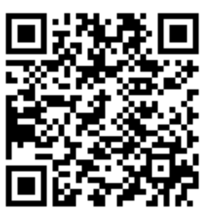
Scan with your Suitable App!

Slide 3
What’s Coming Up?
Cherry Consulting
Wednesday, 9/14 from 12 – 12:50 pm (Alter LL35)
Speaker Session: Philadelphia Business Journal
Friday, 9/16 from 12 – 12:50 pm (Alter LL35)

Slide 4
Notes:
PD

Slide 5
How to Join TU-AMA
*Must be completed in order*
1
Fill out TU-AMA Application
Visit tuowlsama.org/join and complete the electronic chapter application
2
Become a National Member
Go to ama.org, click the menu on the right, and click “Join AMA”
Purchase your National AMA “Undergrad Student Membership” and pay $29
3
Get Approval
Forward the confirmation email or send a screenshot to elenarossetti@temple.edu
4
Pay Dues
Venmo (@tuowlsama) / Credit/Debit to PayPal (owlsama@gmail.com)
Check to “Temple University American Marketing Association”
Notes:
Elena
If you’re interested in TU-AMA you can go to our website listed here, go to Membership and from the pop down menu select Join AMA. From that screen these same directions are listed but you want to click the box at the top that says apply to TU-AMA, once you fill that out you will have to become a national member of the organization ($29), and then please forward that email to me (email is listed). Once that is confirmed then all you need to do is pay the Chapter dues and you will be a full member. We accept Venmo, PayPal or Check if needed.

Slide 6
Chapter Dues:
Semester – $30
Year – $55
Office: Alter 502c
@tuowlsama
Deadline:
Friday, September 30th
Please consider adding an additional $5 to your dues to donate to our Charity of Choice (Grace Cafe)!
Notes:
Elena
As far as the dues go, they are $30 for the Semester or $55 if you pay for the full year and the deadline for these is Friday September 30th so please try to have them in by then. Another great initiative and way to help with our social impact is to add $5 to your dues that will be donated to our Charity of choice for this year which is Grace Cafe. For those who don’t know what Grace Cafe is they provide meals to people in the area who suffer from food insecurity or homelessness, and they also offer weekly wellness clinic so we’re very exciting to work with them this year and while the donation is not mandatory if you would like to add the additional $5 onto your dues it will be going towards them so a really great cause.

Slide 7
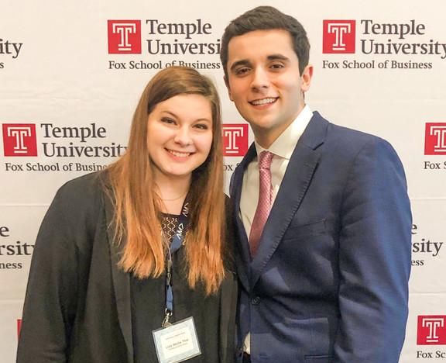
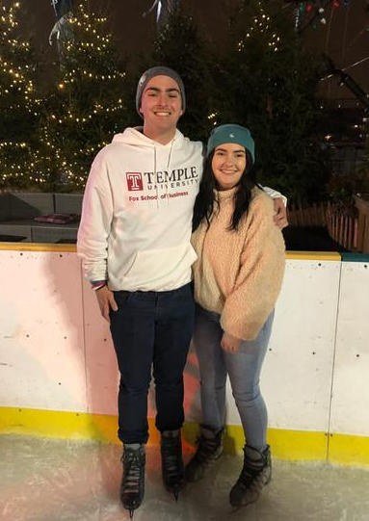
Mentorship Program
General body members are paired with an executive board director
Opportunity to work on your personal and professional goals
Ability to learn skills such as LinkedIn, Resume Building, Graphic Design, Personal Branding, etc.
Sign ups are on a rolling basis
*Must be a paid member
Notes:
Juliette
We also have a mentorship program which elena and I run together. General body members are paired with an executive board member where the opportunity to work on either personal or professional goals.

Slide 8
Last day to sign up!
Notes:
Juliette

Slide 9
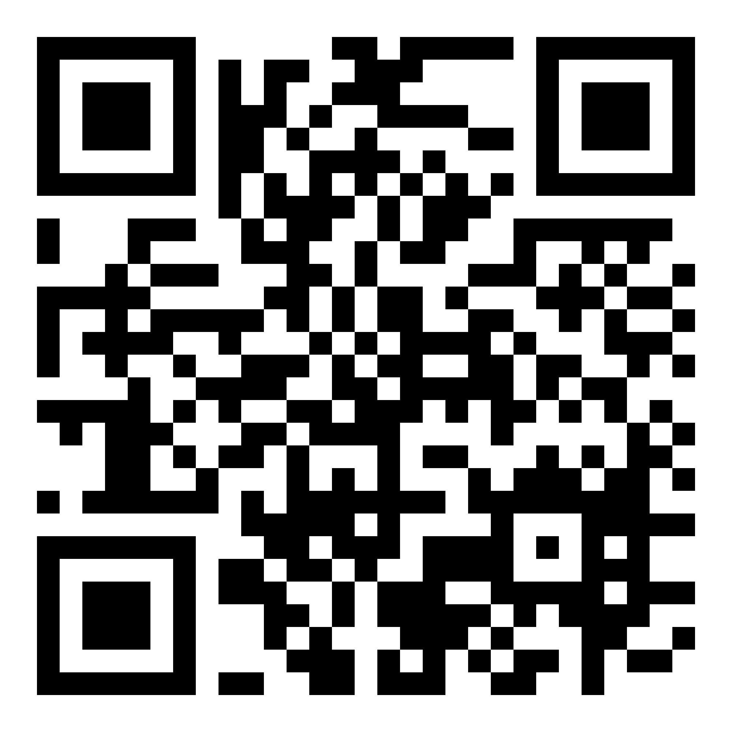
Join our Slack Channel!
:
https://bit.ly/TU-AMA-general-body-slack
Notes:
Aden

Slide 11
Fox Global Immersions
Amy Kumpf
Associate Director, International Programs
Fox School of Business, Temple University
amy.kumpf@temple.edu

Slide 12
Short one-week study trips
Embedded into the 3-credit IB 2509 in Spring or Fall
Expose students to the environment of business by taking them to target destinations for a practical experience.
Engages in a number of learning opportunities, including meeting with business executives in the destination country.
An effective way to develop a solid understaning of global business by seeing it first-hand overseas
Actively gain valuable job skills like cultural understanding and adaptability - skills that employers greatly value.
Fox Global Immersions

Slide 13
Cape Town, South Africa
January 2- 12, 2023
Professor Sheri Lambert
Fox Global Immersions 2023
Porto & Lisbon, Portugal
March 4 - 12, 2023
Professor Katie Gerst
Stockholm, Sweden
May 13 - 20, 2023
Professor Jim Thompson

Slide 14
Accommodations (Double Occupancy)
International roundtrip flight
Corporate Visits
Cultural activities
Some meals
In-country transportation
International health insurance
Students will be financially responsibility for the cost of tuition for the class (3- credits) plus the international program fee.
Program Fee Includes

Slide 15
Next Steps and Application
Visit fox.temple.edu/undergrad-immersions
Be mindful of application deadlines
A $750 non-refundable deposit is required to secure your spot
Fox International Programs will enroll you in the IB 2509 course after the application deadline
Contact foxglobal@temple.edu with any questions

Slide 16
Thank you!
Amy Kumpf
Associate Director, International Programs
amy.kumpf@temple.edu

